Slide 1
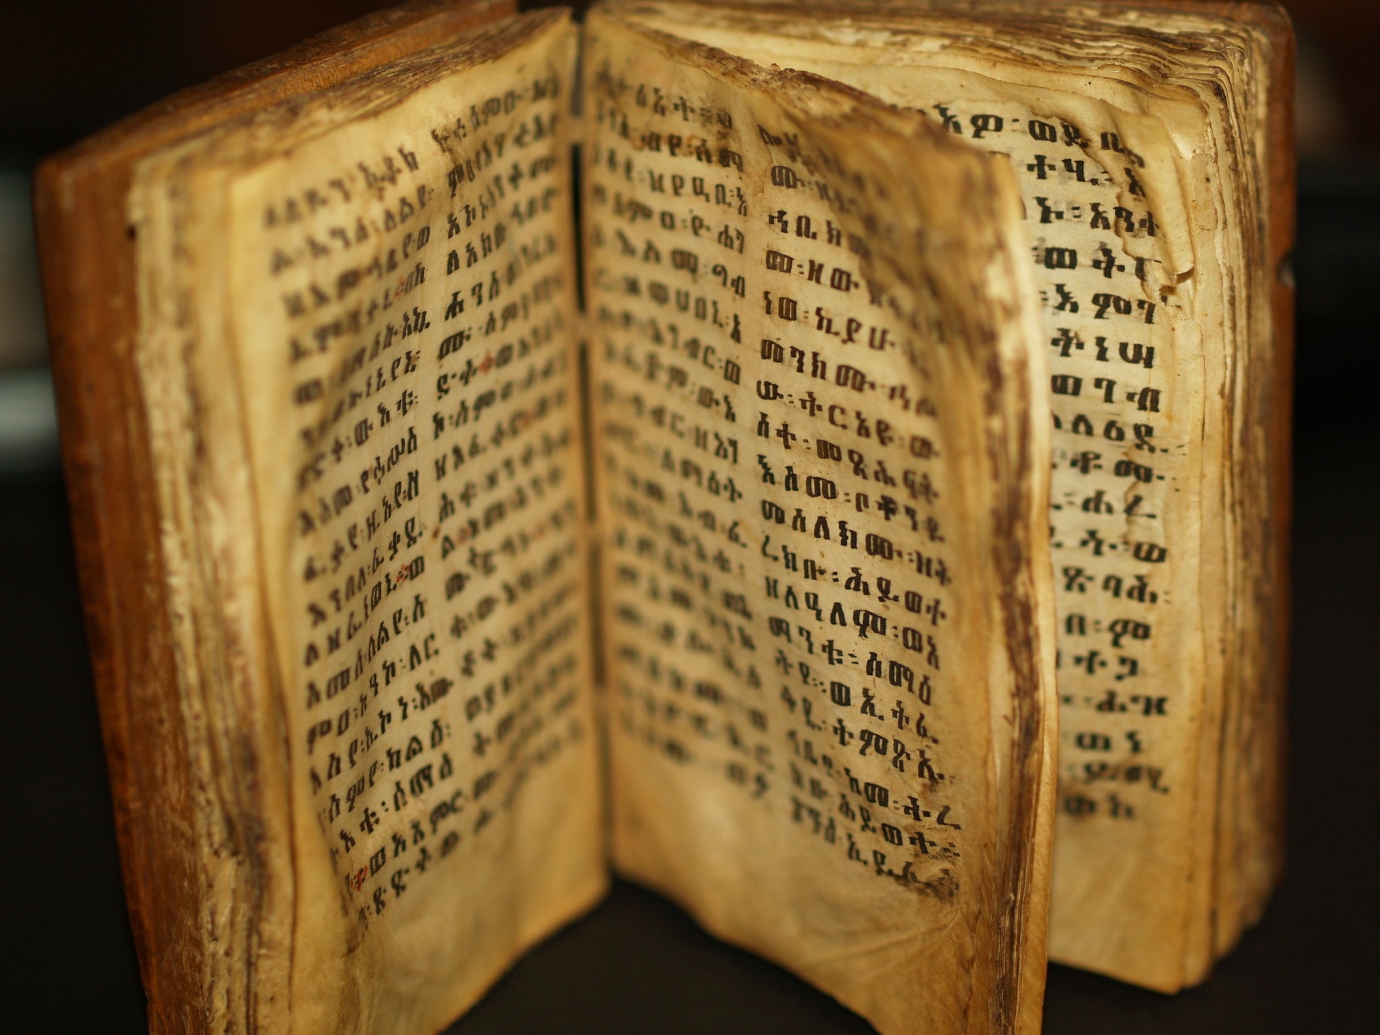
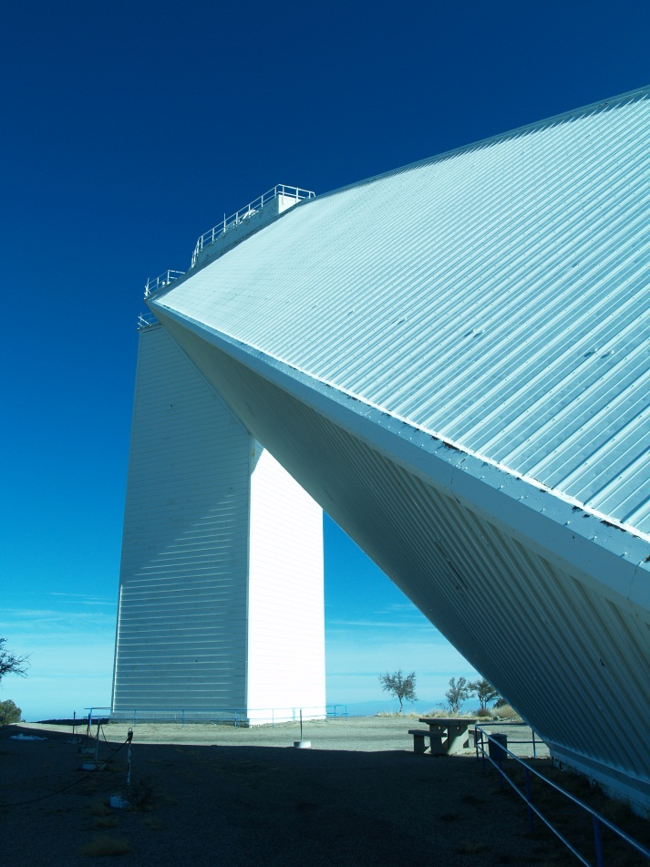
Bible
&/Vs.
Science

Slide 2
History of Bible & Science
Outline
Introduction: 4 views
Jewish Background
Early Church
Roger Bacon
Reformers: Luther & Calvin
Galileo
Isaac Newton
Deism
Geology: Hutton & Lyell
Darwin
The Gap Theory
Scopes Trial
Genesis Flood
Intelligent Design
Dover Trial
Creation Museum
4 views of Creation

Slide 3

4 ways to understand
Bible & science
Ian Barbour in his book When Science Meets Religion gives 4 different views one can have with the relationship between science and religion. Science & Religion are they enemies, strangers or partners? John Haught offers 4 C’s of types.
Conflict - usually the extremes on both sides take this view; Both the fundamentalist (Biblical literalists) and scientific materialists, atheists like Dawkins see conflict, war.
Contrast or Independence - They are separate domains, no conflict. Stephen Gould took this view in his book Rock of Ages, 2001 (NOMA).
Contact or Dialogue - Both are partners respecting their different fields with communication between them.
Confirmation or Integration - a systematic partnership with integration, natural theology like the anthropic principle. God “fine tuned” the universe. God uses evolution is create life.

Slide 4
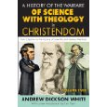
Conflict
Two key books in the late 19th century promoted the “conflict” view of science and the Bible.
History of the Conflict between Religion and Science by J.W. Draper.
A History of the Warfare of Science with Theology in Christendom by A.D. White.
Recent historians point out that the evidence presented in these books are highly selective and a more complex relationship existed while alternative views were more widely held. The media pushes this conflict.

Slide 5
Scientific Materialism
conflict
Materialism believes that only matter is reality. Scientific Materialism adds that the scientific method is the only right path to truth. Materialism also expresses reductionism which believes that all laws and theories are reducible to laws of physics and chemistry. All actions can be explained by material parts. There are no miracles. Reproducible data is needed. Nature replaces God. Examples of this view are Richard Dawkins, Edward O. Wilson, and Carl Sagan. They fail to distinguish between scientific and philosophical questions. Some call this scientism in which science is the only way of understanding the universe.
Arthur Eddington tells of a fisherman only fishing with a 3 inch net and concludes there are no big fish in the ocean. Our method of fishing determines what we catch. If science is selective, its view of reality is incomplete.

Slide 6
Biblical literalism
Conflict
Many take the Bible literally, but when pressed about certain verses they are forced to take it as symbolic. For example, the Book of Revelation has much symbolism. Bible mentions the “four corners of the earth,” the “pillars of the earth” and the earth is immoveable. Are these literal? There are still those who take it literally. There is the flat earth society. There is the Tycho Brahe society who believe the sun revolves around the earth, all based on a literal reading of scripture, and of course, science. For them science is at war with God, and evolution seems to be the root of all social evil.

Slide 7
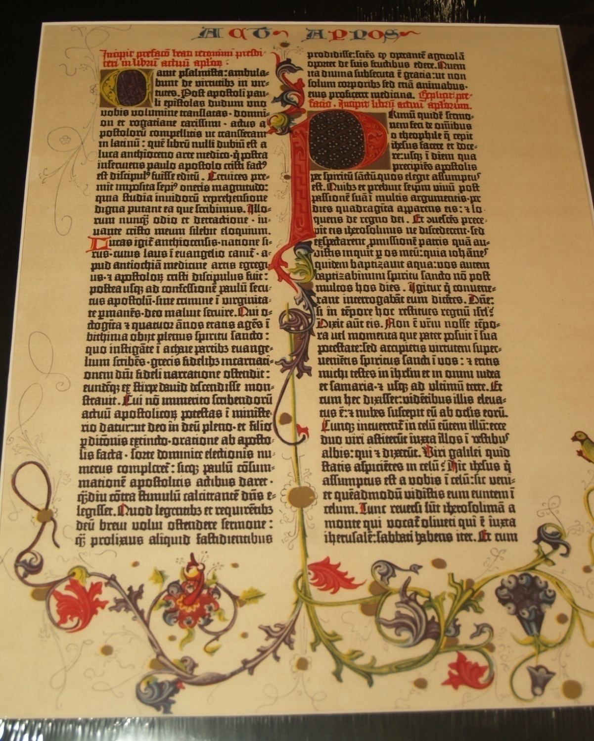
Bible
Inerrant
Infallible
In Faith &
Practice,
Or a science book?
Gutenberg Bible

Slide 8
According to ii timothy 3:16,
All scripture is profitable for
Instruction in righteousness.
It does not say for instruction
In geology or chemistry.
The bible is not meant to be a
Science book, but a spiritual book.
Bible is not a science book!

Slide 9
Jewish Background
Philo (20 BC to 50 AD)
2 ways of interpreting the Scriptures
Literally: The literal meaning was for human need, and not that important.
Allegorically: This was the more important spiritual meaning.
Greek allegory had preceded Philo in this field. As the Stoic allegorists sought in Homer the basis for their philosophic teachings, so the Jewish allegorists, and especially Philo, went to the Old Testament. Following the methods of Stoic allegory, they interpreted the Bible philosophically. Wikipedia

Slide 10
Early Church
Eusebius of Caesarea
Eusebius of Caesarea wrote a book called Preparation of the Gospel around 314 AD (Eusebius 1981, v; Mras 1954). He discusses different Greek philosophies showing how some are similar to the Bible, and how some are contrary. The following is a compilation of Greek views of the shape of the earth:
Thales and the Stoics: the earth is spherical.
Anaximander: it is like a stone pillar supporting the surfaces.
Anaximenes: like a table.
Leucippus: like a kettle-drum.
Democritus: like a disk in its extension, but hollow in the middle.
But Moses and the oracles of the Hebrews trouble themselves about none of these things; and with good reason, because it was thought that those who busied themselves about these matters gained no benefit in regard to the right conduct of life (Eusebius 1981, 913, 869).

Slide 11
Cosmas Indicopleustes
An Egyptian monk named Cosmas Indicopleustes wrote a book called Christian Topography around 547 AD (McCrindle 1897, iv-x). Cosmas was probably a native of Alexandria. Because he was a merchant, he traveled to seas and countries that were far from home. There were many ecclesiastical controversies in his day. Cosmas probably belonged to the Nestorian sect.
The basic purpose of his book was to refute from scripture and common sense, the impious pagan beliefs that the earth was a sphere, and the center around which the heavens which were also a sphere, revolved. He also wrote against antipodes which means that people would be standing on their heads on the other side of the spherical earth.
Cosmas shaped the world through his literal interpretation of Hebrews 9:23-24 which says:
It was therefore necessary that the patterns of things in the heavens should be purified with these, but the heavenly things themselves with better sacrifices that these. For Christ is not entered into the holy places made with hands, which are the figures of the true; but into heaven itself, now to appear in the presence of God for us.
The tabernacle was a pattern of the universe. The tabernacle is divided into two parts by means of a veil. This symbolizes the division of the universe into two worlds, an upper and lower, by means of the firmament. The table of shew-bread with its waved border represented the earth surrounded by the ocean. Since the table was twice as long as it was wide, and was place lengthwise from East to West, the earth also is a rectangular shape extending in length from East to West twice as long as it is wide. The surrounding ocean is unnavigable, and is surrounded by another earth which is the seat of paradise, and the abode of man until the flood when Noah was carried over to this earth.

Slide 12
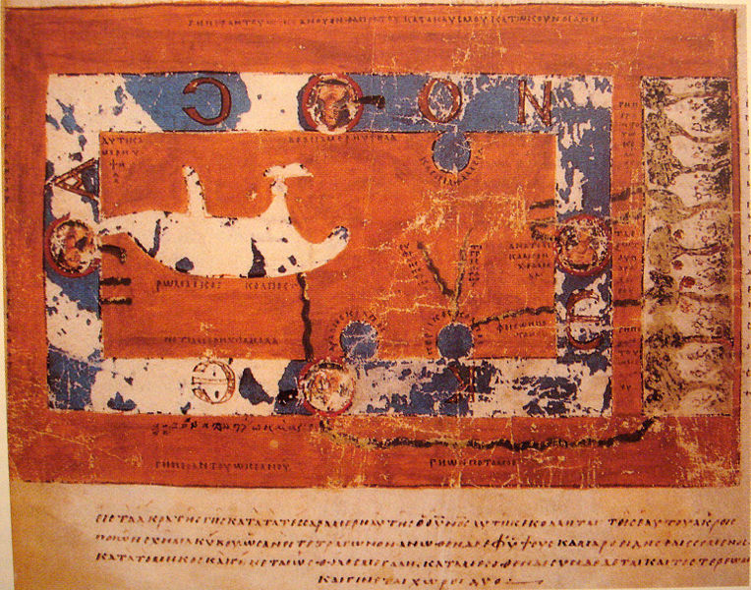
Cosmas Indicopleustes’ World Map

Slide 13
St Augustine
In "The Literal Interpretation of Genesis," Augustine took the view that everything in the universe was created simultaneously by God, and not in seven calendar days like a plain account of Genesis would require. He argued that the six-day structure of creation presented in the book of Genesis represents a logical framework, rather than the passage of time in a physical way - it would bear a spiritual, rather than physical, meaning, which is no less literal. One reason for this interpretation is the passage in Sirach 18:1, creavit omni simul ("he created all things at once"), which Augustine took as proof that the days of Genesis 1 had to be taken non-literally.^{wikipedia}
Science is seen as the handmaiden of the Bible.

Slide 14
St. Augustine
The book of Genesis occupied much of Augustine's thoughts through the years. He constantly defended the view that God created all things good. He wanted the literal meaning of Genesis to be understood so he wrote twelve books called De Genesi as Litteram. In book two chapter nine, Augustine discusses the shape of heaven as follows:
It is also frequently asked what our belief must be about the form and shape of heaven according to Sacred scripture. Many scholars engaged in lengthy discussions on these matters, but the sacred writers with their deeper wisdom have omitted them. Such subjects are of no profit for those who seek beatitude, and, what is worse, they take up very precious time that ought to be given to what is spiritually beneficial. What concern is it of mine whether heaven is like a sphere and the earth is enclosed by it and suspended in the middle of the universe, or whether heaven like a disk above the earth covers it over on one side?
But the credibility of Scripture is at stake, and as I have indicated more than once, there is danger that a man uninstructed in divine revelation, discovering something in Scripture or hearing from it something that seems to be at variance with the knowledge he has acquired, may resolutely withhold his assent in other matters where Scripture presents useful admonitions, narratives, or declarations. Hence, I must say briefly that in the matter of the shape of heaven the sacred writers knew the truth, but that the Spirit of God, who spoke through them, did not wish to teach men these facts that would be of no avail for their salvation.

Slide 15
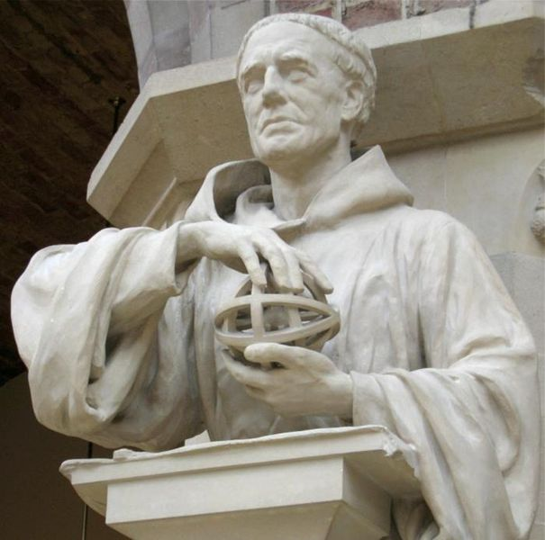
Roger Bacon
Roger Bacon, also known as Doctor Mirabilis meaning "wonderful teacher", was an English philosopher and Franciscan friar who emphasized the study of nature through empirical methods. He was probably born about 1213 AD. He wrote his Opus Magnus for Pope Clement IV. Roger who pushed the experimental method discovered that light can be split into the colors of the rainbow. The rainbow being explained by natural light upset the church that saw the rainbow as miraculous. That Roger was put under house arrest by Jerome of Ascoli (Pope) was questioned by scholars today.
Photograph taken by Michael Reeve

Slide 16

The Rainbow
Roger Bacon: The rainbow is a natural phenomena.
The Church: The rainbow is a miracle from God.
Niagara Falls

Slide 17
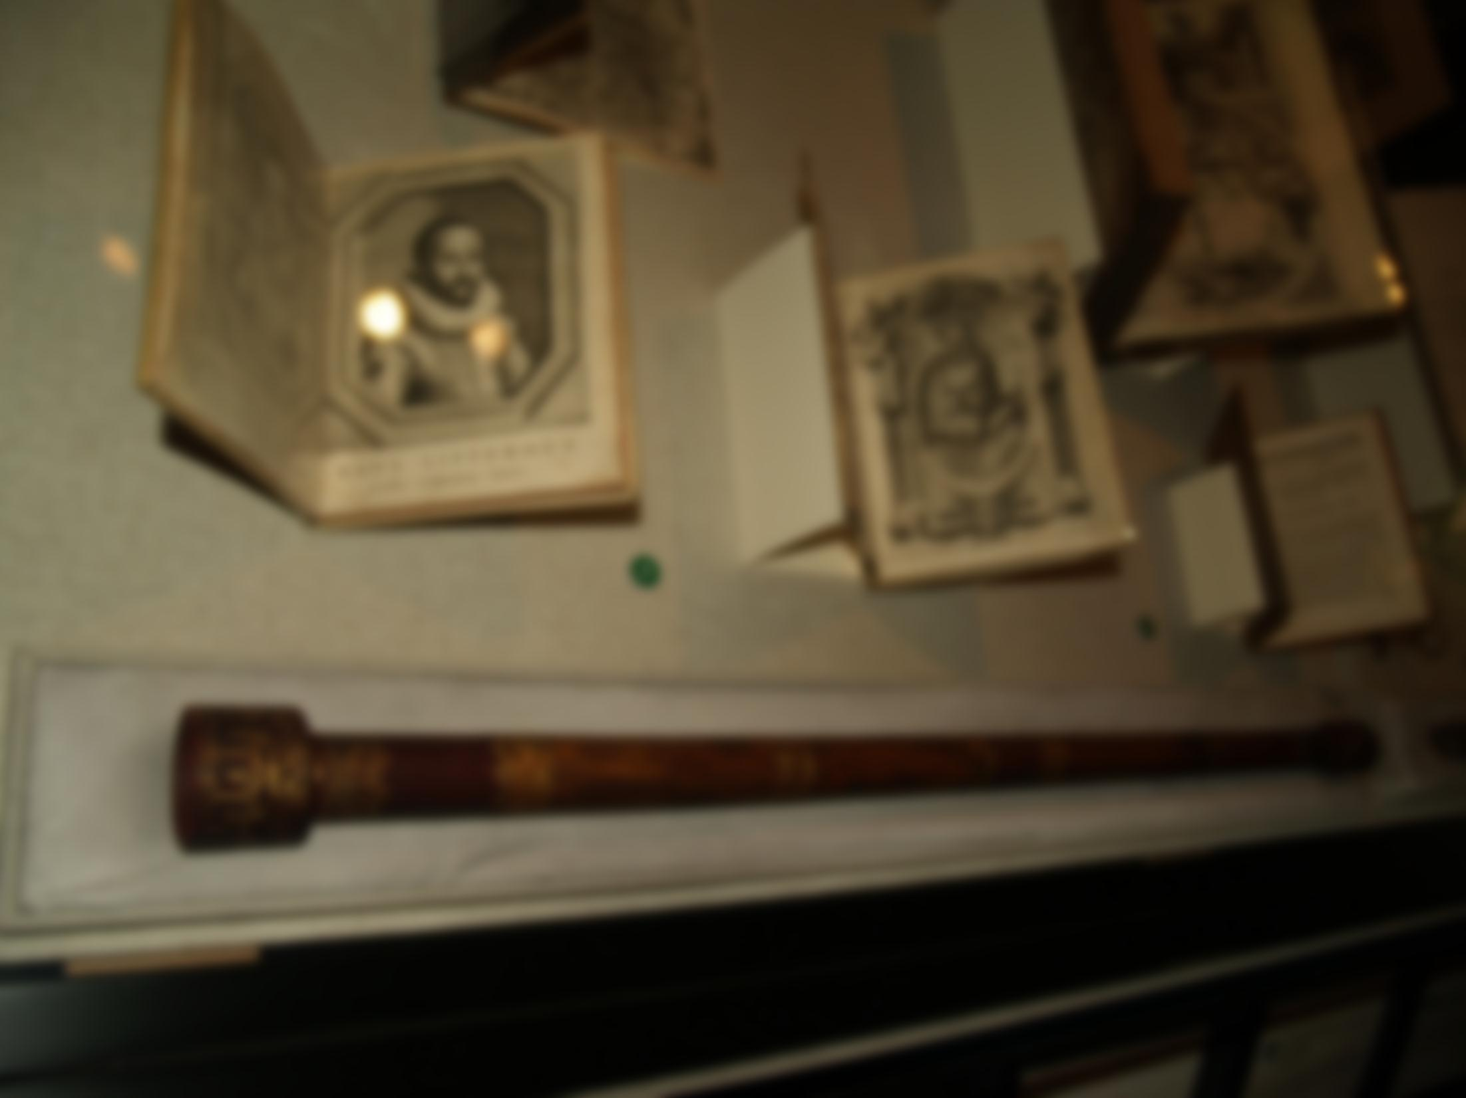
Galileo
In 1610 Galileo turned his telescope toward the heavens and discovered some amazing things that upset the church because they showed heliocentricity, the earth and planets revolve around the sun.
telescope

Slide 18
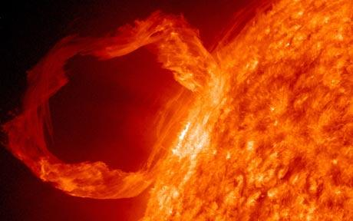
Sun Spots
When Galileo turned his telescope on the sun, he discovered sun spots. This upset the church because God’s creation was perfect. There could not be spots on God’s perfect creation.

Slide 19
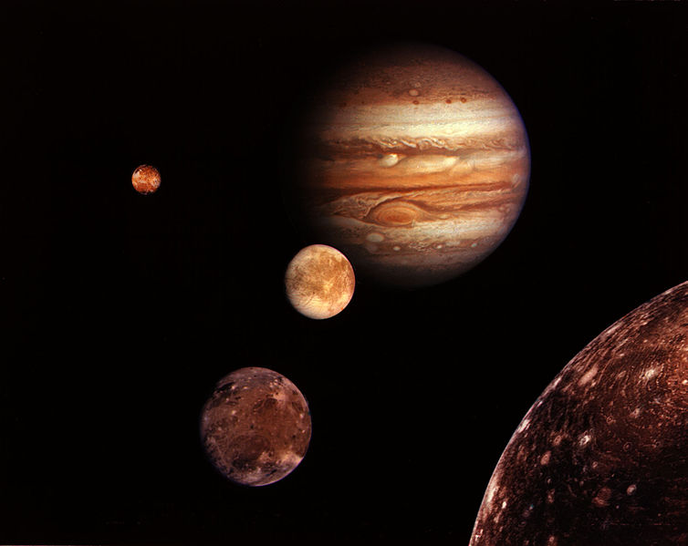
Jupiter’s Moons
When Galileo turned his telescope on Jupiter, he saw 4 moons circling around Jupiter. This upset the church because the sun, moon, planets, and stars all revolve around the earth.

Slide 20
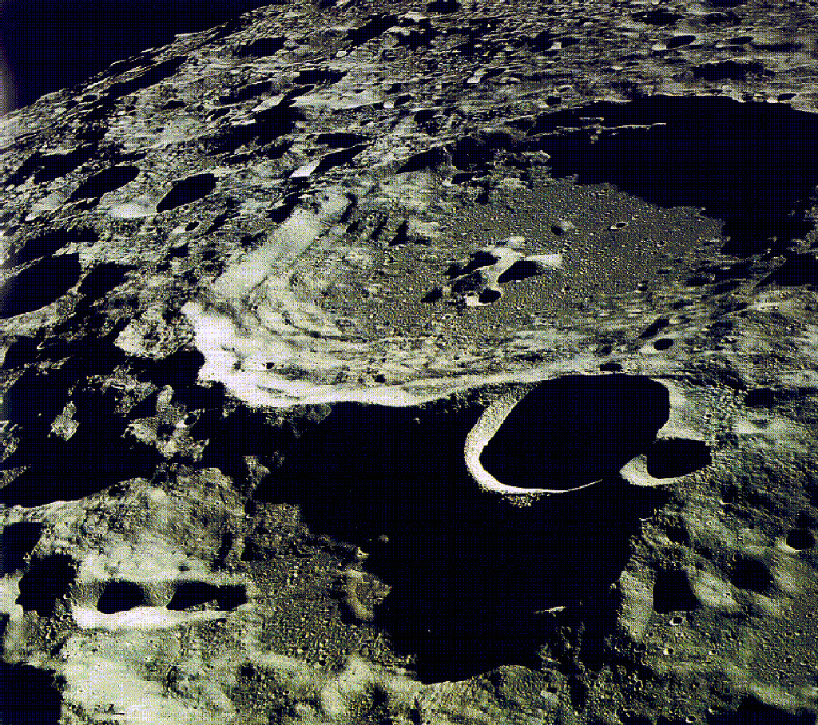
Moon
When Galileo turned his telescope on the moon, he discovered mountains and craters. The church was upset because the moon was to be a perfect orb.

Slide 21

Phases of venus
When Galileo turned his telescope on the Venus, he discovered it went through phases like the moon. This upset the church because Venus was not suppose to go through phases; it was a perfect orb.

Slide 22
Galileo’s Arrest & trial
For writing “Dialogue Concerning the Two Chief World Systems, Galileo was ordered to stand trial on suspicion of heresy in 1633. The sentence of the Inquisition was in three essential parts:
Galileo was found "vehemently suspect of heresy", namely of having held the opinions that the Sun lies motionless at the center of the universe, that the Earth is not at its center and moves, and that one may hold and defend an opinion as probable after it has been declared contrary to Holy Scripture. He was required to "abjure, curse and detest“ those opinions.
He was sentenced to formal imprisonment at the pleasure of the Inquisition. On the following day this was commuted to house arrest, which he remained under for the rest of his life.
His offending Dialogue was banned; and in an action not announced at the trial, publication of any of his works was forbidden, including any he might write in the future.^{” Wikipedia}
Yet during his house arrest Galileo wrote some of his best works.

Slide 23
View of Scripture
Galileo took Augustine's position on Scripture: not to take every passage literally, particularly when the scripture in question is a book of poetry and songs, not a book of instructions or history. He believed that the writers of the Scripture merely wrote from the perspective of the terrestrial world, from that vantage point that the sun does rise and set. Another way to put this is that the writers would have been writing from a phenomenological point of view, or style. So Galileo claimed that science did not contradict Scripture, as Scripture was discussing a different kind of "movement" of the earth, and not rotations.^{wikipedia}

Slide 24

Galileo
“The Bible tells us how to go to Heaven, not how the heavens go.”

Slide 25
Reformers
Rejected heliocentricity
Bible is against it!
Martin Luther
Calvin

Slide 26
Luther
“The fool (Copernicus) would overturn all of astronomy. In the Holy Scriptures we read that Joshua ordained the Sun to stand still, not the earth.”
Copernicus
“To attack me by twisting a passage from scripture is the resort of one who claims judgment upon things he does not understand.”

Slide 27
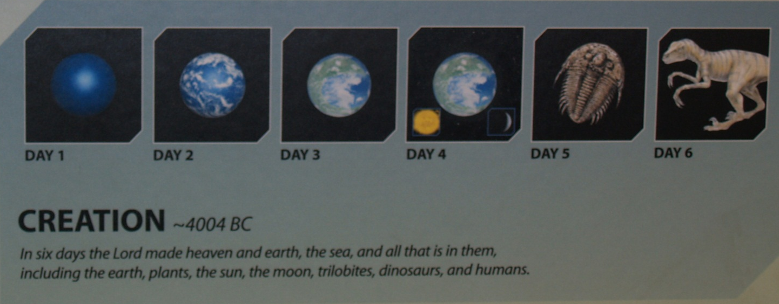
Archbishop ussher
In 1650 the Church of Ireland Archbishop of Armagh, James Ussher, published a monumental history of the world from creation to 70 AD. He used the recorded genealogies and ages in the Bible to derive what is commonly known as the Ussher chronology. This calculated a date for creation at 4004 BC. The date was widely accepted in the English-speaking world. (Wikipedia) The Creation Museum in Kentucky still uses Ussher’s dates.
Creation Museum, Kentucky

Slide 28
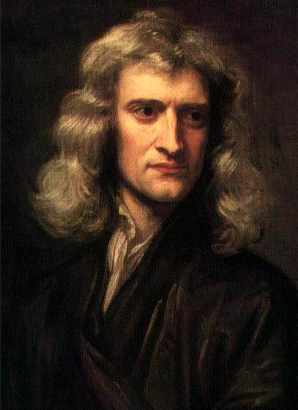
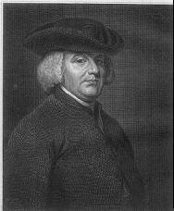
Sir Isaac Newton
With his laws of motion, Isaac Newton gave us the mechanical view of the universe. The universe was like a big watch. This mechanical view also led to the rise of Deism.
William Paley in 1802 published Natural Theology in response to naturalists like Hume. William Paley’s argument that if you find a watch in the woods, you know there must be a watchmaker, even though you can’t see him. This is a design argument or teleological argument.

Slide 29
Arguments for God
Does God Exist?
Cosmological – cause & effect, must be a
first cause of universe, who started the Big Bang?
Teleological – design has designer, if you find
watch in the woods you know someone made it.
Anthropological – Moral & mental, our
sense of right and wrong must be from God.
Ontological – idea of perfect being, how can
we image a perfect being unless there is one.

Slide 30
deism
This mechanical view of Isaac Newton also led to the rise of Deism. God made the universe like clock. God wound up the universe like a clock and left it to run by itself. No need for miracles or the supernatural.
Lord Herbert of Cherbury is generally considered the "father of English deism", and his book De Veritate (On Truth, as It Is Distinguished from Revelation, the Probable, the Possible, and the False) (1624) the first major statement of deism.^{wikipedia}
The publication of John Locke's An Essay Concerning Human Understanding (1689, but dated 1690) marks a major turning point in the history of deism. Innatist deism was replaced by empiricist deism.
Matthew Tindal's Christianity as Old as the Creation (1730), became known as the deist’s Bible. Tindal's "Deist Bible" redefined the foundation of deist epistemology as knowledge based on experience or human reason.
The most famous of the French deists was Voltaire. In the United States Thomas Paine published The Age of Reason. Thomas Jefferson made his Jefferson Bible. A number of founding fathers were deists including Ben Franklin and James Madison.

Slide 31
James hutton
James Hutton is often viewed as the first modern geologist. In 1785 he presented a paper entitled Theory of the Earth to the Royal Society of Edinburgh. Based upon a detailed examination of what we now recognize as the lithosphere, hydrosphere and atmosphere he showed that the present forces seen on the earth were sufficient to explain all the phenomena observed. He wrote "The Mosaic history places this beginning of man at no great distance; and there has not been found, in natural history, any document by which a high antiquity can be attributed to the human race. But this is not the case with regard to the inferior species of animals, particularly those which inhabit the ocean and its shores. We find in natural history monuments which prove that those animals had long existed; and thus we thus procure a measure for the computation of time extremely remote though far from being precisely ascertained"(p8) Based upon these principles of uniformitarianism, he demonstrated that the Earth is much older than had previously been supposed in order to allow enough time for mountains to be eroded and for sediment to form new rocks at the bottom of the sea, which in turn were raised up to become dry land. ^{wikipedia}
The presumption that the world was only 6,000 years old was scientifically abandoned as a result of Hutton's work.

Slide 32
Charles Lyell
From 1830 to 1833, the geologist and clergyman Sir Charles Lyell released a three volume publication called Principles of Geology, which developed Hutton's ideas of uniformitarianism, and in the second volume set out a gradualist variation of creation beliefs in which each species had its "centre of creation" and was designed for the habitat, but would go extinct when the habitat changed. Wikipedia
Philip gosse
With all this evidence of an old earth, Philip Henry Gosse in 1857, published Omphalos: Untying the Geological Knot. The Omphalos hypothesis argued that the World had been created by God recently, but with the appearance of old age. This was largely ignored, and some considered it blasphemous because it accused the Creator of deceit. Wikipedia

Slide 33
The Gap Theory
This development of the scientific discipline of geology, in the late 18th and early 19th centuries, and the discovery that the Earth was far older than a literal interpretation of the Book of Genesis could account for, led to the development, and popularity, of the Gap Theory (now known as gap creationism) to accommodate these discoveries. Gap Theory assumes a recent six-day creation, but also that the Earth existed for many ages before this event, ending in cataclysm and a new creation (hence its alternative title 'ruin-restoration theory'). ^{wikipedia}
The Gap Theory was popularized by the notes in the Scofield Reference Bible. This was the most popular view before the book The Genesis Flood.
In the early 19th century, "a heterogeneous group of writers," known as scriptural geologists, arose to oppose these discoveries, and the Gap Theory. Their views were marginalized and ignored by the scientific community of their time. They "had much the same relationship to 'philosophical' (or scientific) geologists as their indirect descendants, the twentieth-century creationists.“ Paul Wood describes them as "mostly Anglican evangelicals" with "no institutional focus and little sense of commonality.“ They generally lacked any background in geology, and had little influence even in church circles. ^{wikipedia}

Slide 34
Charles darwin
The decades following Charles Darwin's publication of The Origin of Species, in 1859, saw the overwhelming majority of North American and British naturalists accept some form of evolution, with many liberal and educated churchmen following their example, and thereby rejecting a biblically literalist interpretation of Genesis. ^{wikipedia}
Although Darwin's work rejected "the dogma of separate creations," he invoked creation as the probable source of the first life forms ("into which life was first breathed").

Slide 35
Oxford debate
In the 19th century. One of the most famous disputes was the Oxford Debate of 1860, in which T.H. Huxley, Darwin's self-appointed "bulldog," debated evolution with Samuel Wilberforce, the Bishop of Oxford. Both sides claimed victory, then the controversy was overshadowed by the even greater theological furor over the publication of Essays and Reviews questioning whether miracles were atheistic, bringing to a head arguments in the Church of England between liberal theologians supporting higher criticism, and conservative Evangelicals. The essays were described by their opponents as heretical, and the essayists were called "The Seven Against Christ."^{wikipedia}

Slide 36
fundamentalists
In 1878, American Presbyterians held the first annual Niagara Bible Conference, founding the Christian fundamentalist movement, which took its name from the "Five Fundamentals" of 1910, and came to be concerned about the implications of evolution for the accuracy of the Bible. But by no means all orthodox Presbyterians were opposed to evolution as a possible method of the Divine procedure. Dr. Charles Hodge of Princeton Seminary objected in 1874 to the atheism he considered implied in the naturalistic explanation but both he and Dr. B. B. Warfield were open to its possibility/probability within limits, and most churchmen sought to reconcile Darwinism with Christianity. ^{wikipedia}

Slide 37
Louis agassiz
The Swiss-American paleontologist Louis Agassiz opposed evolution. He believed that there had been a series of catastrophes with divine re-creations, evidence of which could be seen in rock fossils. Though uniformitarianism dominated ideas from the 1840s onwards, Catastrophism remained a major paradigm in geology until replaced by new models that allowed for both cataclysms (such as meteor strikes) and gradualist patterns (such as ice ages) to explain observed geologic phenomena. ^{wikipedia}

Slide 38
Lord Calvin
In 1862, the Glaswegian physicist William Thomson (later Lord Kelvin) published calculations, based on his presumption of uniformitarianism, and that the heat of the sun was caused by its gravitational shrinkage, that fixed the age of the Earth and the solar system at between 20 million and 400 million years, i.e. between ~3,000 and ~70,000 times Ussher's value. ^{wikipedia}
This came as a blow to Darwin's anticipated timescale, though the idea of an ancient Earth was generally accepted without much controversy. Darwin and Huxley, while not accepting the timing, said it merely implied faster evolution. It would take further advances in geology and the discovery of radioactivity that showed that the sun was in fact heated by nuclear fusion that demonstrated the present estimated 4.567 billion years. ^{wikipedia}

Slide 39
The fundamentals
In 1910, the General Assembly of the Presbyterian Church distilled the principles of Christian fundamentalism into what were known as the "five fundamentals," one of which was the inerrancy of the Scriptures, including the Genesis account of creation. The Fundamentals were published as a series of essays. Its authors accepted ancient earth geology, while holding different ideas about how this was reconciled with biblical accounts. The views expressed on evolution were mixed: two short articles were anti evolution, one anonymous and one by the little known Henry Beach. Their focus was on human evolution, as were attacks made on evolution by Dyson Hague. Major figures were explicitly open to the possibility that God created through a Lamarckian form of evolution: long articles by James Orr and George Frederick Wright expressed this openness, and Benjamin Breckinridge Warfield and A H Strong shared this view. ^{wikipedia}

Slide 40
The Scopes Trial, or Monkey Trial
Scopes was indicted by a grand jury for violating the anti-evolution law(the Butler Law) in 1925. As the tension was building for the trial, the town built a pedestrian mall close by, a platform on the lawn of the courthouse, and a tourist camp. The courtroom was prepared to broadcast the trial to the world as the equipped it with the necessary technology.

Slide 41
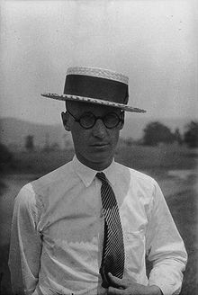
John Thomas Scopes
John Thomas Scopes was born in Paducah, Kentucky. His family moved to Illinois when he was a teenager. He eventually got a law degree from the University of Kentucky in 1924. He moved to Dayton, Tennessee where he became a football coach and a substitute teacher for Rhea County High School. He was 24 when he was asked to participate in the trial.

Slide 42
The Scopes Trial
While in Rhea High School, working as a football coach and substitute, he accepted the challenge of being put on trial for teaching evolution. He later admitted as a substitute teacher, he was not sure if he covered teaching evolution to the students. However, he still accepted the challenge of saying he would teach students evolution. He was asked to be the test of the Butler law. He agreed to be indicted to see how this case played out.

Slide 43
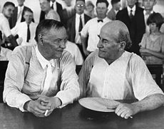
The Scopes Trial
Due to the shear publicity of this issue, many well-known people stepped up to be apart of the trail. William Jennings Bryan who brought about the Butler law decided to be the prosecutor for the trial. Clarence Darrow and Dudley Field Malone were high profile attorneys that wanted to represent Scopes in the trial.
Pictured: Darrow and Bryan

Slide 44
The Trial – Interpretation of the Bible
Bryan is called as a biblical text expert to testify. Clarence Darrow asks Bryan many questions about if the Bible should be taken literally. Bryan states that Darrow is making a “slur at the Bible.” Darrow replied back with accusing Bryan of “fool ideas that no intelligent Christian on Earth believes.”

Slide 45
The Ruling
Judge Raulston expunges Bryan’s testimony from the record stating that it is not relevant to the case. Darrow asks the jury to find Scopes guilty and go deliberate. They could chose to appeal this verdict. The jury deliberated for a total of 9 minutes. Scopes was found guilty and only had to pay $100 in fines. Both ACLU and Bryan offer to pay for his fine.

Slide 46
After the Trial
Five days after trial, Bryan died in his sleep in Dayton. In May 31, 1926, the appealing hearing started. Ultimately, the judge upheld the Butler Law, stating that it was constitutional. However, Scopes’ verdict was overturn, because Judge Raulston should have not set the fine amount, the jury should have. In May 17, 1967, the Butler Act is repealed.

Slide 47
George mccready price
George McCready Price was important in developing flood geology, and while he had limited influence at a time when all geologists had long accepted an ancient earth, many of his ideas that a young earth could be deduced from science were taken up later by young earth creationists like Henry Morris. Price was a Seventh-day Adventist, and followed Ellen White, in seeing fossils as evidence of the Great Flood. Ellen White believed the days of creation were literal 24 hour days. In 1906, Price published Illogical Geology: The Weakest Point in the Evolution Theory in which he offered $1000 "to any one who will, in the face of the facts here presented, show me how to prove that one kind of fossil is older than another."^{[29] wikipedia}
In 1929, a book by one of George McCready Price's former students, Harold W. Clark described Price's catastrophism as "creationism" in Back to Creationism.^{[42]} Previously anti-evolutionists had described themselves as being "Christian fundamentalists" "Anti-evolution" or "Anti-false science.“ Wikipedia
Price and his supporters retreated to California, and with several doctors working at the College of Medical Evangelists (now Loma Linda University), formed the "Deluge Geology Society." The "Deluge Geology Society" published the Bulletin of Deluge Geology and Related Science from 1941 to 1945. They made secret plans to unveil discoveries of fossils of human footprints that were in rock that was purportedly older than accounted for in evolutionary theory.^{[46]} However, again the organization foundered over disagreements about a 6000 year old earth.^{[47]Wikipedia}

Slide 48
Humanist manifesto
In 1933, a group of atheists seeking to develop a "new religion" to replace previous, deity-based religions, composed the Humanist Manifesto, which outlined a fifteen-point belief system, the first two points of which provided that "Religious humanists regard the universe as self-existing and not created" and "Humanism believes that man is a part of nature and that he has emerged as a result of a continuous process."^{wikipedia}
This document exacerbated the ideological tone of the discussion in many circles, as many creationists came to see evolution as a doctrine of the "religion" of atheism.

Slide 49
Religion & Science Association
In 1935, the "Religion and Science Association" was formed by a small group of creationists, led by a Wheaton College professor, to form a "unified front against the theory of evolution."^{wikipedia} There were three main schools of creationist thought, represented by Price, Rimmer, and tidal expert William Bell Dawson. However, since Dawson was a proponent of day-age creationism and Rimmer was ardently convinced that gap creationism was correct, the staunch supporters of a literal 6 day creation and 6000 year old earth were incensed, and the organization fell apart.^{Wikipedia}

Slide 50
American Scientific Affiliation
The ASA was formed in 1941 by Christian scientists, who were concerned about the quality of Christian evangelism on the subject of religion and science. It was the idea of Irwin A. Moon, who talked Moody Bible Institute president William H. Houghton into inviting a number of scientists of known orthodox Christian views to Chicago to discuss its formation. Those who attended were F. Alton Everest, Peter W. Stoner, Russell D. Sturgis, John P. VanHaitsma, and Irving A. Cowperthwaite, and the ASA was formed from this .
During the 1940s and 1950s, it served as the main evangelical forum for discussing the merits and drawbacks of evolution, and for evaluating the works of prominent creationists such as George McCready Price and Harry Rimmer. The influence of an inner circle affiliated with Wheaton College led it to reject strict creationism in favor of first progressive creationism and then theistic evolution, encouraging acceptance of evolution among evangelicals.^{[3]wikipedia}

Slide 51
The Genesis Flood
In 1961, Henry M. Morris and John C. Whitcomb, Jr. published a book entitled The Genesis Flood, in an effort to provide a scientific basis for young earth creationism and Flood geology. Morris had published several books previously, but none had the impact that The Genesis Flood did. Its publication resulted in ten like-minded creationists forming the Creation Research Society in 1963, and the Institute for Creation Research in 1972. This one book became most important and influential book of the revival young earth creationism.

Slide 52
Arkansas Trial 1981
McLean v. Arkansas Board of Education
In 1981 the Arkansas legislature passed a law, Balanced Treatment for Creation-Science and Evolution-Science Act (Act 590), requiring that creationist theory be given equal time with evolutionary theory in high school biology texts and classes, with no references to God or the Bible.
The U.S. district court overturned the Arkansas law in 1982, because it violated the separation of church and state.

Slide 53
Louisiana Trial 1987
Edwards v. Aguillard
In 1987, the U.S. Supreme Court struck down a Louisiana creationism law because the law would have restricted academic freedom and supported a particular viewpoint. They ruled that Creation science is not science, but a religious view.
As a result of this ruling, drafts of the creation science school textbook Of Pandas and People were revised to change all references to "creation" to relate to "intelligent design.“^{wikipedia}
Another result was that Phillip Johnson wrote the popular book, Darwin on Trial. He is seen as the father of the intelligent design movement.

Slide 54

Intelligent Design Movement
Charles Thaxton, editor of Of Pandas and People, had picked up the phrase “intelligent design "from a NASA scientist, and thought "That's just what I need, it's a good engineering term".^{[36]} In drafts of the book over one hundred uses of the root word "creation", such as "creationism" and "Creation Science", were changed, almost without exception, to "intelligent design",^{[13]} while "creationists" was changed to "design proponents" or, in one instance, "cdesign proponentsists". [sic]^{[35]} In June 1988 Thaxton held a conference titled "Sources of Information Content in DNA" in Tacoma, Washington,^{[23]} and in December decided to use the label "intelligent design" for his new creationist movement.^{[37]Wikipedia}

Slide 55
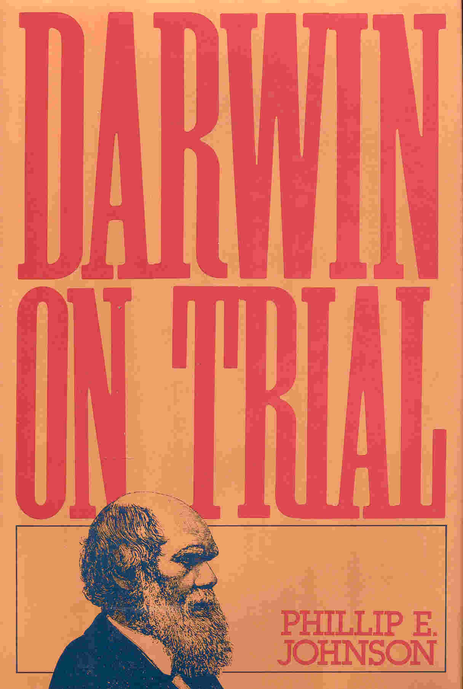
Intelligent Design Movement
Phillip Johnson, Darwin of Trial 1991
Michael Behe, Darwin’s Black Box 1996
Jonathan Wells, Icons of Evolution 2000
Key Organizations:
Discovery Institute: www.discovery.org/crsc/
Access Research Network: www.arn.org

Slide 56

1996 the Discovery Institute is formed
They promote the Intelligent Design theory (ID). What is Intelligent Design?
"The theory of intelligent design holds that certain features of the universe and of living things are best explained by an intelligent cause, not an undirected process such as natural selection."
Philip Johnson is co-founder and one of the authors of the Discovery Institute's Wedge Document and its Teach the Controversy campaign

Slide 57

Key Players
Phillip Johnson, Darwin of Trial
Michael Behe, Darwin’s Black Box
Jonathan Wells, Icons of Evolution
William Dembski, No Free Lunch: Why Specified Complexity Cannot Be Purchased without Intelligence
Stephen Meyer, Science & Evidence For Design in the Universe
Key Video: Unlocking the Mystery of Life.

Slide 58
Evidence of Design
In cosmology, evidence suggests the universe--including all matter, space, time, and energy--came suddenly into existence a finite time ago, contradicting the earlier picture of an eternal and self-existing material cosmos.
In physics, evidence has shown that the universe is "finely-tuned" for the existence of life, suggesting the work, as Astrophysicist Fred Hoyle puts it, "of a super intellect."
In biology, the presence of complex and functionally integrated machines has cast doubt on Darwinian mechanisms of self-assembly, and has sparked new interest in the design hypothesis.
In molecular biology, the presence of information encoded along the DNA molecule has suggested the activity of a prior designing intelligence.
In "artificial intelligence" research, the persistence of the so-called "frame" and "consciousness" problems suggests a fundamental chasm separating machine intelligence and the human mind.
Predictably, many defenders of the status quo have refused to address the new evidence and have simply exhorted each other to keep faith with materialism. Harvard biologist Richard Lewontin, for example, urges scientists to embrace a "materialism [that] is absolute" and to stick with "material explanations, no matter how counter intuitive."

Slide 59
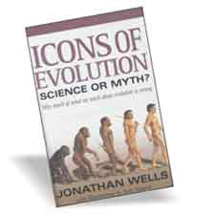
Intelligent Design Movement
Jonathan Wells, Icons of Evolution
10 Icons of Evolution he refutes:
1 | Miller–Urey experiment
2 | Darwin's tree of life
3 | Homology in vertebrate limbs
4 | Haeckel's embryos
5 | Archaeopteryx
6 | Peppered moth
7 | Darwin's finches
8 | Four-winged fruit flies
9 | Fossil horses
10 | Hominid evolution

Slide 60

Intelligent Design Movement
Michael Behe, Darwin’s Black Box
“For the record, I have no reason to doubt
that the universe is the billions of years old
that physicists say it is. Further, I find the
idea of common descent (that all organisms
share a common ancestor) fairly convincing,
and have no particular reason to doubt it."
(Behe, "Darwin's Black Box", p. 5)
Key Term: “Irreducible complexity”

Slide 61

abiogenesis
Changes in allele frequencies in populations
How life started on earth
Evolution

Slide 62
Intelligent Design
Young-Earth Creation
Old-Earth Creation

Slide 63
Dover Trial
The Dover trial otherwise known as Kitzmiller v. Dover Area School District or The Dover Panda Trial. Trial was about questioning intelligent design’s eligibility to be taught in public schools in Dover, Pennsylvania. Intelligent Design(ID) says that life is so complex that it could not have evolved, there must be a designer (God).

Slide 64
School Changes Textbook
In June 2004, the Dover Area School District began its selection of a biology textbook. In the past their textbooks focused on evolution. In August 2004, the school district selected the textbook: Biology: The Living Science, by Kenneth Miller and Joseph Levine. Now they had their textbooks recommended by the science teachers, however, 50-60 copies of an intelligent design book called Of Pandas and People was anonymously donated to use in the classrooms. Since receiving the intelligent design book, the school board passed an intelligent design curriculum policy, and two school board members resigned because of it as a sign of protest. In November 2004, the school board issued how the policy was to be implemented and stated a one minute speech about the addition of intelligent design in classrooms.

Slide 65
The Suit
Some parents were outrage at the new addition of intelligent design being added to the curriculum. Less than a month later, they filed a suit to the Federal District Court against the school board on the grounds that it violated the establishment clause, which separates church and state functions. They believed the theory was religious and should not be included in public schools. The parents were represented by Pennsylvania ACLU, Americans United, and Pepper Hamilton LLP.

Slide 66
The Trial
In September 2005, the judge denies the plaintiff's motion for summary judgment and send the suit to trial. The plaintiffs sought for declaratory and injunctive relief. The bench trail before Judge John E. Jones begins in Federal District Court in Harrisburg, PA.
The plaintiffs brought witness such as Kenneth R. Miller, a biology professor to testify. They brought in witnesses of the intelligent design speech, Dover parents, philosophers aware of intelligent design, scientists, an expert witness, and many more.
As for the defense, they brought in Michael Behe, who was a professor at Lehigh University and is a leader in the intelligent design movement. They also brought to the stand other intelligent design scientists, a professor, a superintendent, and other people as well. The trial concludes in November 2005.

Slide 67
The final verdict
In December 2005, Judge Jones states that the intelligent design policy violates the U.S. Constitution. He issued a 139 page findings act that concluded how the board violated the constitution. He said that intelligent design represented a religious belief. The school board could no longer force teachers to teach about intelligent design and not to discourage the teaching of evolution. In February 2006, the Dover Are School District must pay more than one million dollars in legal fees to the plaintiffs.

Slide 68
Key Leaders in
Dialogue
John Polkinghorne a leader in the dialogue with science and religion. Natural theology is the bridge between science and religion. There is order in this world. The anthropic principle or fine-tuning of the universe is key. He wrote Belief in God in an Age of Science in 1998.
Author Peacoke argues for “critical realism” in Paths of Science Towards God: The End of All Our Exploring, 2001.
Ian G. Barbour wrote the important book Issues in Science and Religion, 1966. In 2000 he wrote When Science meets Religion.
Alister E. McGrath wrote A Scientific Theology about the convergences of the natural science with Christian theology. A good introduction is Science & Religion: A new Introduction, 2010.

Slide 69
Scientific Atheism
Richard Dawkins
The key question is whether the natural sciences can either deny the existence of God, or render God unnecessary to explain things. Dawkins wrote The God Delusion in 2006 which is referred to as the “new atheism” in which nature science endorses atheism. In The Blind Watchmaker, 1986 he argues that evolution eliminates the need for God. Dawkins develops this further in Climbing Mount Improbable in 1996. In the Selfish Gene, 1989 proposes a dichotomy between blind faith and overwhelming evidence.
The key issue is whether the scientific method can prove there is a God or not. Peter Medawar in The Limits of Science in 1985 shows that science can not answer the metaphysical questions. Stephen Jay Gould says that science can only work with naturalistic explanations, and can neither affirm or deny the existence of God. Does not “fine-tuning” in nature point to a creator?

Slide 70

Creation Museum
The Creation Museum, which is said to have cost $27 million, is privately funded through donations to the ministry Answers in Genesis head by Ken Ham, and opened its doors to the public on May 28, 2007.

Slide 71

Noah’s Ark & Theme Park
The Ark Encounter will include a full-scale Ark, built according to the biblical dimensions and constructed with materials and methods as close as possible to those of Noah’s time. More than just the Ark, the project will include a large complex of associated attractions, theaters, amenities, event venues, and ample parking. http://arkencounter.com/
The Walled City: Along with plenty of shopping and food, guests experience Bible events through various themed venues situated on 40 acres.
The Ark: A full-size wooden Ark.
The Tower of Babel: A 100-foot-tall themed building with exhibits and a 500-seat 5-D special effects theater.
Journey Through History: This themed attraction takes visitors on a trip through events of the Bible, experiencing spectacular special effects.
The First-Century Village: This attractive area presents a town as it might have appeared in the Middle East.
In Kentucky 2014

Slide 72
Young Earth Creationists
Old Earth Creationists
Semi-Literal
Progressive Creationism
Heliocentric- earth spins around the sun.
Creation over long time
10,000+ Earth, Gaps
6,000 years old, No Gaps
Literalists
Theistic Evolution
Geocentric View- Sun goes around the earth.
God creates using evolution
Spherical Earth-Middle Ages
Flat Earth-Ancient Times

Slide 73
Geocentricity
Ecclesiastes 1:5 “The sun also ariseth, and the sun goeth down, and hasteth to his place where he arose.”
Joshua 10:13 “So the sun stood still in the midst of heaven, and hasted not to go down about a whole day.”
Psalm 93:1 “the world also is established, that it cannot be moved.”

Slide 74
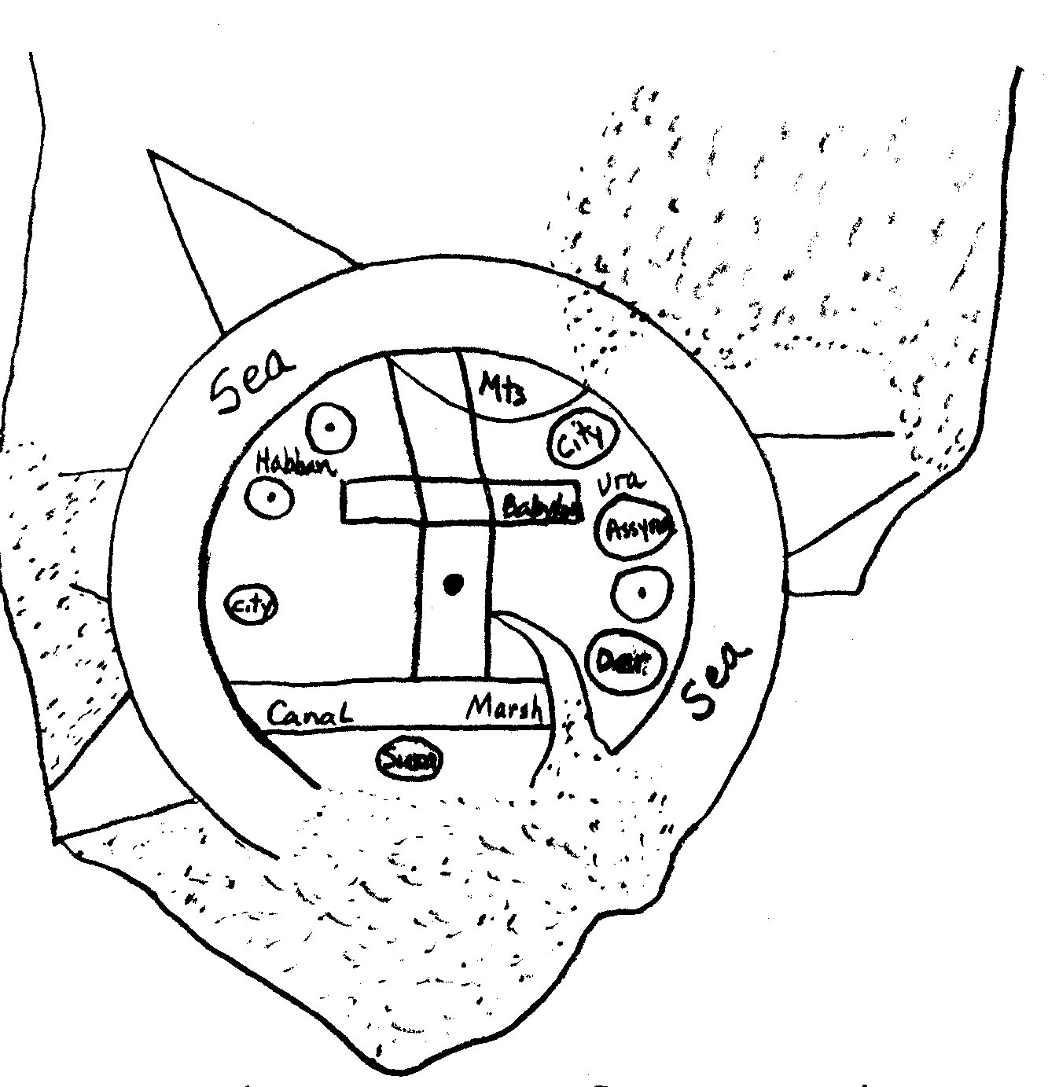
Geocentric View
The Flat Earth Ancient times
Scriptural Support
Babylonian Map of the World
Matthew 4:8 “Again, the devil taketh him up into an exceeding high mountain, and showeth him all the kingdoms of the world” (Daniel 4:10-11)
Isaiah 40:22 “the circle of the earth”

Slide 75
Noah's Flood
4,300 – 4,400 years ago
Trees 4,900 years old.
ICR
Jericho – 8,000 years old
LXX
Egyptian Dynasties – 5,100 years

Slide 76
Genealogies
ICR
AIG
Gaps!
No Gaps!
Luke 18:38 states, “Jesus, Thou son of David, have mercy on me.”
Luke 3:36 “Cainan”
1,000 years between Jesus and David

Slide 77
Harmonize
ICR
Henry Morris
Science
AIG
Ken Ham
Reject

Slide 78
Old Earth Creationists
Young Earth Creationists
Gap Theory: Scofield Bible
Heliocentric
Creation over long time-Day Age
10,000+ earth ICR
Progressive Creation –Hugh Ross
6,000 years old earth AIG
New Creationism - ID
Literalists
Theistic Evolution
Geocentric
God creates using evolution
Spherical earth
God of the Gaps - active
Flat earth
Deism - passive

Slide 79
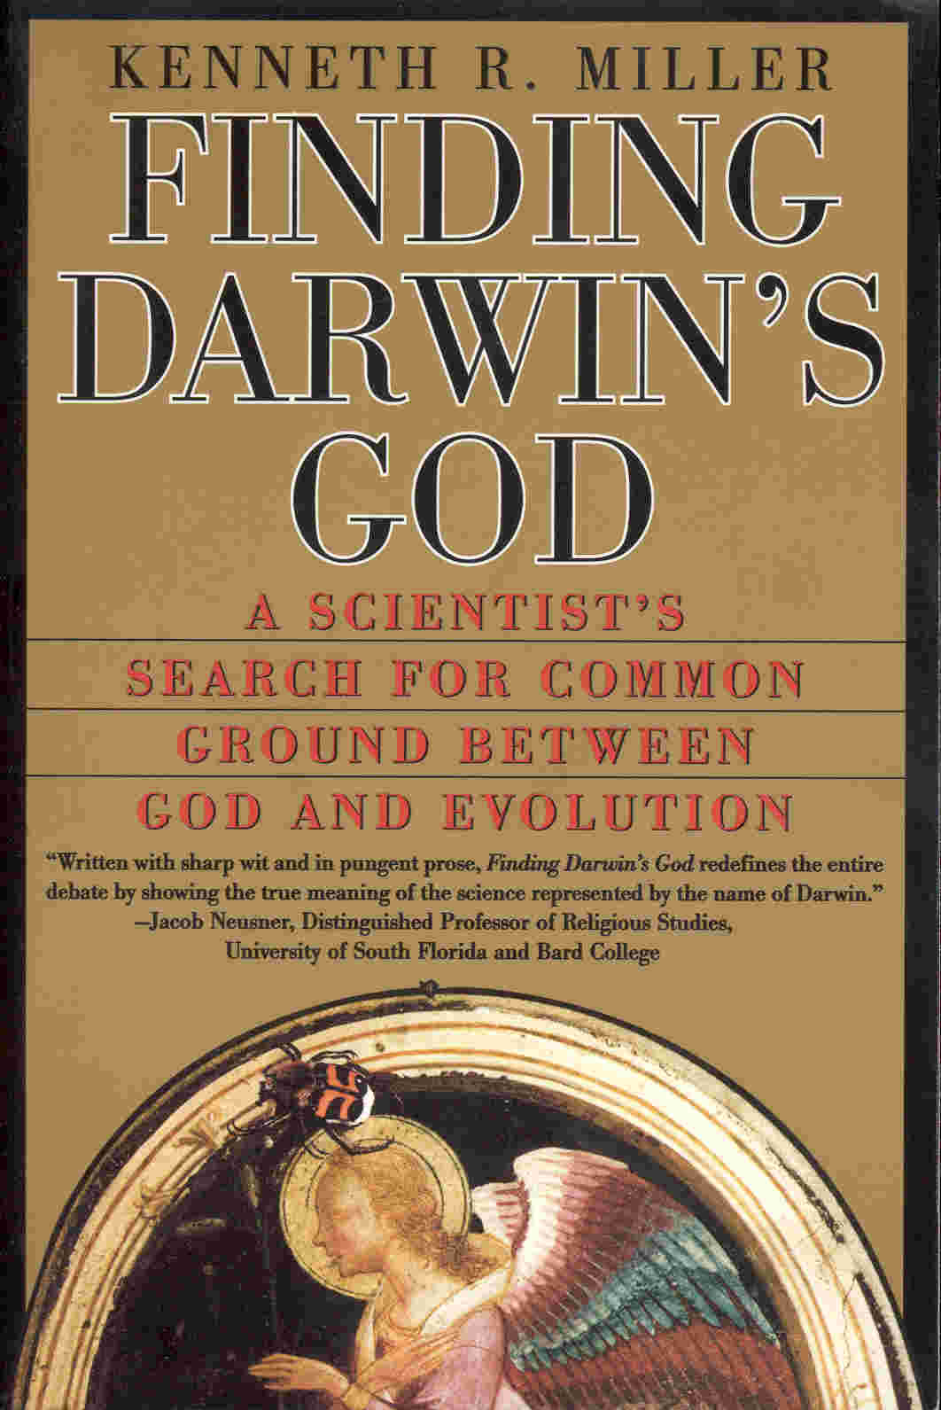
Old Earth Creationists
Reasons to Believe, Hugh Ross. See www.reasons.org Progressive Creationism (Day is more than 24 hours)
ID-Intelligent Design Movement, Discovery Institute, ARN New Creationism
American Scientific Affiliation, See www.asa3.org
Theistic Evolution
Finding Darwin’s God by Kenneth Miller
The Language of God by Francis Collins
God of the Gaps, Active or Passive

Slide 80
Theistic Evolution
Genesis 1:11
God commands, "Let the earth bring forth grass, the herb yielding seed" God does not directly create the plants. Verse 12 “The earth brought forth grass" This seems to be a clear statement of evolutionary process from scripture according to theistic-evolutionists.

Slide 81
Phenomenal Language
Poetic Language
Isaiah 55:12 “the mountains and the hills shall break forth before you into singing, and all the trees of the field shall clap their hands.”
Not
Scientific Language

Slide 82
Inspiration
I I Timothy 3:16-17
“All scripture is given by inspiration of God, and is profitable for doctrine, for reproof, for correction, for instruction in science, in the areas of geology, biology, chemistry, and astronomy.
That the man of God may be perfect, thoroughly furnished unto all good works.”
RIGHTEOUSNESS

Slide 83
Young Earth Creationists
Old Earth Creationists
Semi-Literal
Progressive Creationism
Salvation
Literalists
Theistic Evolution

Slide 84
Young Earth Creationists
Old Earth Creationists
Can Old Earth Creationists be Christians?
Acts 16:31 “Believe on the literal 6 day creation and thou shalt be saved”
Lord Jesus Christ

Slide 85
Genesis
Who
Science
How

Slide 86
Galileo
“The Bible tells us how to go to Heaven, not how the heavens go.”

Slide 87
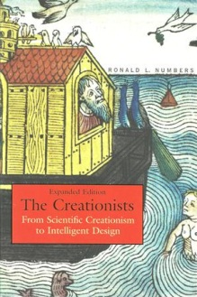
Key resources
The Creationists by Ronald Numbers, 2006 expanded edition. This is the definitive book on the history of creationism.
When Science Meets Religion by Ian G. Barbour, 2000.
4 simple views of Science & Religion.
Science & Religion: A Historical Introduction edited by Gary Ferngren, 2002. A good introduction.
Science & Religion: A New Introduction by Alister McGrath, 2nd edition 2010. A good introduction.
When Science & Christianity Meet edited by Linberg and Ronald Numbers, 2003. A good Introduction.
Galileo Goes to Jail and Other Myths about Science and Religion edited by Ronald Numbers, 2009. Very interesting book about the myths of science and religion.

Slide 88
Resources
http://www.aboutpaducah.com/directory/celebrities/354.html
http://www.biographyplus.com/john_t_scopes.htm
http://law2.umkc.edu/faculty/projects/ftrials/scopes/Sco_sco.htm
http://www.pbs.org/wgbh/amex/monkeytrial/peopleevents/p_scopes.html
http://en.wikipedia.org/wiki/John_T._Scopes
http://www.npr.org/templates/story/story.php?storyId=4723956
http://law2.umkc.edu/faculty/projects/ftrials/scopes/evolut.htm
http://en.wikipedia.org/wiki/Scopes_Trial

