Slide 1
Bibliology
& Textual history
Institute for Biblical & Scientific Studies
www.bibleandscience.com
By
Dr. Stephen Meyers

Slide 2
Bibliology: Study of Bible
Revelation: Disclosing what Is unknown
Inspiration: God’s superintending of
Human authors to compose & record His
Revelation to man.
Canonicity: Books recognized by Church
Councils as the authoritative word of God.

Slide 3
Bibliology
Two types of revelation
Of god to man
God’s world
God’s Word

Slide 4
General Revelation
Creation
Special revelation
Bible

Slide 5

General Revelation= God’s Creation
“The heavens declare the glory of God; and the
Firmament showeth his handiwork”
Psalm 19:1
Pillars of Creation, Eagle Nebula (NASA)

Slide 6

“Because that which is may be known of God is manifest in
them; for God hath showed it unto them. For the invisible
things from the creation of the world are clearly seen, being
understood by the things that are made, even his eternal
Power and Godhead; so they are without excuse”Romans 1:19-20
We can learn about God by studying his creation.

Slide 7
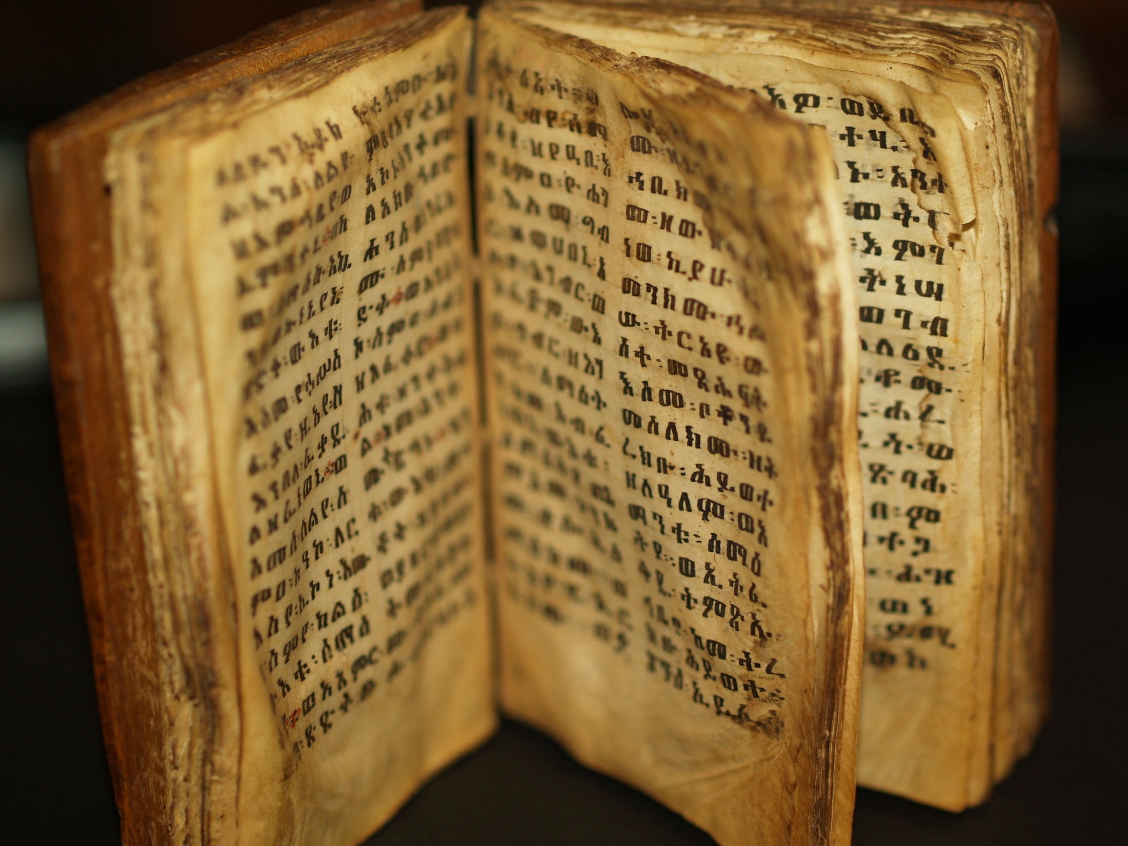
Special Revelation
God’s Word
“For prophecy came not in old time by
the will of man: but holy men of God
spake as they were moved by the
Holy Ghost”
II Peter 1:21
Old Ethiopian Bible

Slide 8
Special Revelation
God’s Word
“All scripture is given by inspiration of
God, and is profitable for doctrine
for reproof, for correction, for
Instruction in righteousness”
II Timothy 3:16
Old Ethiopian Bible

Slide 9
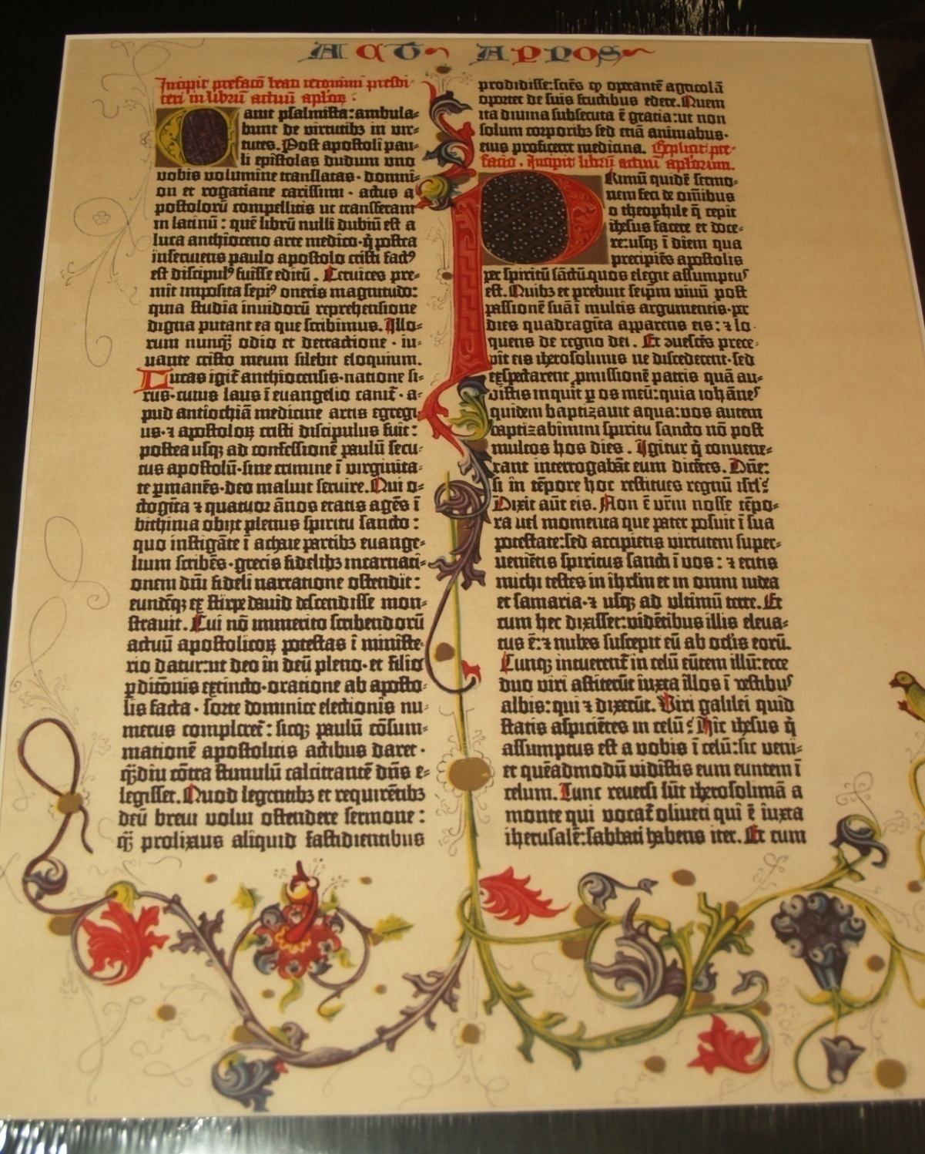
Bible
Inerrant
Infallible
In Faith &
Practice,
Or in every
Thing?
Gutenberg Bible

Slide 10
According to ii timothy 3:16
All scripture is profitable for
Instruction in righteousness.
It does not say for instruction
In geology or chemistry.
The bible is not meant to be a
Science book, but a spiritual book.

Slide 11
Canon of Scripture
What books should be
Included in the Bible?

Slide 12
Protestants only accept the Old &
New Testaments
New Testament 27 Books
Apocrypha 15
Old Testament
66 Books
Jews only accept the
Old Testament
Orthodox
Have other
Books in
LXX
Roman Catholics also
Include the Apocrypha in Latin Vulgate

Slide 13
The Old Testament or
Jewish Bible was confirmed
At the Council of Jamnia 90 AD
The New Testament was confirmed
By the Council of Carthage in 397 AD
Roman Catholics add the
Apocrypha at the Council of Trent
In 1546 AD

Slide 14
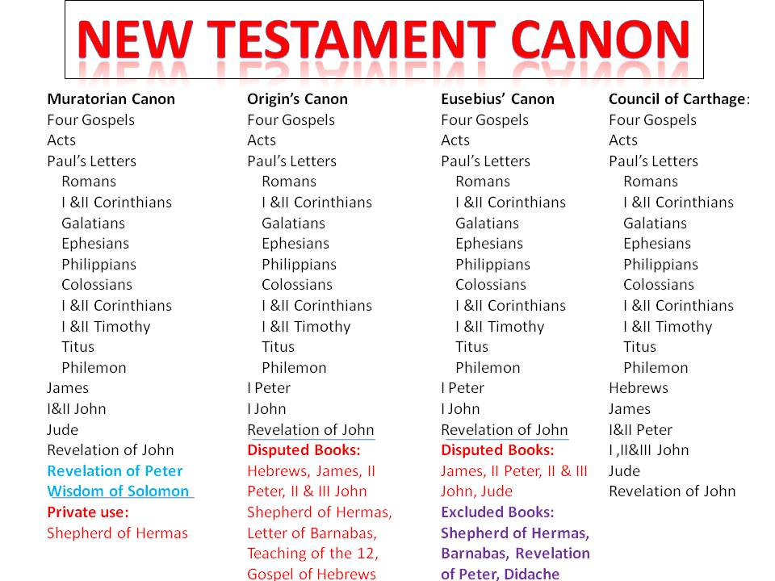

Slide 15
The Jews accept the Hebrew Old
Testament (some Aramaic) & rejects apocrypha not written in Hebrew.
Protestants accept Jewish Hebrew Bible and Greek New Testament.
Eastern Orthodox accept the
Greek Septuagint & New Testament
Roman Catholics accept the Latin
Vulgate with the Apocrypha.

Slide 16
Eastern Orthodox church
Greek & Russian
Their canon is the Septuagint (LXX) The Greek translation of the Old Testament which includes 10 Apocyrpha books.
They reject 2 Esdras (not in LXX)
& add Psalm 151, 3 & 4 Maccabees which is in the LXX.

Slide 17
Ancient fragments
& scrolls of the Hebrew
Bible (Old Testament)
How reliable is the Bible, if it has been copied over and over again through the centuries?
We want to look at some of the great discoveries of ancient fragments and manuscripts of the Bible to see how accurately it has been copied.

Slide 18
Hebrew text
The basic Hebrew text is called the Masoretic Text (MT), which is named after a group of scribes in the ninth century that preserved the text and added vowels and punctuation marks. The original Hebrew just had consonants, but a few consonants functioned as vowels. No one would know how to pronounce the Hebrew words unless vowel marks were added. This is a great help in understanding the text. (Hebrew Bible) There were three different tasks of copying the OT. The Sopherim wrote the consonantal text. The Nakdanim added the vowel points and accents. The Masoretes added the marginal notes. An example is the Kethib (what is written) and Qere (what should be read). There are over 1,300 of these. The vowels of the Qere were written in the text of the Kethib. There are three different systems of vowel pointing, the Babylonian, Palestinian and Tiberian which the Masoretes created. The marginal notes called Masora were mainly written in Aramaic and were like a concordance.

Slide 19
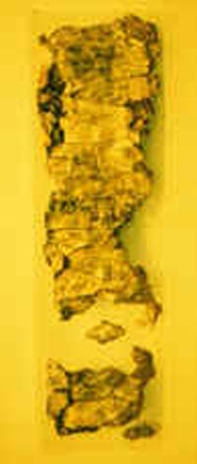
Oldest text of the
Hebrew bible
Ketef Hinnom
Silver Scrolls
OLDEST BIBLICAL TEXTS DISCOVERED about 625 B.C.
“The LORD bless you and keep you;
The LORD make His Face shine on you,
And be gracious to you;
The LORD lift up His countenance on you,
And give you peace.”
-Numbers 6:24-26

Slide 20
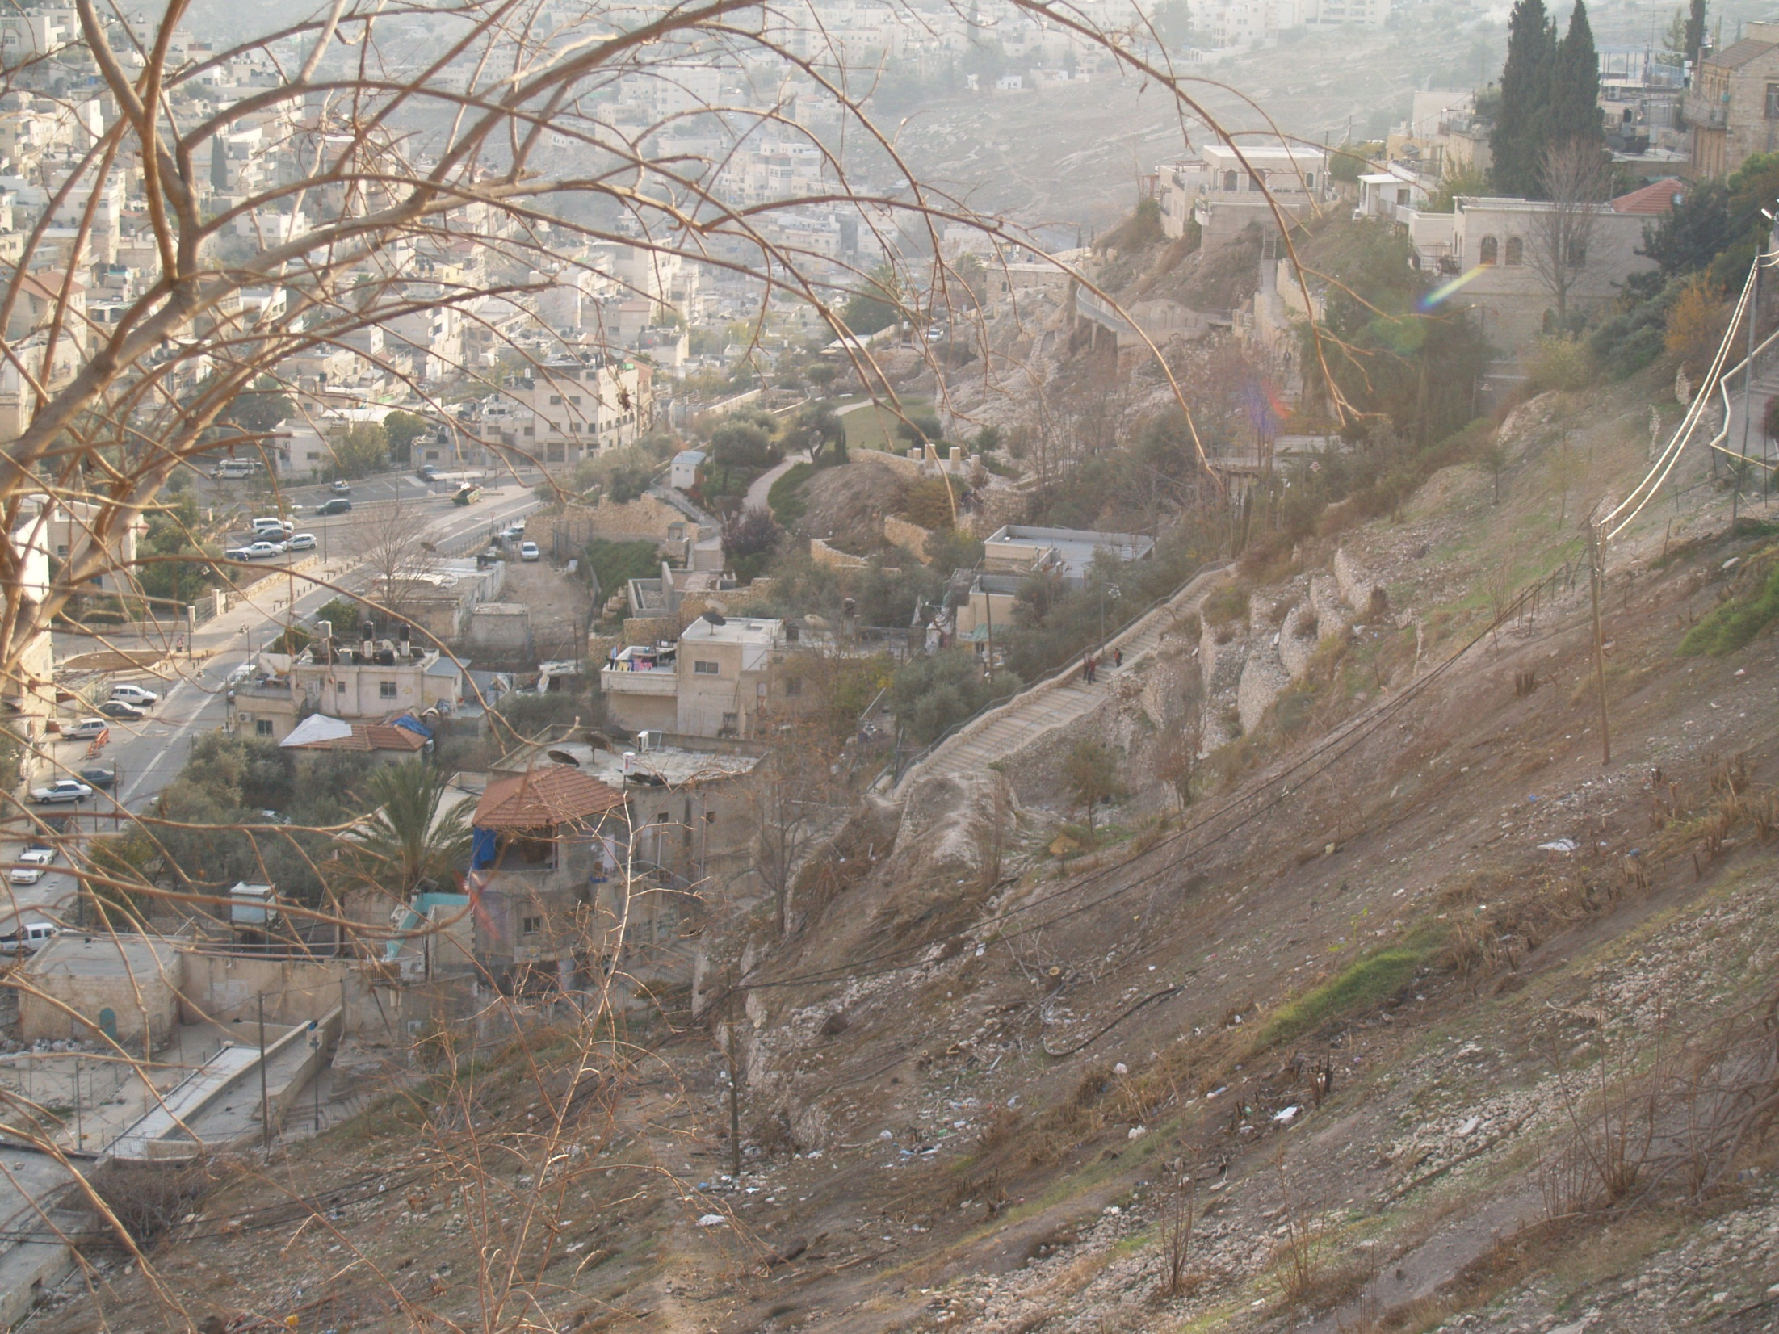
In 1979 two tiny silver scrolls, inscribed with portions of the Priestly Blessing (Numbers 6:24-26) and once used as amulets, were found in burial chamber 25 by archaeologist Gabriel Barkay in the Ketef Hinnom (meaning “shoulder of Hinnom”). The chance discovery by a 13-year-old "assistant" revealed that a partial collapse of the ceiling long ago had preserved the contents of Chamber 25. The delicate process of unrolling the scrolls while developing a method that would prevent them from disintegrating took three years. They contain the oldest surviving texts from the Hebrew Bible, dating from around 625 BC.
Background shows where the Kidron & Hinnom Vallies meet just south of Jerusalem.

Slide 21
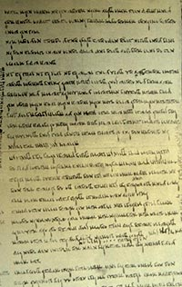
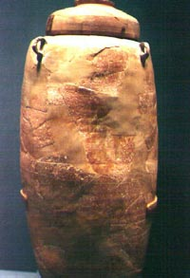
Greatest Discovery
Dead Sea Scrolls
On the left is a page from the great Isaiah Scroll from the Dead Sea Scrolls. On the right is a jar that housed Dead Sea scrolls.

Slide 22
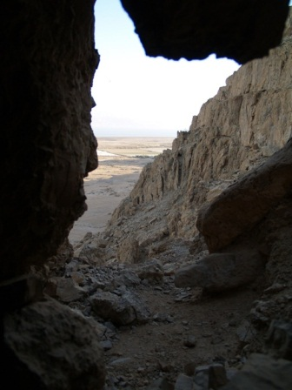
Cave one where the Great Isaiah Scroll was found. In 1947 a Bedouin shepherd boy was looking for his wandering goat when he came across a cave. He threw a rock into the cave, and heard something break, so he went in and found large jars with scrolls in them.

Slide 23
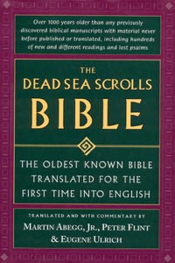
Three of the most important Biblical texts from Qumran are: (1) The Isaiah Scroll from Cave 1 which has two different text types, with about 1,375 differences from the MT. (2) The Habakkuk Commentary from Cave 1 which uses the pesher method of interpretation, and the name Yahweh is written in paleo-Hebrew. (3) The Psalm scroll from Cave 11 contains 41 canonical psalms and 7 apocryphal psalms mixed in among them. The order of the psalms differs largely from the MT (Wurthwein 1979, 32).
This is an excellent book with translations of the Bible from the Dead Sea Scrolls. Differences are italicized. The Dead Sea Scrolls Bible translated by Abegg, Flint, and Ulrich. Published by HaperSanFranciso, 1999

Slide 24
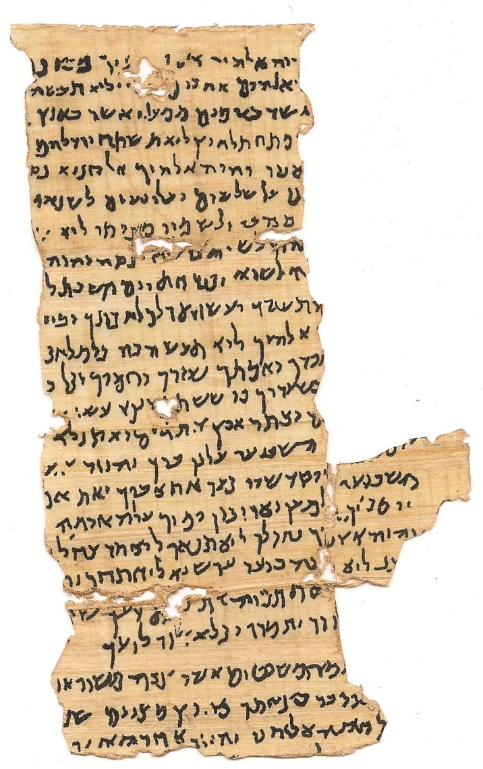
Nash Papyrus
Before the discovery of the Dead Sea Scrolls the Nash Papyrus was the oldest known witness to the OT which dated to the first or second century AD. It contained the Decalogue. It was found in Egypt in 1902. The Tetragrammaton YHWH (God's name) is visible twice on the last line.

Slide 25
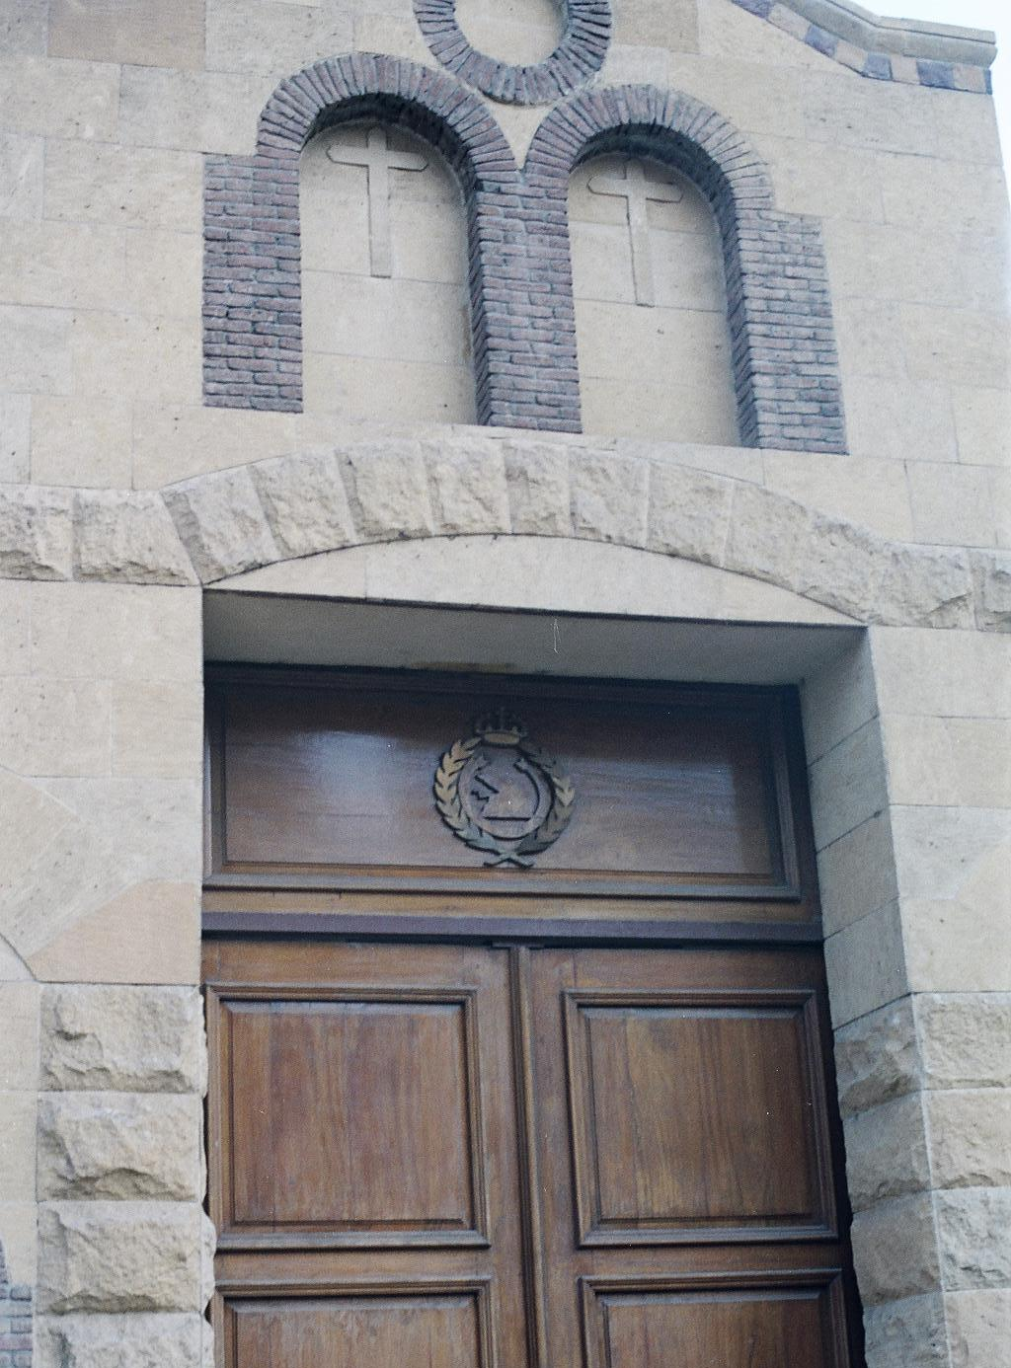
Cairo Geniza
The second oldest before the Dead Sea Scrolls were the Cairo Geniza fragments (about 280,000) which date to the fifth century AD (See Princeton Geniza Project). Most of these are in the Cambridge University Library and the Bodleian Library at Oxford. The Cairo Geniza (meaning “storeroom”) of the Ben Ezra Synagogue in Fustat, is presently Old Cairo, Egypt.
Coptic Cairo, Egypt

Slide 26
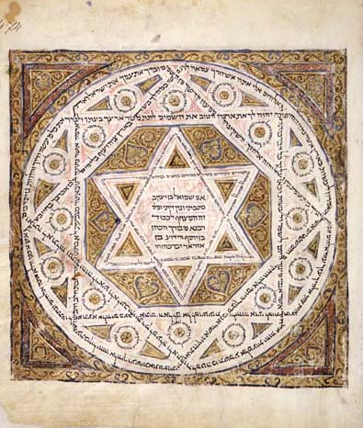
Codex Leningradensis
The oldest surviving manuscript of the complete Bible is the Codex Leningradensis which dates to 1008 AD. A Facsimile edition of this great codex is now available (Leningrad Codex 1998, Eerdmans). The BHS (Biblia Hebraica Stuttgartensia) follows this codex.

Slide 27

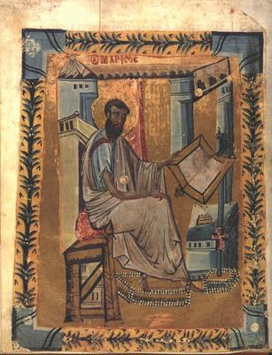
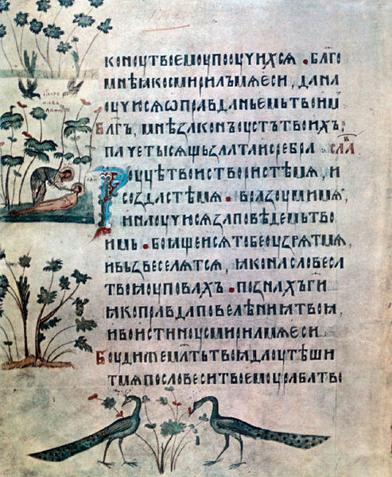
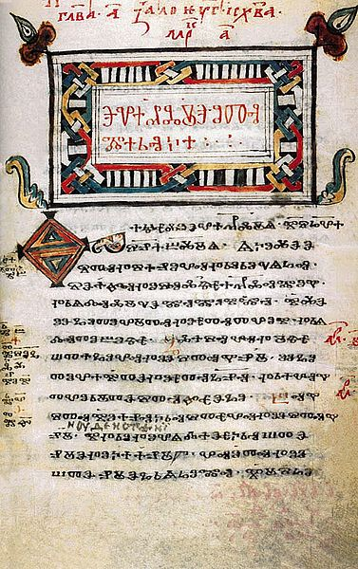
The most comprehensive collection of old Hebrew manuscripts is in the Russian National Library in St. Petersburg formerly called Leningrad. It is the oldest public library in Russia.
Trebizond Gospel
Spiridon Psalter
Codex Zographensis

Slide 28
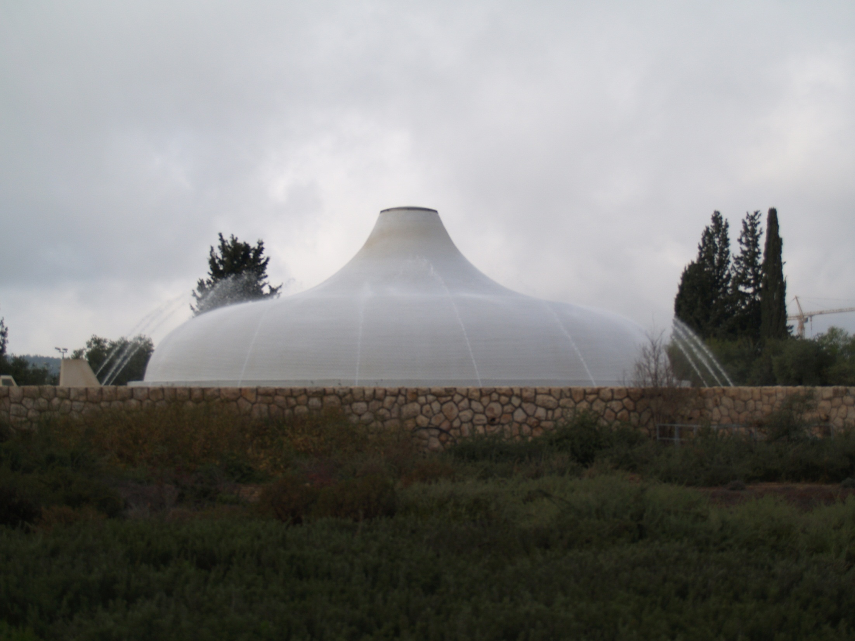
Another important text is the Aleppo Codex which is now in the Israel Museum, Jerusalem. The HUB (Hebrew University Bible) follows the Aleppo Codex. For a more detailed study see The Text of the Old Testament by Ernst Wurthwein and Textual Criticism: Recovering the Text of the Hebrew Bible by P. Kyle McCarter, Jr.
Aleppo codex

Slide 29
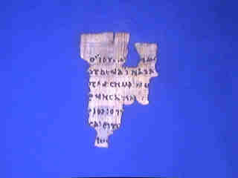
New Testament
Oldest Papyrus
P52
Fragment of the Gospel of John. The oldest known manuscript of the New Testament dated between 125-150 AD from Egypt. Written in Greek on papyrus, and found in 1920. The front has John 18:31-33. It is on display at John Rylands University Library, Manchester, UK.

Slide 30
Septuagint (LXX)
The oldest and most important translation of the Hebrew Old Testament (OT) is the Septuagint (LXX). It translated the Hebrew into Greek in the third century BC in Alexandria, Egypt. The Letter to Aristide tells the story how the Egyptian king Ptolemy II (285-247 BC) ordered his librarian, Demetrius to collect all the books of the world. Demetrius thought there should be a Greek translation of the Torah so 72 Jews, six from each tribe, were sent to translate the Torah into Greek which they did in 72 days (Charlesworth 1985, 7-34).
There are a number of differences in the LXX from the Masoretic Text (MT), most noticeable is the Book of Jeremiah where the LXX is a third shorter. The chronology in Genesis is also very different than the MT. (Finegan 1998, 195; Larsson 1983, 401-409). Larsson believes that the translators of the LXX tried to harmonize the Biblical chronology with the Egyptian chronology of Manetho by adding 100 years to the patriarchs ages to push back the time of the flood before the first Egyptian dynasty because there is no record of a great flood. Early Christian chronologists emphasized the perfect agreement of Manetho with the LXX (Larsson, 403-4). It is interesting to see how they understood Genesis by the way they translated the text.

Slide 31
Samaritan pentateuch
The Samaritan Pentateuch (SP), is an important witness to the Hebrew text. It is preserved in ancient Hebrew called "paleo-Hebrew," whereas the Masoretic Text (MT) is in Aramaic block script. Some places differ from the MT especially where to worship, but when the SP agrees with the Septuagint it can be an important alternate reading. There are 1900 such instances (Wurthwein 1979, 43). The only striking difference in Genesis is the chronology in chapters 5 and 11.
The Samaritan Targum translates the Samaritan Pentateuch into Aramaic which can show us how they understood the text. There was no official recension of this targum so surviving manuscripts have their own text.

Slide 32
targums
The targums are the Aramaic translation of the Hebrew texts. As a result of the Babylonian captivity the Jews learned Aramaic and forgot Hebrew. From the conquest of Cyrus the Great to the conquest of Alexander the Great the lingua franca of the day was Aramaic. Even in the New Testament Jesus most likely spoke Aramaic, the common language of Palestine at that time. The book of Matthew was probably originally written in Aramaic. I think this accounts for the differences in the other synoptic gospels. It is very interesting to see how the Targums translated and explained the OT.
The block script of Aramaic was adopted for writing the Hebrew text. This might have been to distinguish it from the Samaritan Pentateuch. In some of the Dead Sea Scrolls the name of God was written in Paleo-Hebrew while the rest of the text was in Aramaic block script.
The Targums can be divided geographically into two parts; Palestinian targums, and the Babylonian targums. There are three major Palestinian targums; Targum Neofiti I, Fragment Targum (Jerusalem II), and Targum Pseudo-Jonathan (Jerusalem I). There are two major Babylonian targums; Targum Onkelos for the Pentateuch, and Targum Jonathan for the Prophets. These two are authoritative for Judaism. These targums have been purged of midrashic additions.

Slide 33
talmud
According to Jewish tradition, Ezra founded the "Great Assembly" of teachers who would preserve the oral traditions. Towards the middle of the third century BC the Great Assembly ceased and another organization the "Sanhedrin" took charge of the affairs of the community. Hillel started the school of Tannaim (meaning Teachers) with a lenient view of the law. His contemporary Shammai also started a school, but was stricter in his views of the law. Judah the son of the great Simeon Gamaliel (Acts 5:34, and teacher of Paul, Acts 22:3), complied the Mishnah about 200 AD which is like the official textbook of the torah. Mishnah is from the root meaning "to repeat" the oral teaching. The Mishnah is arranged in six sections called Sedarim (Orders), each Order has a number of Massichtoth (Tractates). The Tosifta (Supplement) is another work that has additional teaching that was not as authoritative as the Mishnah. Commentary about the Mishnah accumulated which was called Gemara (completion) because it completes the Mishnah. The Mishnah together with the Gemara is called the Talmud. Two Talmuds were complied; the Palestinian Talmud written in Western Aramaic (similar in Biblical Aramaic), and the Babylonian Talmud written in Eastern Aramaic. Miscellaneous material of the Talmud is divided into subject matter into two categories known as Halachah and Haggadah. The Halachah is the section of the Mishnah and Gemara that deals with the law and how to keep it. The Haggadah deals with all non-legal sections, the moral lessons and opinions of the teachers. The Talmud was completed about 600 AD.

Slide 34
vulgate
The Latin Vulgate translated by Jerome from the original languages was declared to be the official text of the Roman Catholic Church by the Council of Trent in 1546. Jerome was commissioned by Pope Damasus I (366-384). Augustine was disturbed at Jerome for setting aside the inspired LXX to go back to the original Hebrew text that no one else could understand (The City of God 18,43).
The Old Latin versions were translated from the LXX which are important witnesses to the LXX before its recensions (revisions). There are two main groups of Old Latin texts; African and European.

Slide 35
4 great uncials
Only four great codices have survived to the present day: Codex Sinaiticus, Codex Vaticanus, Codex Alexandrinus, and Codex Ephraemi Rescriptus.^{[1]} Though they were discovered at different times and places, they share many similarities. They are written in a certain uncial style of calligraphy using only capital letters, written in scriptio continua (meaning without regular gaps between words).^{[1][2]} Though not entirely absent, there are very few divisions between words in these manuscripts. Words do not necessarily end on the same line on which they start. All these manuscripts were made at great expense of material and labor, written on vellum (animal skin) by professional scribes.^{[3]} They seem to have been based on the most accurate texts in their time. Wikipedia

Slide 36
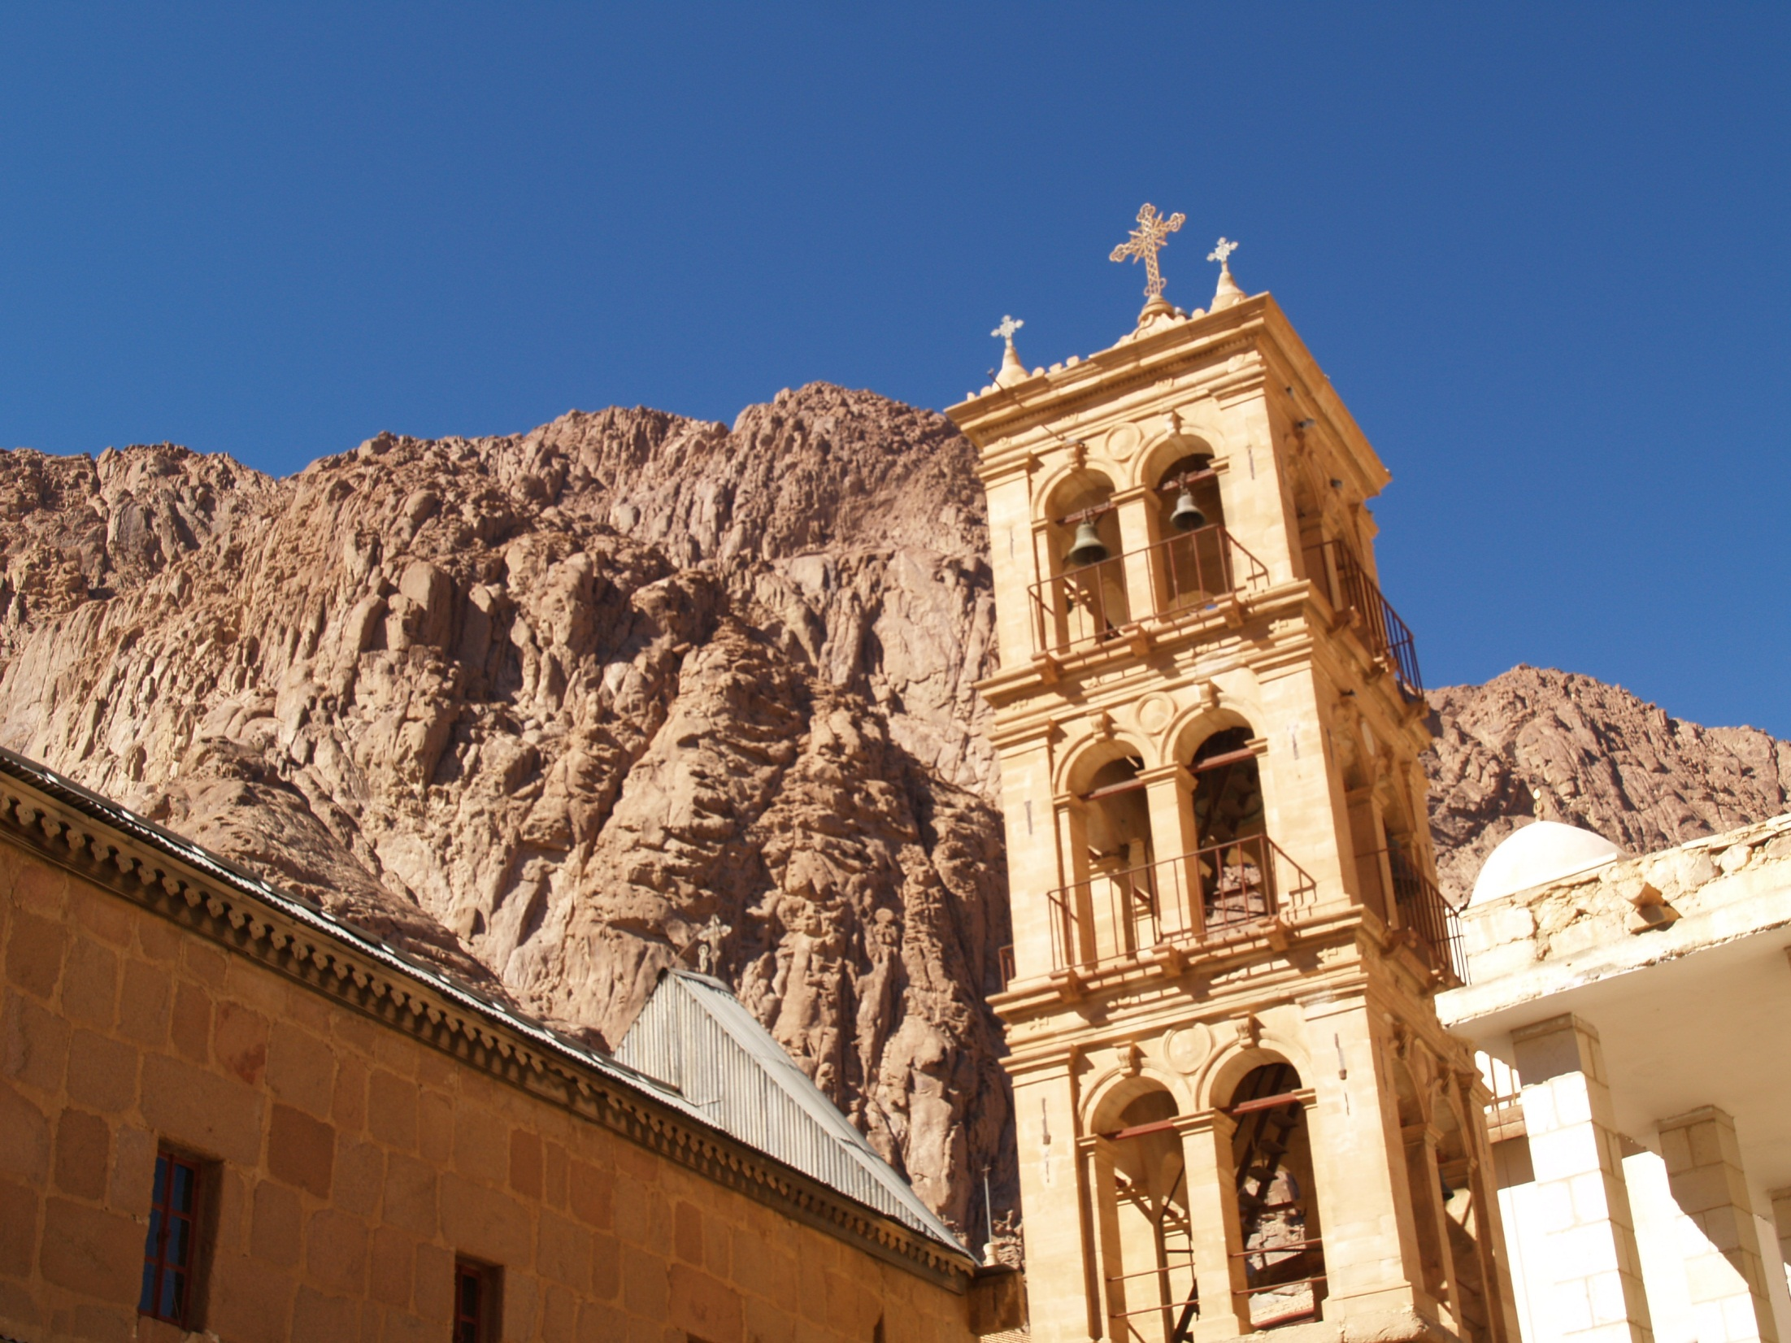
Codex sinaiticus
Discovered in 1844 by
Constantin von Tischendorf
at Monastery of Saint Catherine at the bottom of Mt. Sinai.

Slide 37
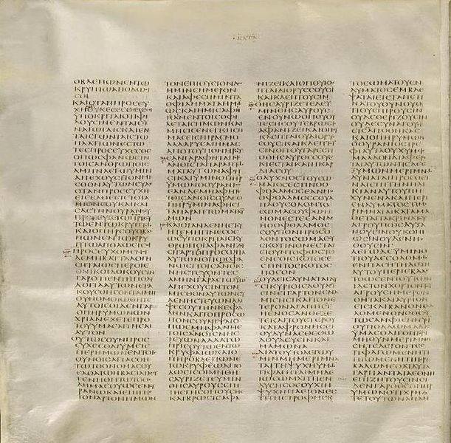
Codex Sinaiticus is an ancient, handwritten copy of the Greek Bible. It is an Alexandrian text-type manuscript written in the 4th century in uncial (capital) letters on parchment (sheep & goat skin).
The Codex Sinaiticus was discovered by Constantin von Tischendorf at the Greek Orthodox Monastery of Mount Sinai (St. Catherine’s Monastery), with further material discovered in the 20th and 21st centuries. Most of the manuscript today resides within the British Library. Since its discovery, study of the Codex Sinaiticus has proven to be extremely useful to scholars for the purposes of biblical translation.
Originally, the Codex contained the whole of both Testaments. Approximately half of the Greek Old Testament (or Septuagint) survived, along with a complete New Testament, plus the Epistle of Barnabas, and portions of The Shepherd of Hermas. Wikipedia.

Slide 38
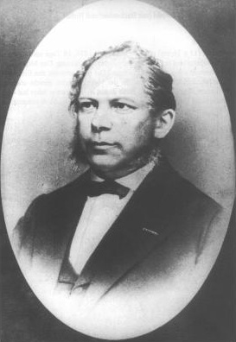
“In 1844, during his first visit to the Monastery of Saint Catherine, Leipzig archaeologist Constantin von Tischendorf claimed that he saw some leaves of parchment in a waste-basket. He said they were "rubbish which was to be destroyed by burning it in the ovens of the monastery",^{[74]} although this is firmly denied by the Monastery. After examination he realized that they were part of the Septuagint, written in an early Greek uncial script. He retrieved from the basket 129 leaves in Greek which he identified as coming from a manuscript of the Septuagint. He asked if he might keep them, but at this point the attitude of the monks changed. They realized how valuable these old leaves were, and Tischendorf was permitted to take only one-third of the whole, i.e. 43 leaves. These leaves contained portions of 1 Chronicles, Jeremiah, Nehemiah, and Esther. After his return they were deposited in the Leipzig University Library, where they still remain.” Wikipedia.

Slide 39
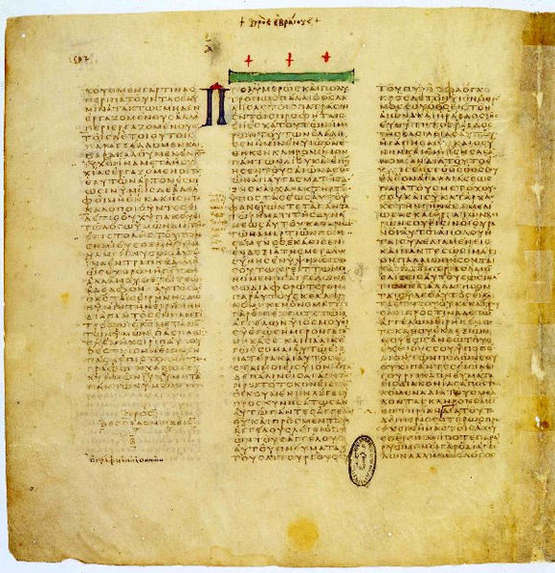
Codex vaticanus
It is written on 759 leaves of vellum in uncial letters, and has been dated palaeographically to the 4th century AD.

Slide 40
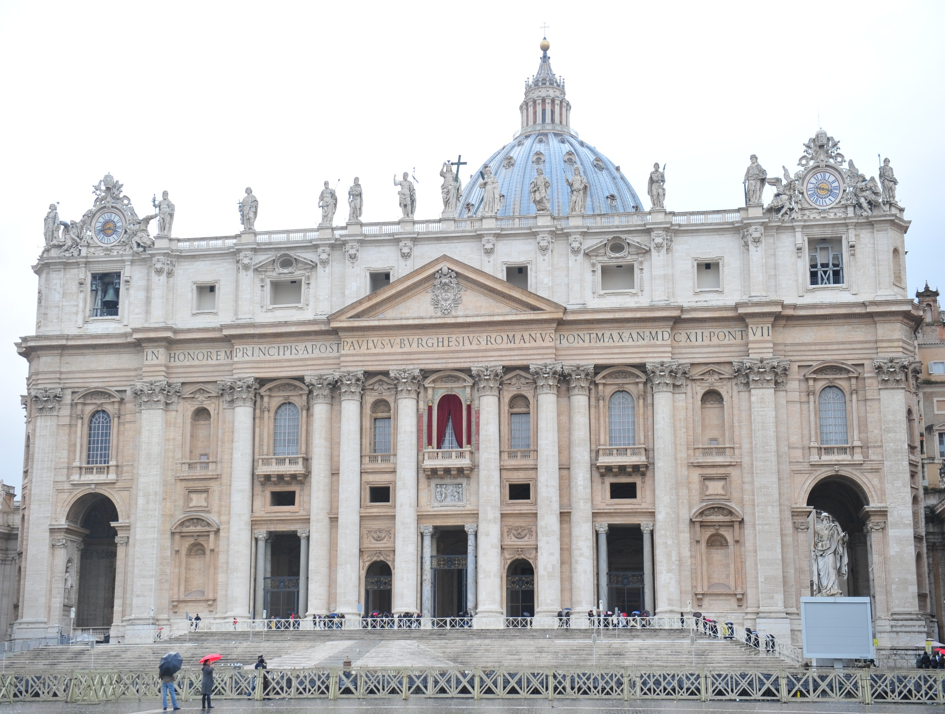
Codex
vaTICANUS
The Codex is named for the residence in the Vatican Library where it has been stored since at least the 15th century.

Slide 41
Codex vaticanus
The manuscript became known to Western scholars as a result of correspondence between Erasmus and the prefects of the Vatican Library. Portions of the codex have been collated by several scholars, but numerous errors were made in the process. The Codex's relationship to the Latin Vulgate was unclear, and scholars initially were unaware of the Codex's value,^{[4]} which changed in the 19th century, when transcriptions of the full codex were completed.^{[1]} At that point scholars realised the text differed from the Vulgate and the Textus Receptus.^{[5]}
Current scholarship considers the Codex Vaticanus to be one of the best Greek texts of the New Testament,^{[3]} with that of the Codex Sinaiticus as its only competitor. Until the discovery by Tischendorf of the Sinaiticus text, the Codex was unrivaled.^{[6]} It was extensively used by Westcott and Hort in their edition of The New Testament in the Original Greek in 1881.^{[3]} The most widely sold editions of the Greek New Testament are largely based on the text of the Codex Vaticanus.^{[7]} Wikipedia.

Slide 42
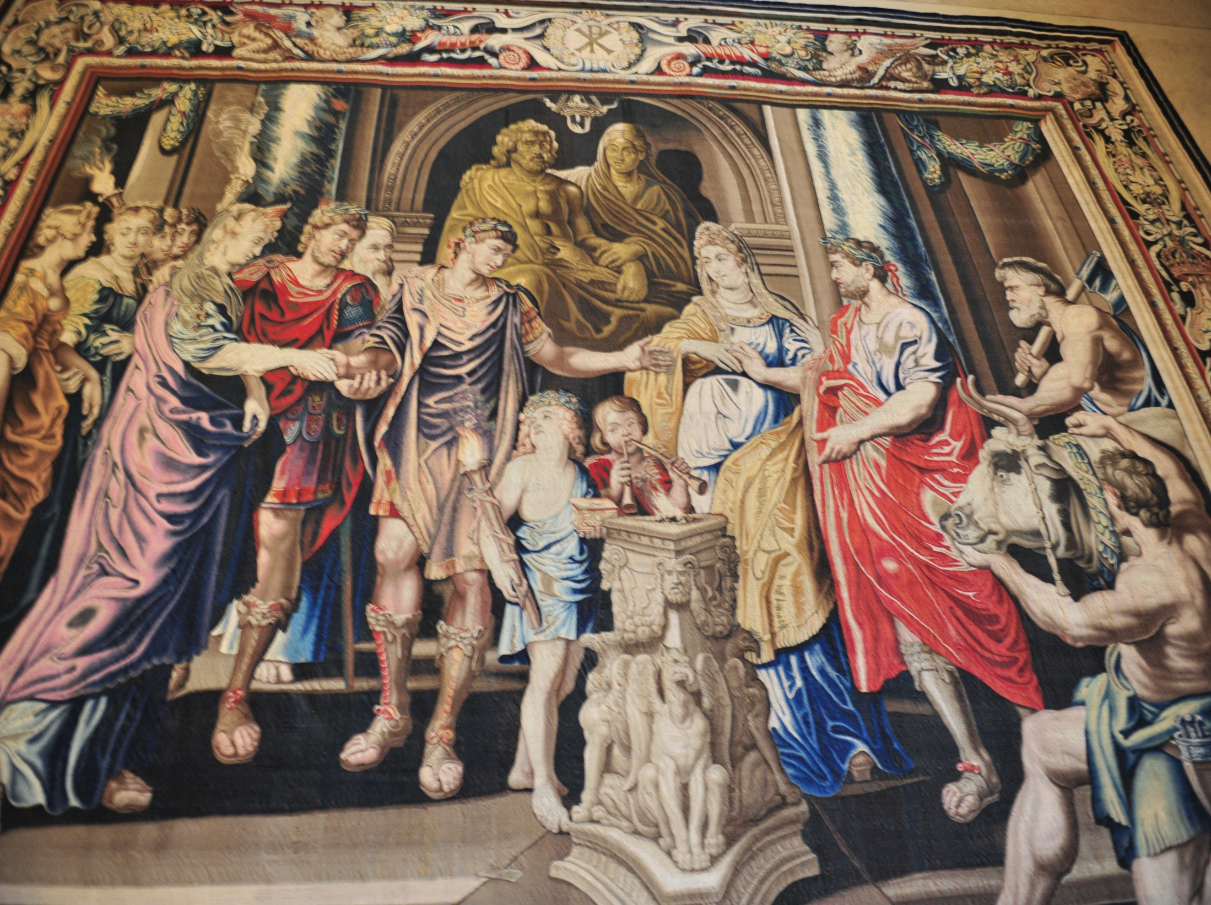
Constantine the great
It has been speculated that Codex Sinaiticus and Codex Vaticanus were part of a project ordered by Emperor Constantine the Great to produce 50 copies of the Bible.

Slide 43

Codex alexandrinus
Codex Alexandrinus was the first of the greater manuscripts to be made accessible to scholars. It is a 5th century manuscript of the Greek Bible,^{[n 1]} containing the majority of the Septuagint and the New Testament.^{[1]} It received the name Alexandrinus from its having been brought by the Eastern Orthodox Patriarch Cyril Lucaris from Alexandria to Constantinople (17th Century).^{[2] Wikipedia}
Egypt

Slide 44
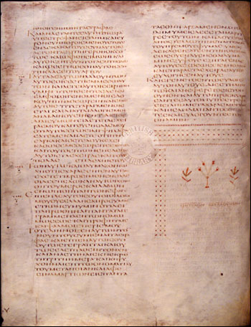
Codex alexandrinus
The codex Alexandrinus contains almost a complete copy of the LXX, including the deuterocanonical books 3 and 4 Maccabees, Psalm 151 and the 14 Odes. The "Epistle to Marcellinus" attributed to Saint Athanasius and the Eusebian summary of the Psalms are inserted before the Book of Psalms. It also contains all of the books of the New Testament, in addition to 1 Clement (lacking 57:7-63) and the homily known as 2 Clement (up to 12:5a). Wikipedia.

Slide 45
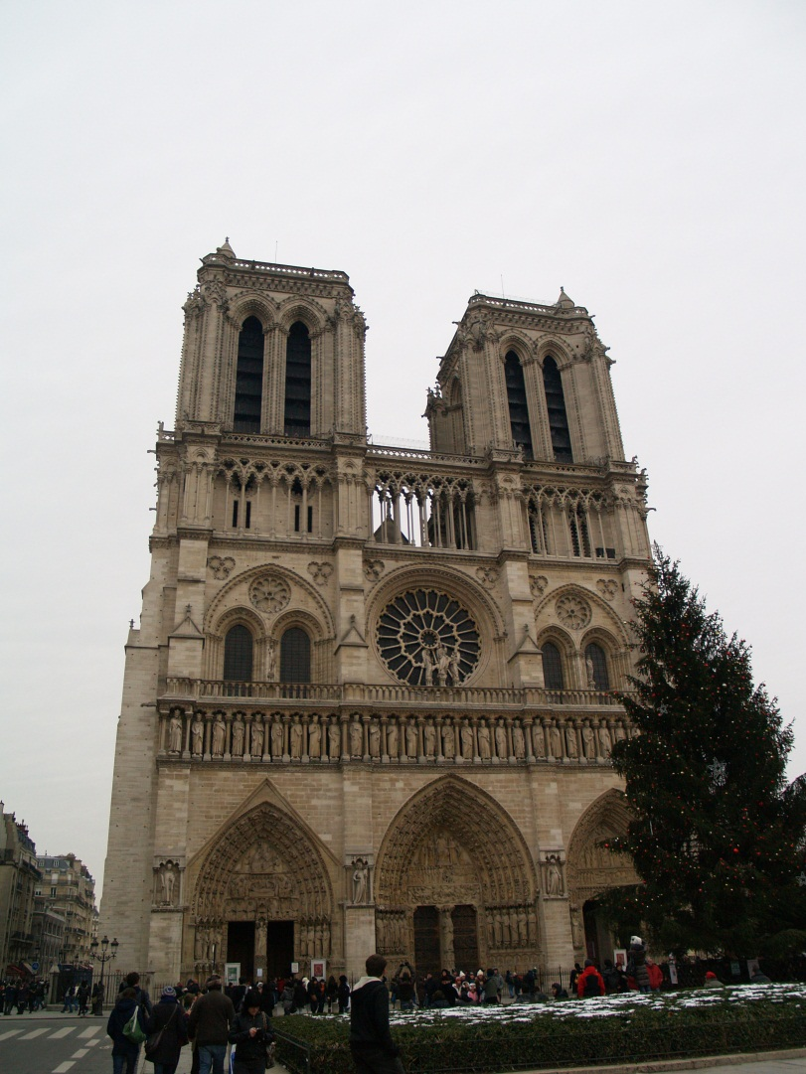
Codex Ephraemi rescriptus
Codex Ephraemi Rescriptus housed in Paris, National Library of France, is an early 5th century Greek manuscript of the Bible, the last in the group of the four great uncial manuscripts of the Greek Bible. The manuscript is lacunose. Originally the whole Bible seems to have been contained in it.
It receives its name, as a codex in which the treatises of Ephraem the Syrian, in Greek translations, were written over ("rescriptus") a former text that had been washed off its vellum pages, thus forming a palimpsest.^{[1]} The later text was produced in the 12th century. The effacement of the original text was incomplete, for beneath the text of Ephraem are the remains of what was once a complete Bible, containing both the Old Testament and the New. Wikipedia
Notre Dame in Paris, France

Slide 46
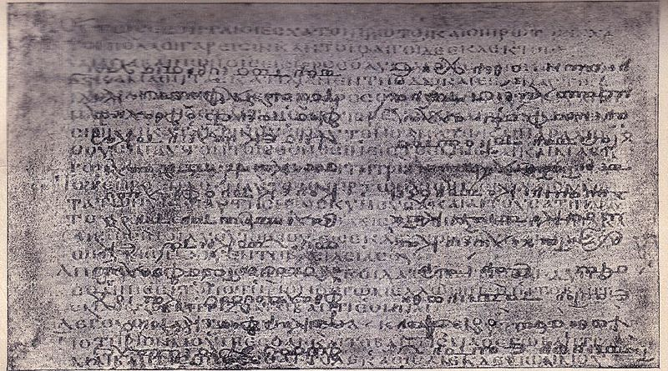
Codex Ephraemi rescriptus
There are only 209 leaves of the Codex surviving, of which 145 belong to the New Testament and 64 to the Old Testament. The text is written in a single column per page, 40-46 lines per page, on parchment leaves. The lower text of the palimpsest was deciphered by Tischendorf in 1840-1841.

Slide 47
Textus receptus
Textus Receptus (Latin: "received text") is the name subsequently given to the succession of printed Greek texts of the New Testament which constituted the translation base for the original German Luther Bible, the translation of the New Testament into English by William Tyndale, the King James Version, and for most other Reformation-era New Testament translations throughout Western and Central Europe. The series originated with the first printed Greek New Testament to be published; a work undertaken in Basel by the Dutch Catholic scholar and humanist Desiderius Erasmus in 1516, on the basis of some six manuscripts, containing between them not quite the whole of the New Testament. The lacking text was translated from Vulgate. Although based mainly on late manuscripts of the Byzantine text-type, Erasmus's edition differed markedly from the classic form of that text. Wikipedia

Slide 48
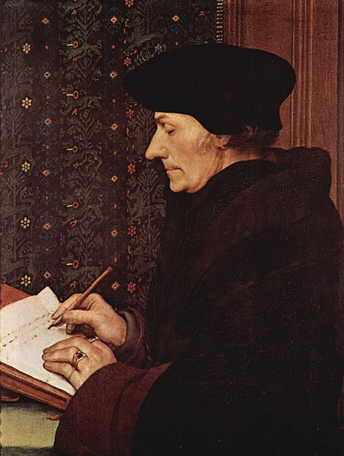
erasmus
Erasmus included the Greek text to prove the superiority of his Latin version. He wrote, "There remains the New Testament translated by me, with the Greek facing, and notes on it by me."^{[3]} He further demonstrated the reason for the inclusion of the Greek text when defending his work: "But one thing the facts cry out, and it can be clear, as they say, even to a blind man, that often through the translator’s clumsiness or inattention the Greek has been wrongly rendered; often the true and genuine reading has been corrupted by ignorant scribes, which we see happen every day, or altered by scribes who are half-taught and half-asleep."^{[4]} Erasmus's new work was published by Froben of Basel in 1516 and thence became the first published Greek New Testament, the Novum Instrumentum omne. Wikipedia

Slide 49
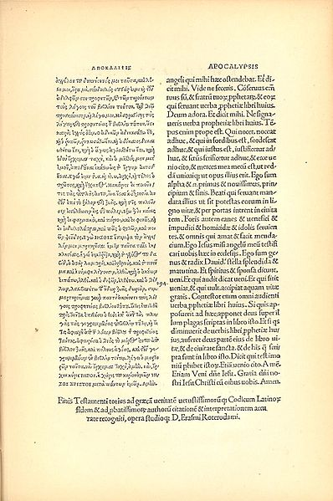
Textus receptus
Typographical errors (attributed to the rush to complete the work) abounded in the (first)published text. Erasmus also lacked a complete copy of the book of Revelation and was forced to translate the last six verses back into Greek from the Latin Vulgate in order to finish his edition. Erasmus adjusted the text in many places to correspond with readings found in the Vulgate, or as quoted in the Church Fathers; consequently, although the Textus Receptus is classified by scholars as a late Byzantine text, it differs in nearly two thousand readings from the standard form of that text-type, as represented by the "Majority Text" of Hodges and Farstad (Wallace 1989). The edition was a sell-out commercial success and was reprinted in 1519, with most—though not all—the typographical errors corrected.^{[6] Wikipedia}
Erasmus Text of the NT, last page.

Slide 50
Textus receptus
The origin of the term "Textus Receptus" comes from the publisher's preface to the 1633 edition produced by Bonaventure and his nephew Abraham Elzevir who were partners in a printing business at Leiden: textum ergo habes, nunc ab omnibus receptum, in quo nihil immulatum aut corruptum damus, translated "so you hold the text, now received by all, in which nothing corrupt." The two words, textum and receptum, were modified from the accusative to the nominative case to render textus receptus. Over time, this term has been retroactively applied to Erasmus' editions, as his work served as the basis of the others.^{[10] Wikipedia}

Slide 51
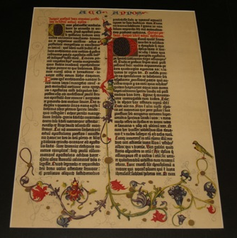
Gutenberg bible
The Gutenberg Bible was the first major book printed with a movable type printing press, marking the start of the "Gutenberg Revolution" and the age of the printed book. Widely praised for its high aesthetic and artistic qualities,^{[1]} the book has an iconic status. It is an edition of the Vulgate, printed by Johannes Gutenberg, in Mainz, Germany, in the 1450s. Only 21 complete copies survive, and they are considered by many sources to be the most valuable books in the world. Wikipedia

Slide 52
English Translations
Of the Bible
John Wycliffe Translation from Latin
William Tyndale Translation from Greek
Geneva Bible with notes
King James Version 1611
NIV

Slide 53
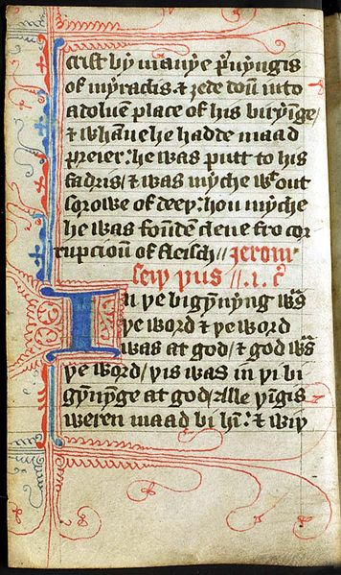
John wycliffe
John Wycliffe is called the “morning star” of the reformation.
Wycliffe's Bible is the name now given to a group of Bible translations into Middle English that were made under the direction of, or at the instigation of, John Wycliffe. They appeared over a period from approximately 1382 to 1395.^{[1]} Long thought to be the work of Wycliffe himself, it is now generally believed that the Wycliffe translations were the work of several hands. The translators worked from the Vulgate, the Latin Bible that was the standard Biblical text of Western Christianity. Wikipedia

Slide 54
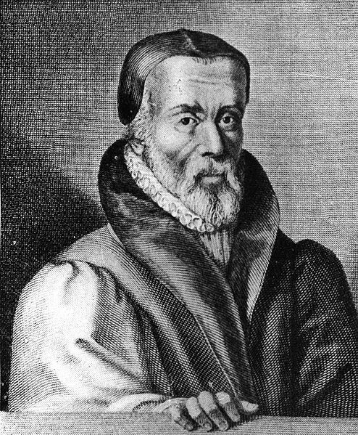
William tyndale
William Tyndale (1494 – 1536) was an English scholar and translator who became a leading figure in the Protestant reformation towards the end of his life. Tyndale was the first to translate considerable parts of the Bible from the original languages (Greek and Hebrew) into English, for a public, lay readership. While a number of partial and complete translations had been made from the seventh century onward, particularly during the 14th century, Tyndale's was the first English translation to draw directly from Hebrew and Greek texts, In 1535, Tyndale was arrested and jailed in the castle of Vilvoorde outside Brussels for over a year. He was tried for heresy, strangled and burnt at the stake in 1536. Wikipedia

Slide 55
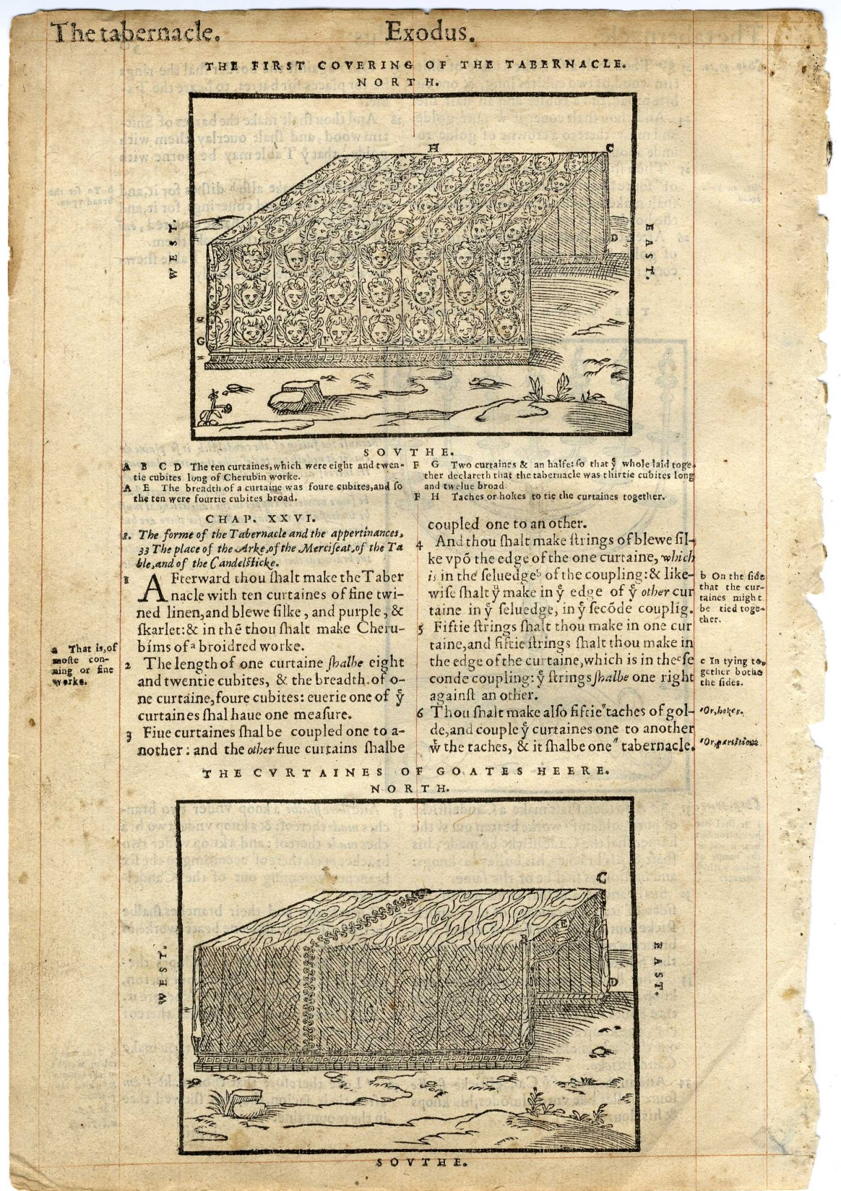
Geneva bible
The Geneva Bible is one of the most historically significant translations of the Bible into the English language, preceding the King James translation by 51 years. It was the primary Bible of the 16th century Protestant movement and was the Bible used by William Shakespeare, Oliver Cromwell, John Milton, John Knox, John Donne, and John Bunyan, author of Pilgrim's Progress.^{[1]} It was one of the Bibles taken to America on the Mayflower, it was used by many English Dissenters. The Geneva Bible remained popular among Puritans and remained in widespread use until after the English Civil War. Wikipedia

Slide 56
Geneva bible
What makes this version of the Holy Bible significant is that, for the very first time, a mechanically printed, mass-produced Bible was made available directly to the general public which came with a variety of scriptural study guides and aids (collectively called an apparatus), which included verse citations which allow the reader to cross-reference one verse with numerous relevant verses in the rest of the Bible, introductions to each book of the Bible which acted to summarize all of the material that each book would cover, maps, tables, woodcut illustrations, indexes, as well as other included features — all of which would eventually lead to the reputation of the Geneva Bible as history's very first study bible. It is best known for its Calvinistic footnotes. The King James Bible was meant to supplant the Geneva Bible and get rid of its Calvinistic notes. More than 80 percent of the language in the Geneva Bible is from Tyndale. Wikipedia

Slide 57
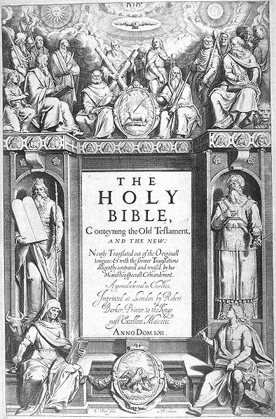
King james version 1611
King James Version is also known as the Authorized Version (AV). First printed by the King's Printer, Robert Barker,^{[4][5]} this was the third such official translation into English; the first having been the Great Bible commissioned by the Church of England in the reign of King Henry VIII, and the second having been the Bishop's Bible of 1568.^{[6]} In January 1604, King James I of England convened the Hampton Court Conference where a new English version was conceived in response to the perceived problems of the earlier translations as detected by the Puritans,^{[7]} a faction within the Church of England.^{[8]}
James gave the translators instructions intended to guarantee that the new version would conform to the ecclesiology and reflect the episcopal structure of the Church of England and its beliefs about an ordained clergy.^{[9]} The translation was done by 47 scholars, all of whom were members of the Church of England.^{[10]} Wikipedia

Slide 58
The 47 independent scholars who created the King James Version of the bible in 1611 drew significantly on Tyndale's translations. One estimation suggests the New Testament in the King James Version is 83% Tyndale's, and the Old Testament 76%.^{[3]} Two editions of the whole Bible are recognized as having been produced in 1611, which may be distinguished by their rendering of Ruth 3:15; the first edition reading "he went into the city", where the second reads "she went into the city.";^{[65]} these are known colloquially as the "He" and "She" Bibles.^{[66]} However, Bibles in all the early editions were made up using sheets originating from several printers, and consequently there is very considerable variation within any one edition. It is only in 1613 that an edition is found,^{[67]} all of whose surviving representatives have substantially the same text.^{[68]}
The original printing was made before English spelling was standardized, and when printers, as a matter of course, expanded and contracted the spelling of the same words in different places, so as to achieve an even column of text.^{[69]} They set v for initial u and v, and u for u and v everywhere else. They used long ſ for non-final s.^{[70]} The glyph j occurs only after i, as in the final letter in a Roman numeral. Punctuation was relatively heavy, and differed from current practice. When space needed to be saved, the printers sometimes used ye for the, (replacing the Middle English thorn with the continental y), set ã for an or am (in the style of scribe's shorthand), and set & for and. On the contrary, on a few occasions, they appear to have inserted these words when they thought a line needed to be padded. Current printings remove most, but not all, of the variant spellings; the punctuation has also been changed, but still varies from current usage norms. Wikipedia

Slide 59
Today’s Translations
3 different ways of translating the text:
Formal equivalence, Literal translation, or Word-for-word translation. One Hebrew, Aramaic, or Greek word is translated into English with one English word. The King James Bible and The New American Standard Bible.
Dynamic equivalence or Thought-for-thought translation. The New International Version.
Paraphrastic or Idiomatic translation. The Living Bible by Kenneth Taylor.
The terms "dynamic equivalence" and "formal equivalence" are associated with the translator Eugene Nida, and were originally coined to describe ways of translating the Bible, but the two approaches are applicable to any translation.

Slide 60
NIV-New International Version
The New International Version is an English translation of the Christian Bible. Published by Zondervan in the United States, it has become one of the most popular modern translations in history.^{[3]} The New International Version project was started after a meeting in 1965 at Trinity Christian College in Palos Heights, Illinois, between the Christian Reformed Church, National Association of Evangelicals, and a group of international scholars.^{[4]} The New York Bible Society (now Biblica) was selected to do the translation. The New Testament was released in 1973 and the full Bible in 1978. It underwent a minor revision in 1984 and another revision in 2011.^{[5][6]} The manuscript base for the Old Testament was the Biblia Hebraica Stuttgartensia Masoretic Hebrew Text. The manuscript base of the NIV was the Koine Greek language editions of the United Bible Societies and of Nestle-Aland for the New Testament.^{[8]} The translation is a balance between word-for-word and thought-for-thought.^{[12][13][7]} Recent archaeological and linguistic discoveries helped in understanding traditionally difficult passages to translate. Familiar spellings of traditional translations were generally retained.^{[14] Wikipedia}

Slide 61
Textual criticism
Lower Criticism or Textual Criticism does not mean one hates the text, but it is a technical term. Textual Criticism is the weighing of the evidence for the most likely textual reading. Since the translation of the KJV many ancient manuscripts have been found. The most important has been the Dead Sea Scrolls. Some thought this would prove how different the Bible was, but it showed how accurately it had been preserved. Even in the Dead Sea Scrolls and other ancient manuscripts there are textual differences that must be looked at.

Slide 62
Textual troubles
There are four main groups of common causes of textual corruption.
First there are changes that expand the text.
Secondly, there are changes the shorten the text.
Thirdly, there are changes that do not add or shorten the text.
Finally, there are deliberate changes in the text.

Slide 63
Additions to the text
Let us look at reasons for the expansion of the text. (1) Simple additions to the text usually to explain it. This may be done for clarity or emphasis. For example in Joshua 9:24 lk, meaning "all" is added to the text. (2) Dittography which means "double writing." This is seen in Jeremiah 51:3 (draw 2x), and Ezekiel 48:16 (five 2x). The KJV omits these doubles, but leaves the one in Leviticus 20:10. (3) Glosses which are like an explanatory note. One example of a gloss is with obscure or ambiguous place-names like "On" in Jeremiah 43:13 in the LXX. The city of Dan mentioned in Genesis 14:14 must be a gloss. Some cities are just updated with their new name. (4) Explicitation is making the implicit explicit which expands the text. In Genesis 29:25 the LXX adds "Jacob" to show who is speaking. (5) Conflation is the combination of two or (rarely) more readings. This is seen in 2 Samuel 22: 38-9 and 43 when the MT is compared to 4QSama and the LXX.

Slide 64
Shortening the text
Secondly, let us look at reasons for the shortening of the text. (1) Haplography which means "single writing" when it should be repeated (Judges 20:13). (2) Parablepsis meaning "oversight" is when a scribe skips over part of the text. An example is Judges 16:13-14 when MT is compared to the LXX. (3) Homoioarkton which means "like beginning" is when a similar beginning of words is skipped over (Genesis 31:18). (4) Homeioteleuton which means "like ending" is when a similar ending is skipped over. An example is in Genesis 4:8 and Leviticus 15:3.

Slide 65
Other changes
Thirdly, let us look at the reasons for changes in the text that do not change the length of the text. (1) Letters are confused. Since some Hebrew words look very similar, it is easy to confuse them like h for j and d for r (Genesis 10:4). (2) Misdivision of the words sometimes occurs Genesis 49:19-20. (3) Metathesis which is the switching of letters occurs (Leviticus 3:7). (4) Modernization of grammar, spelling and pronunciation occurs. In Isaiah 24:23 the LXX understood different spelling for the same Hebrew words moon/brick and sun/wall.. (5) Prosaizing is when the scribe changes the poetry to prose (Psalm 31:22). (6) Interpretative errors occur with misdivision of verses and misvocalization (Isaiah 7:11).

Slide 66
Deliberate changes
Lastly, let us look at the reasons for deliberate changes. (1) A scribe deliberately changes one or more letters to disguise the text. In I Samuel 3:13 Eli’s sons blaspheme "for themselves" rather than the LXX blaspheme "God" which is too dishonorable. (2) Euphemistic insertions to avoid dishonor (2 Samuel 12:9). (3) Euphemistic substitutions (2 Samuel 2:8). (4) Harmonizing the text (Genesis 2:2). (5) Suppressed readings (I Samuel 13:1). These are some of the things that can happen to a text (for more examples see McCarter 1986).

Slide 67
Key Debates
Do I use older manuscripts or majority texts? For example, should I use the older Dead Sea Scroll manuscripts, or the later Codex Leningradensis. Should I use the older Codex Vaticanus, or the later Byzantine texts? It is best to decide on a case by case basis. Usually the older text reading is preferred.
King James Only! Some believe that you should only use the inspired King James Version. All other versions are corrupt, but this ignores the evidence of better ancient manuscripts.
Do I use literal or dynamic translations? NIV has a good balance of both.

Slide 68
Key Texts
The key texts for the Old Testament are the Biblia Hebraica Stuttgartensia Masoretic Hebrew Text and the Aleppo Text.
The key texts for the New Testament are the Koine Greek language editions of the United Bible Societies and of Nestle-Aland for the New Testament.

Slide 69

references
The Text of the Old Testament by Ernst Wurthwein
The Text of the New Testament: Its Transmission, Corruption, and Restoration by Bruce Metzger and Bart Ehrman.
The English Bible, from KJV to NIV: A History and Evaluation by Jack Lewis

Slide 70
Thank you for taking the course in Bibliology & Textual History
Institute for Biblical & Scientific Studies
www.bibleandscience.com
By
Dr. Stephen Meyers

