Slide 1
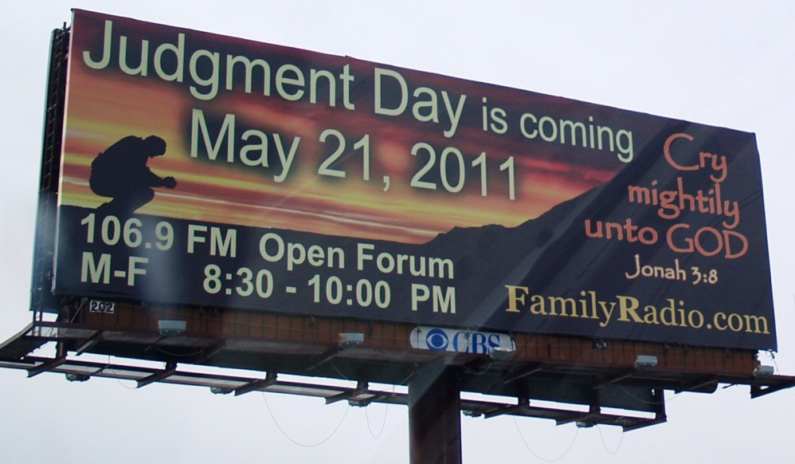
Cults
Institute for Biblical & Scientific Studies
www.bibleandscience.com
By
Dr. Stephen Meyers

Slide 2
Cults
Introduction
Mormons
Quiz
Resources

Slide 3
4 Main Kinds of cults
Religious Cults
Unification Church
Jehovah Witnesses
Political Cults
Lyndon LaRouche
The Aryan Nation
Psychotherapy/educational Cults
Key Insights
Peak experience
Commercial Cults
Pyramid style organization
Promise big money but fleece their victums

Slide 4
Cult Recruitment
Meeting a number of sincere committed members is more attractive than any doctrine.
There are three main approaches: by friend, or relative; by a stranger who befriends them, or cult-sponsored event.
Most are approached at a vulnerable time of stress in their lives.
Most are college age students.
Cults avoid recruiting people that will burden them.
When joining a cult the first few weeks or months you are treated as royalty.
Cult members spend most of their time recruiting more people, fundraising, or public relations projects.

Slide 5
Mind Control
Mind control is not brainwashing which is coercive, but subtle and sophisticated. The perpetrators are regarded as friends or peers so the person is less defensive.
The person gives them private information that will later be used against them.
Mind control uses hypnotic processes combined with group dynamics to create indoctrination.
There are behavior modification techniques, group conformity, and obedience to authority.

Slide 6
Cognitive dissonance theory
Leon Festinger’s Cognitive Dissonance Theory
“If you change a person’s behavior, this thoughts, and feelings will change to minimize the dissonance” (conflict or contradictions).
In 1956 Festinger wrote, When Prophecy Fails, about a flying saucer cult whose leader predicted the end of the world. Followers sold their homes, gave away their money, and waited on a mountain side for flying saucers to pick them up. When nothing happened, most members became more convinced than ever. The leader proclaimed that the aliens saw their faithful vigil and decided to spare the earth from destruction. Members became more committed to the leader after they took a dramatic public stand that resulted in public humiliation.

Slide 7
4 Parts of Mind control
Behavior Control
You must ask permission from leaders to do almost anything.
Almost everything is regulated; what you wear, what you eat.
There is an authoritarian chain of command.
Thought Control
Everything is absolute; either right or wrong, black or white, us vs. them.
Their doctrine has all the answers.
The outside world is evil. Thought-stopping rituals are used (chanting).
The problem is with you, not the leader.
Emotional Control
Guilt is the single most important emotional lever, then fear.
No negative emotions. Never criticize the leader. Blame yourself.
Leader controls relationships, who to talk to, or who to marry.
Confession of past sins, rarely results in forgiveness and is not forgotten.
Information Control
Minimal access to newspapers, TV, and radio.
Not allowed to talk critically.
Members are to spy on each other, and report improper activities.

Slide 8
3 steps to Mind Control
Unfreezing
Breaking a person down. Sleep deprivation is the most common.
Contradictory information. Doubt self, defer to the leader, or group.
Example: the more you try to understand, the less you will understand.
No time or privacy to think for yourself.
Changing
New identity, new behavior, new thoughts, and new emotions.
Repetition is key. Material is repeated over and over again.
Group psychology; sharing sessions, confession of sins.
Spiritual experience like a word of knowledge, or speaking in tongues.
Study and pray to know God’s will which is to follow the leader.
Refreezing
Key is modeling: A new member is paired with an older member.
New member must proselytize.
Nothing firms one’s beliefs faster than trying to sell them to others.

Slide 9
Cult Psychology
Their Doctrine is the truth, it’s perfect. Everyone else is wrong.
Everything is black or white, right or wrong, good vs. evil,
spiritual vs. physical.
Elitist mentality: you are a member of an elite group,
(chosen to save the world).
Group will over Individual will.
Strict obedience to the Leader.
Find happiness through good performance.
Manipulation through Guilt and fear. Any problem is your fault.
Emotional highs and lows like a roller-coaster ride.
Changes in time orientation. Members past is rewritten (evil).
End of world is near. They will be rewarded soon so be faithful.
When a prophesy fails, a new date is set.
No way out. No way to leave the group.

Slide 10
Cult leader
Many of today’s cult leaders were themselves once victims of a mind control cult.
Some cult leaders have an inferiority complex and some antisocial personality.
Most cult leaders want attention and power.
Most actually believe their own propaganda, like the world will end in 1994. Some think they are the messiah, or God.
Many leaders have questionable background and lifestyle.
Cult leader is in absolute control. Power tends to corrupt, and absolute power corrupts absolutely.
Cult leaders manipulate through their interpretation of the Bible and what is God’s will for them.

Slide 11
Helping a cult member
Build rapport and trust with them. Be their friend.
Avoid sending money, especially cash. It will be turned over to the cult.
It is better to send clothes, pictures, books, and homemade cookies.
Collect valuable information, how far into the group is he.
Communicate as regularly as possible.
Remember the good times before he was in the cult.
Don’t send unsolicited critical information. This does more harm than good.
It is better to make one point thoroughly than the shotgun approach.
Be sure to follow up.

Slide 12
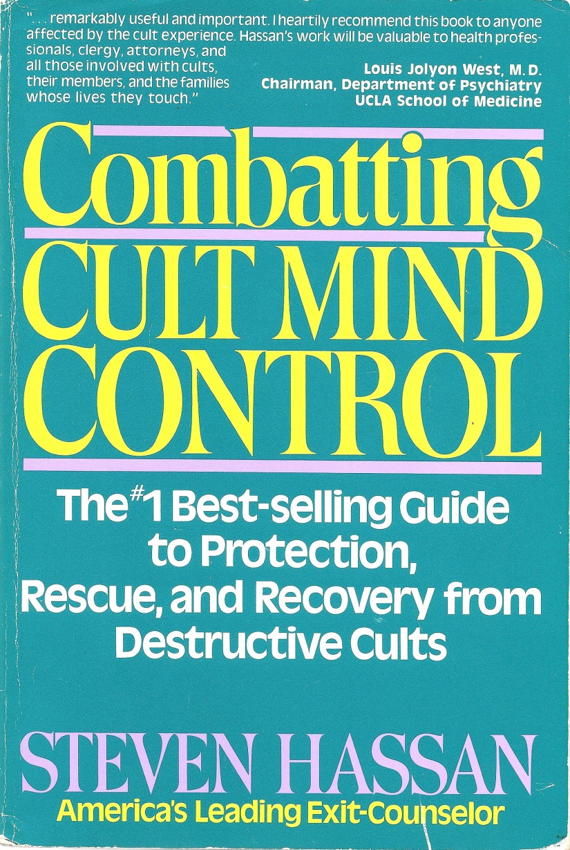
More Information
Most of what was say in this introduction can be found in more detail in the book, Combatting Cult Mind Control by Steven Hassan. There is much helpful information and stories in this book.

Slide 13
Religious Cults
Similarities
Many Cults start out with the sincere desire to study the Bible.
Many Cults start out by then setting a date for the end of the world, or for Christ’s coming.
--The Jehovah Witnesses say it was 1914.
--The Seventh day Adventists say 1845.
--Harold Camping says 2011.
Many of the cult leaders are not very well educated in the Bible, yet claim they know when the end of the world is. Joseph Smith had a third grade education.
Many of the cult leaders seem to have psychological problems. They see and hear things others don’t. They can’t see when they are wrong.

Slide 14
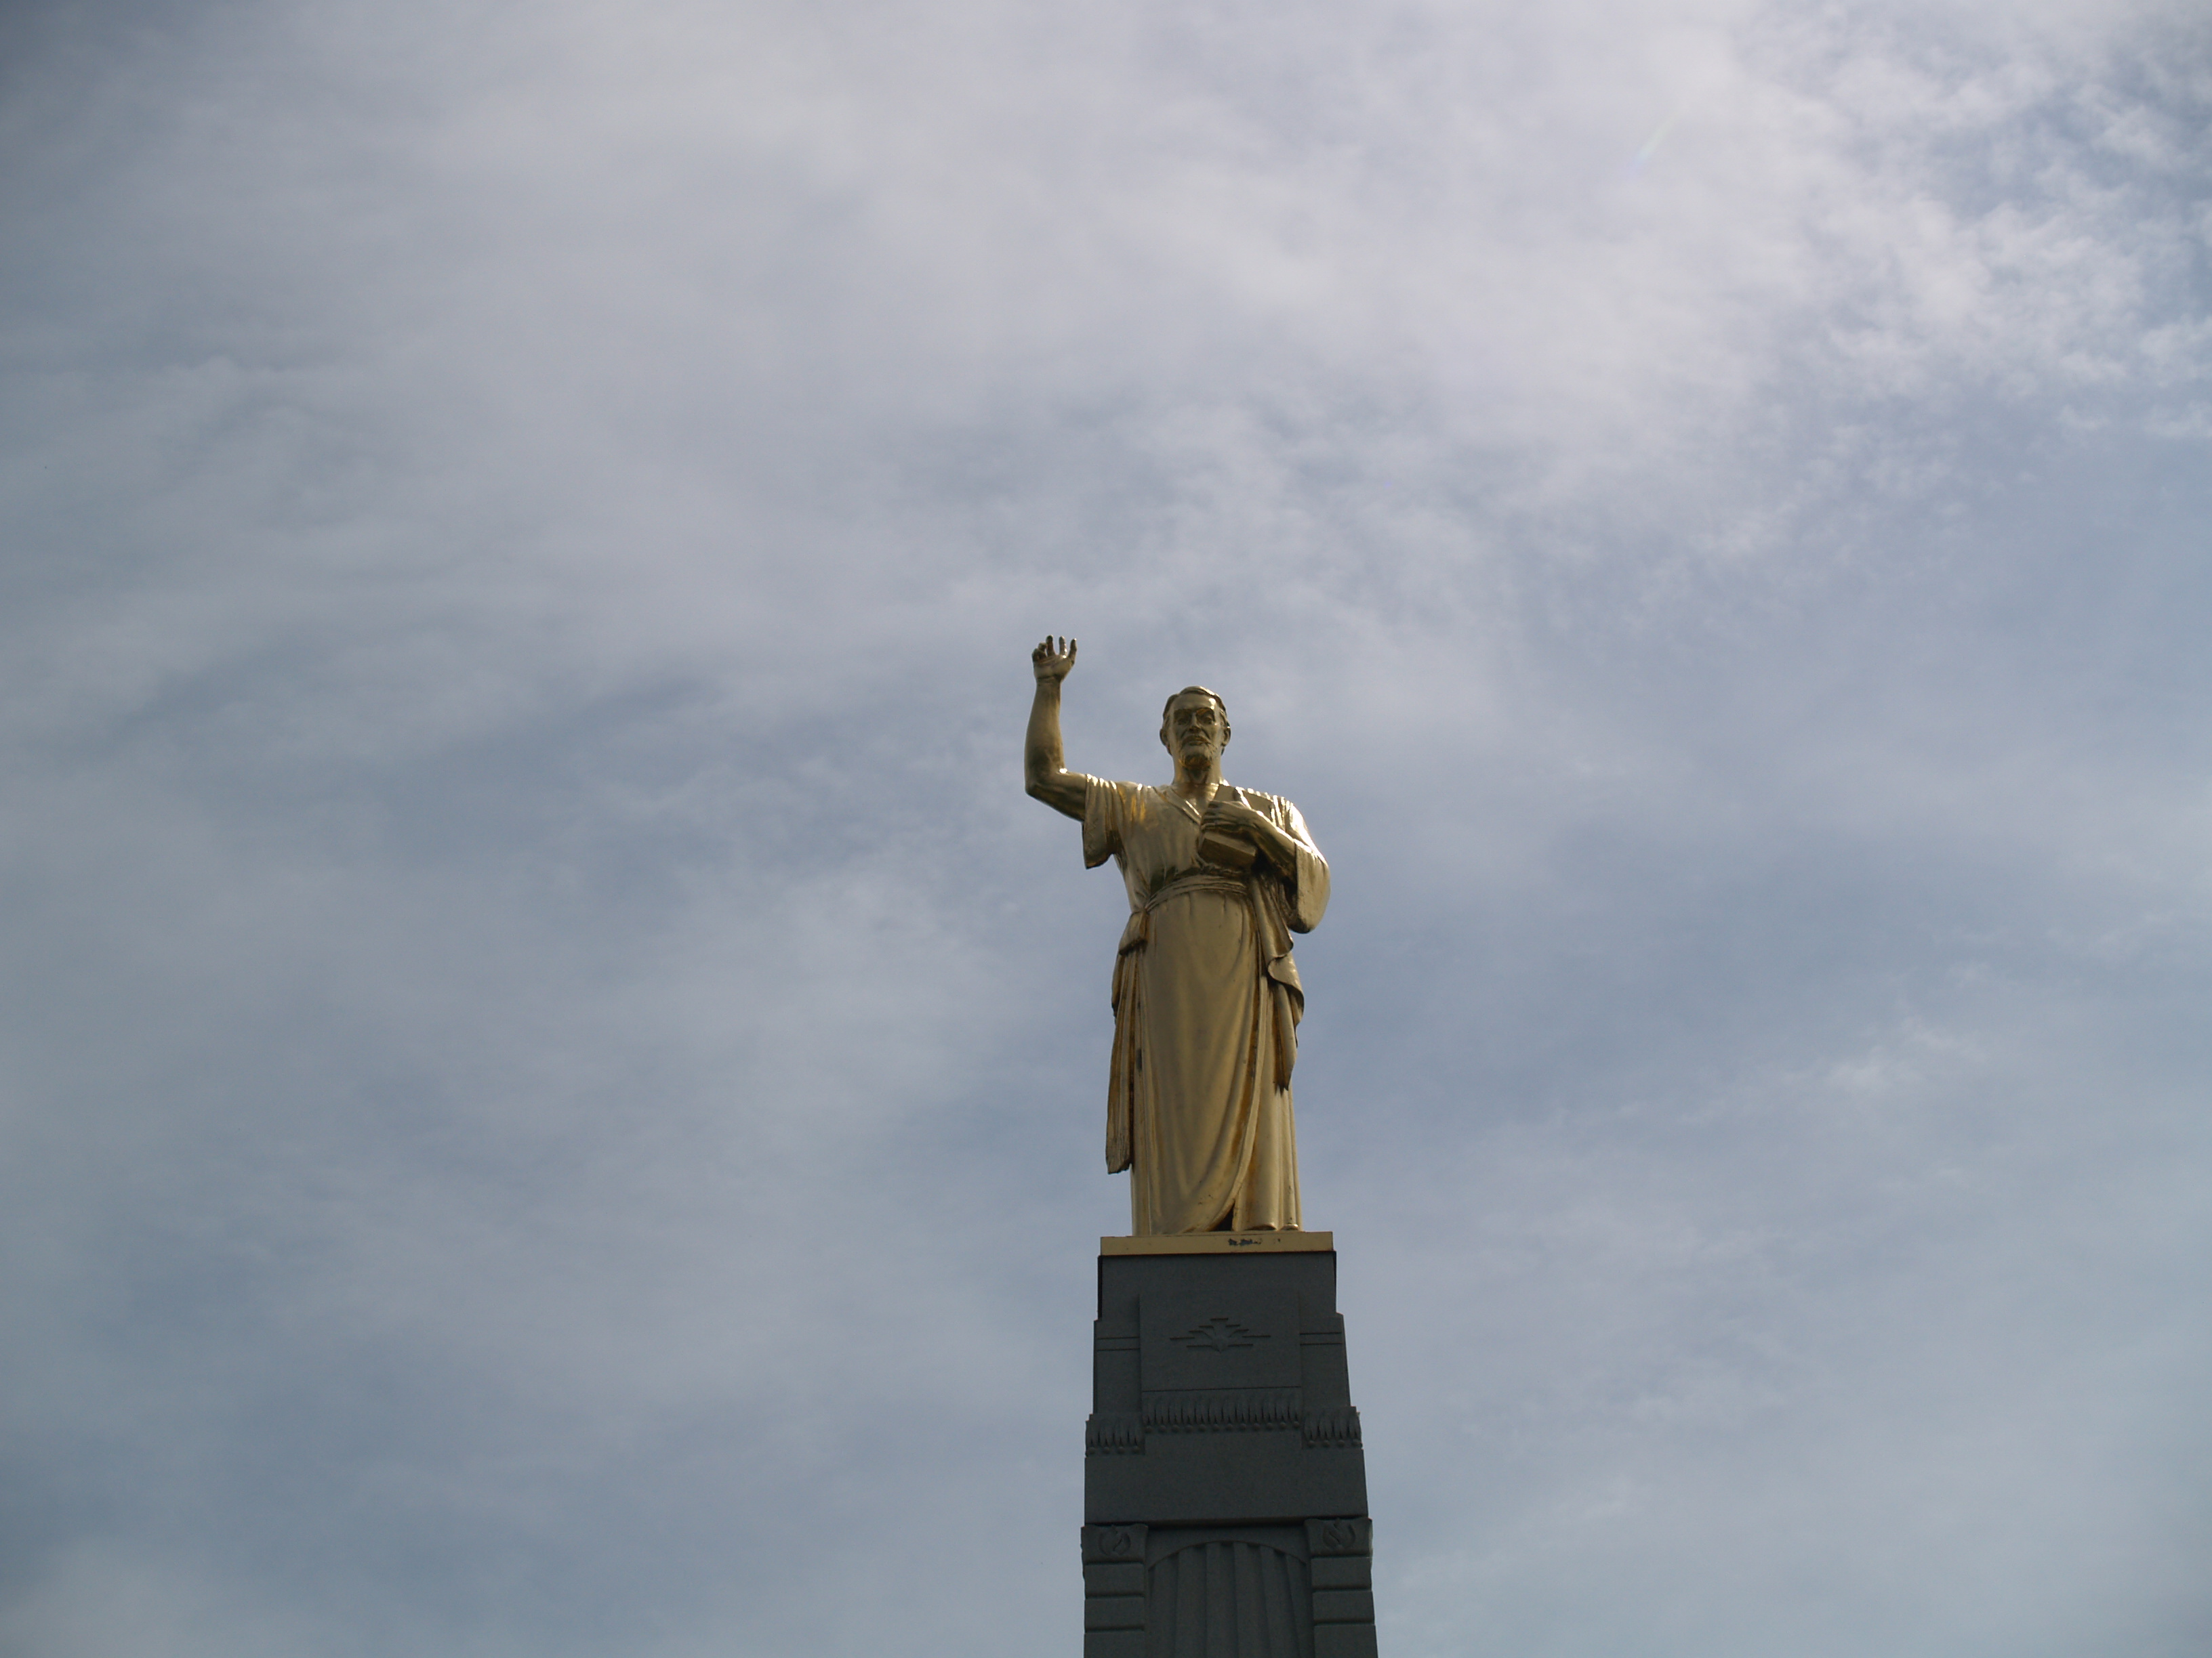
Mormonism

Slide 15
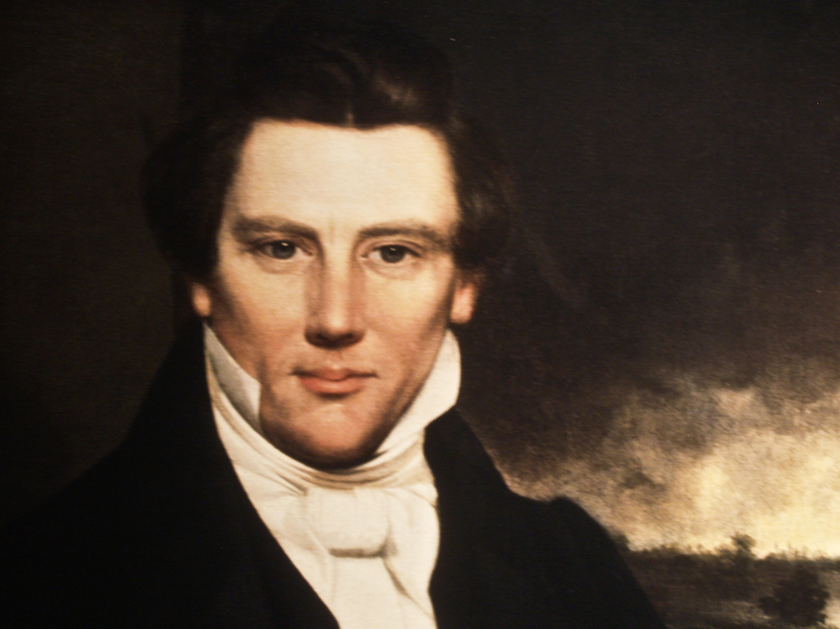
Who was Joseph Smith?

Slide 16
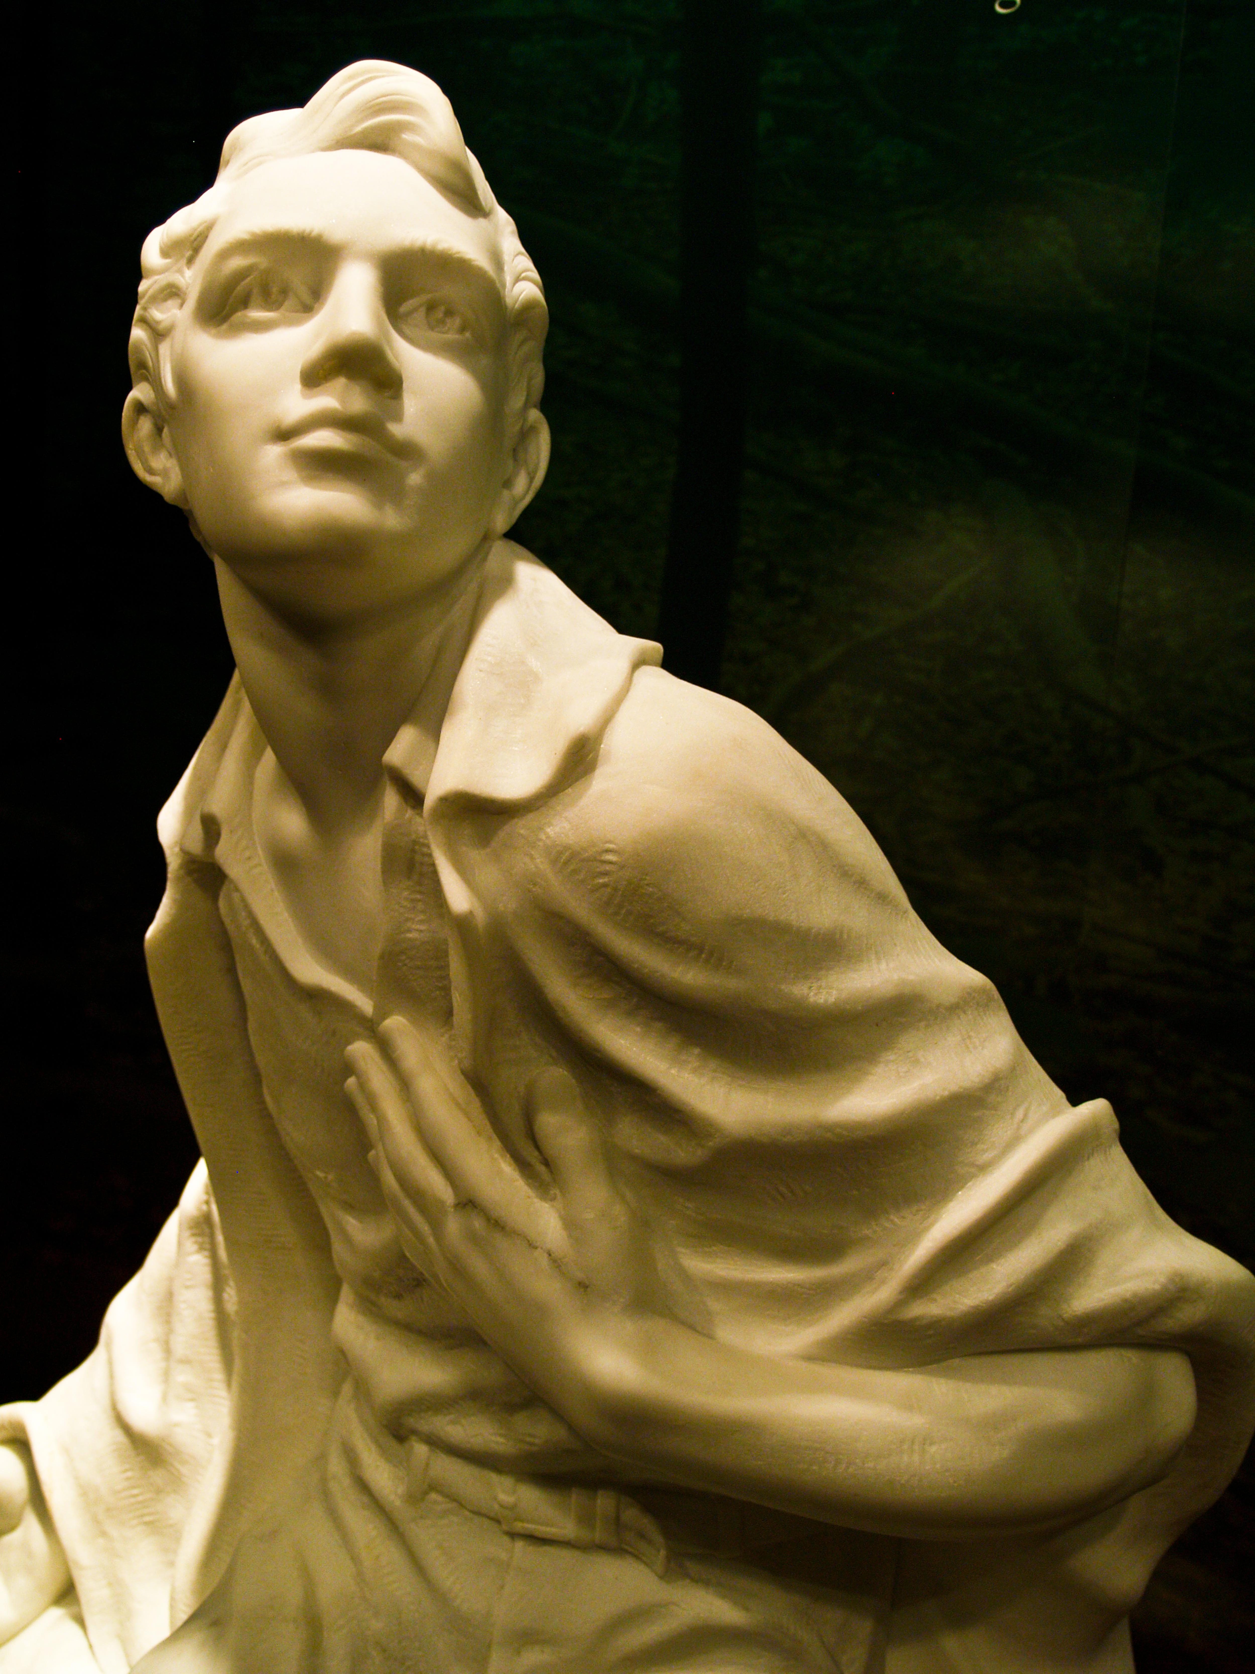
Joseph Smith Jr.
Early Life
-Born on December 23, 1805 in Sharon, Vermont.
-He was raised around Palmyra, New York.
-is known as Joseph Smith Jr.
-grew up in a large family whose parents were influenced by the Second Great Awakening.
-had up to a third grade education.
-his family was undecided about what church to join, none felt right.
-in the 1820’s Smith was paid to search for buried treasure with a seer stone.

Slide 17
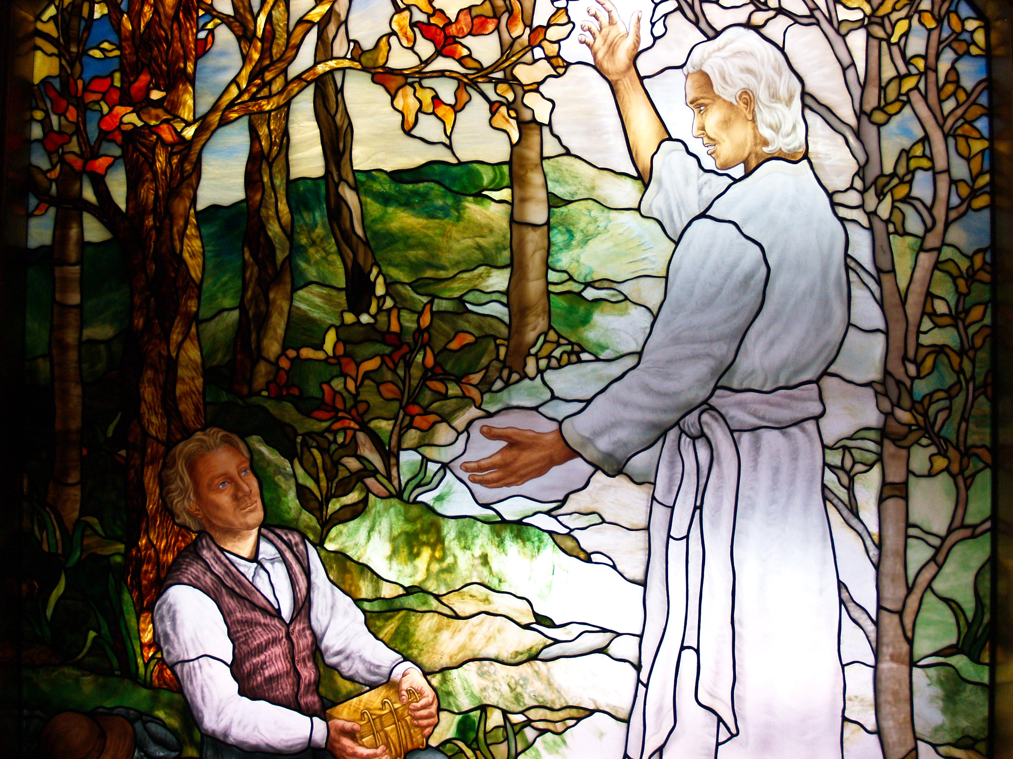
Joseph Smith Jr.
Revelation
-when Smith was 17 he was told by the Angel Moroni that golden plates were underneath a rock on the Hill Cumorah. He also discovered Urim and Thummim as well as a breast plate.
-Joseph Smith was told by God to not join any church and that the bible was corrupt.
-he claimed to be a prophet.

Slide 18

Sacred Grove where Joseph Smith prayed, and God told him not to join any church.

Slide 19

Log House where the angel Moroni appeared to Joseph Smith in 1823 telling him where the golden plates were buried.

Slide 20

Hill of Cumorah
Palmyria, NY
Hill where the Golden Plates were supposedly found by Joseph Smith. At first the Angel Moroni prevented him from taking the Golden plates until four years later with his wife Emma he was allowed to dig them up.

Slide 21
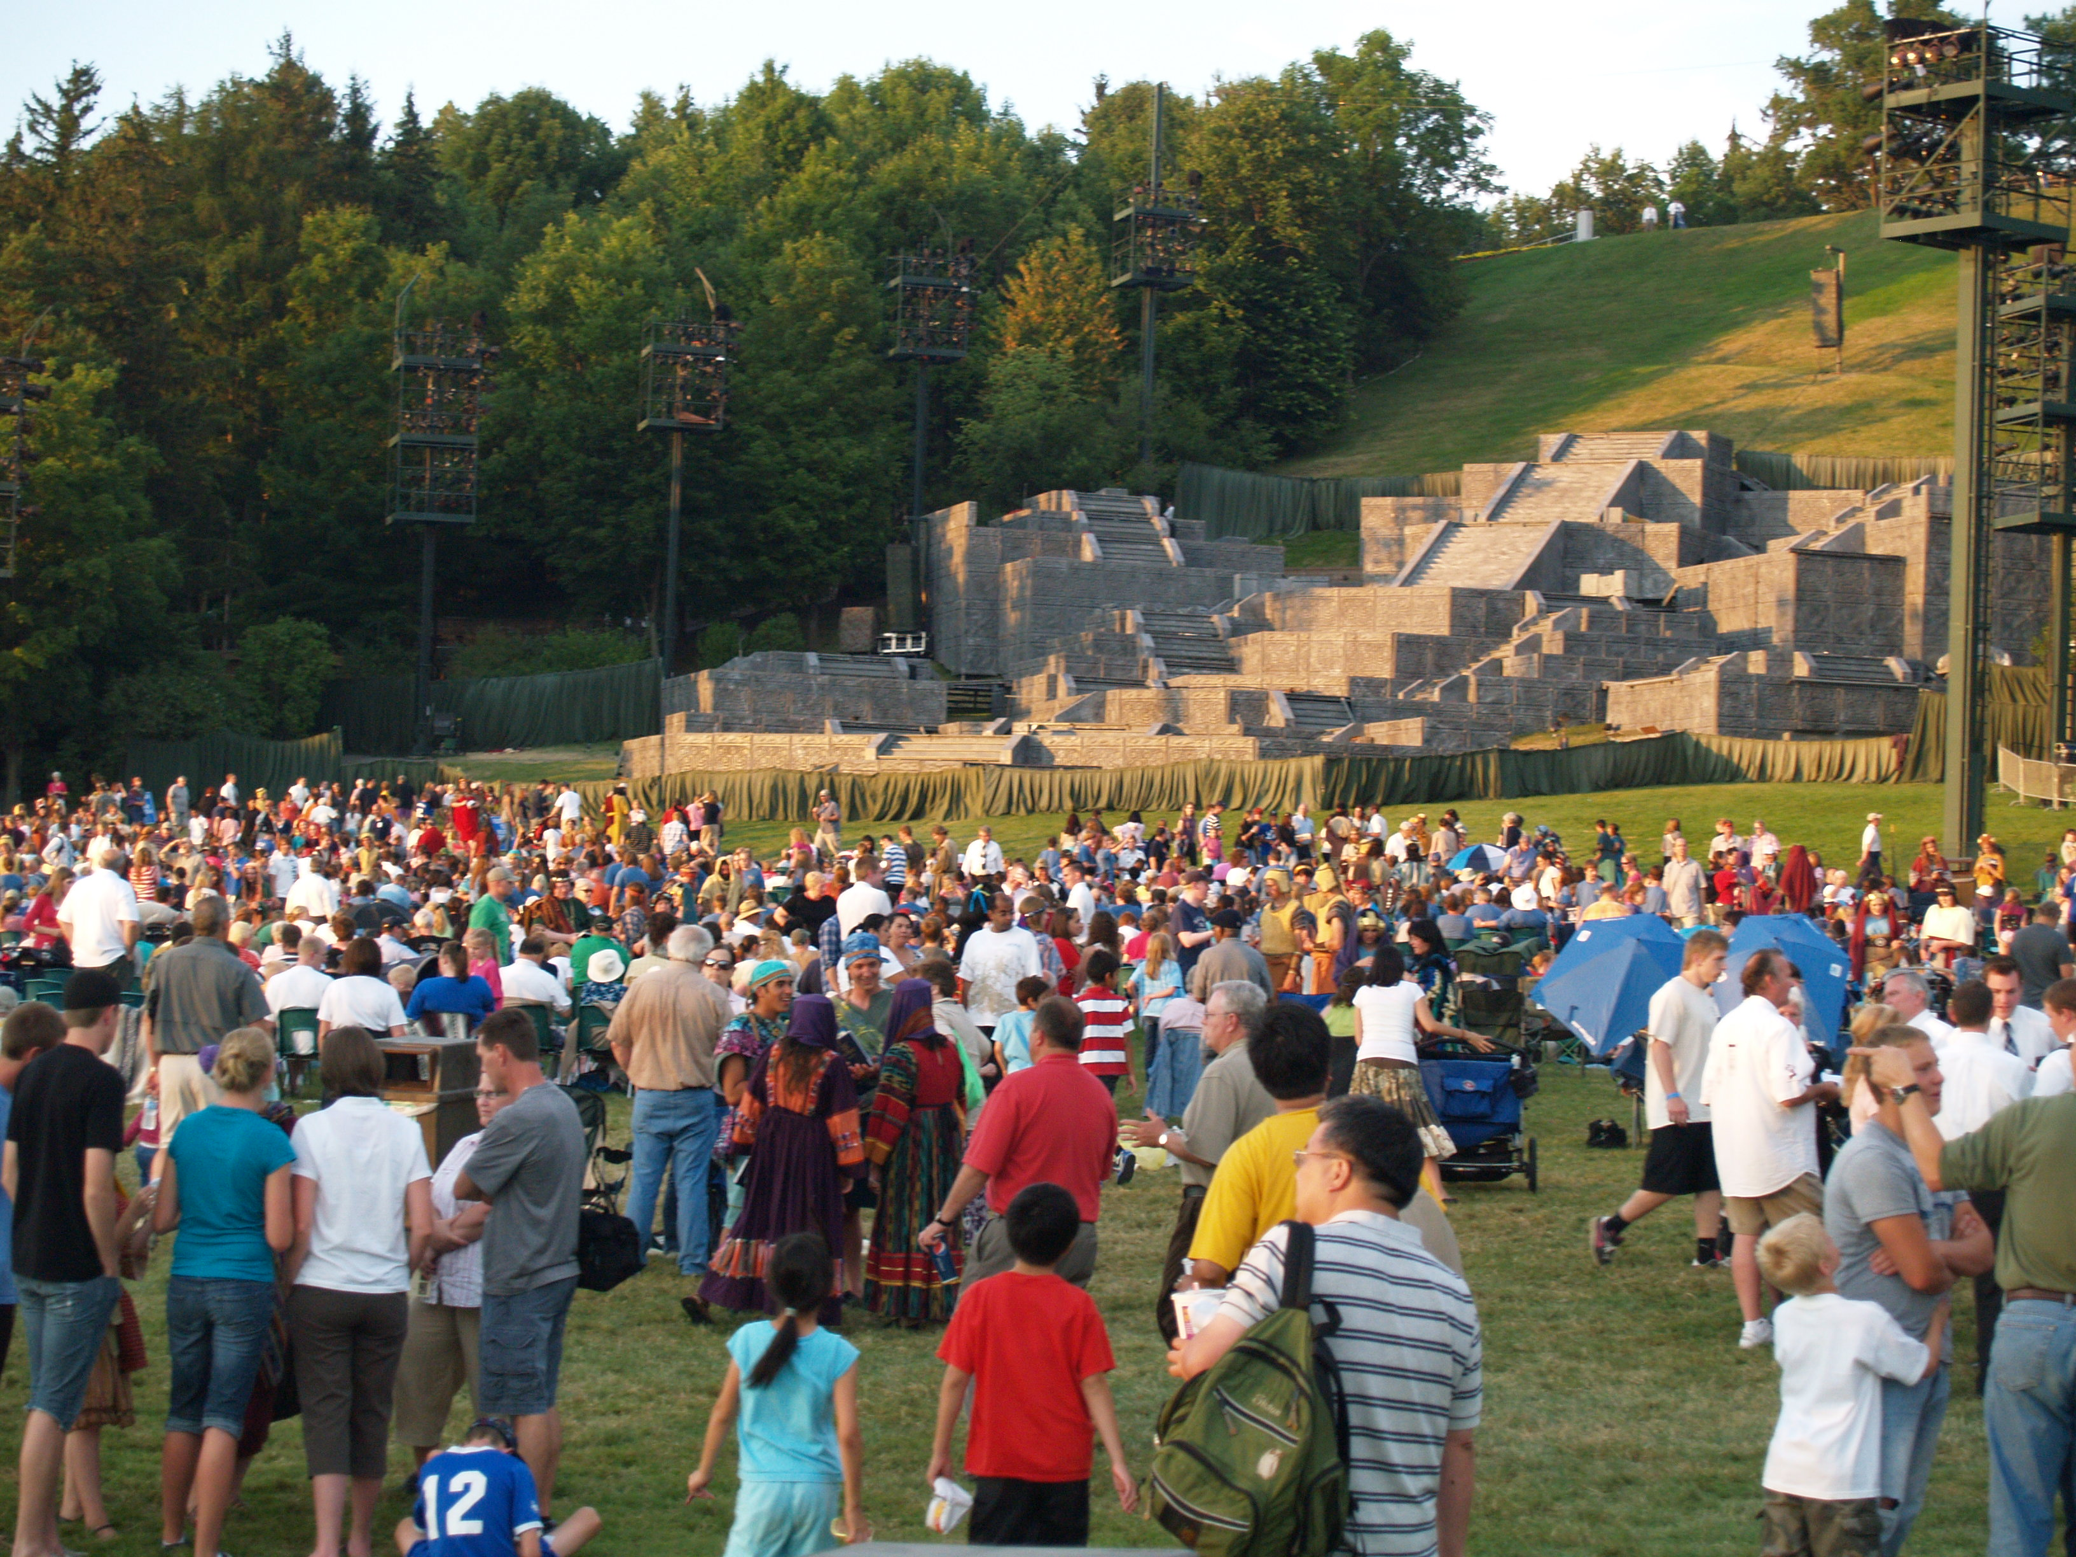
Today a large pageant play is put on at the bottom of the Hill of Cumorah, Palmyria, NY every July.

Slide 22
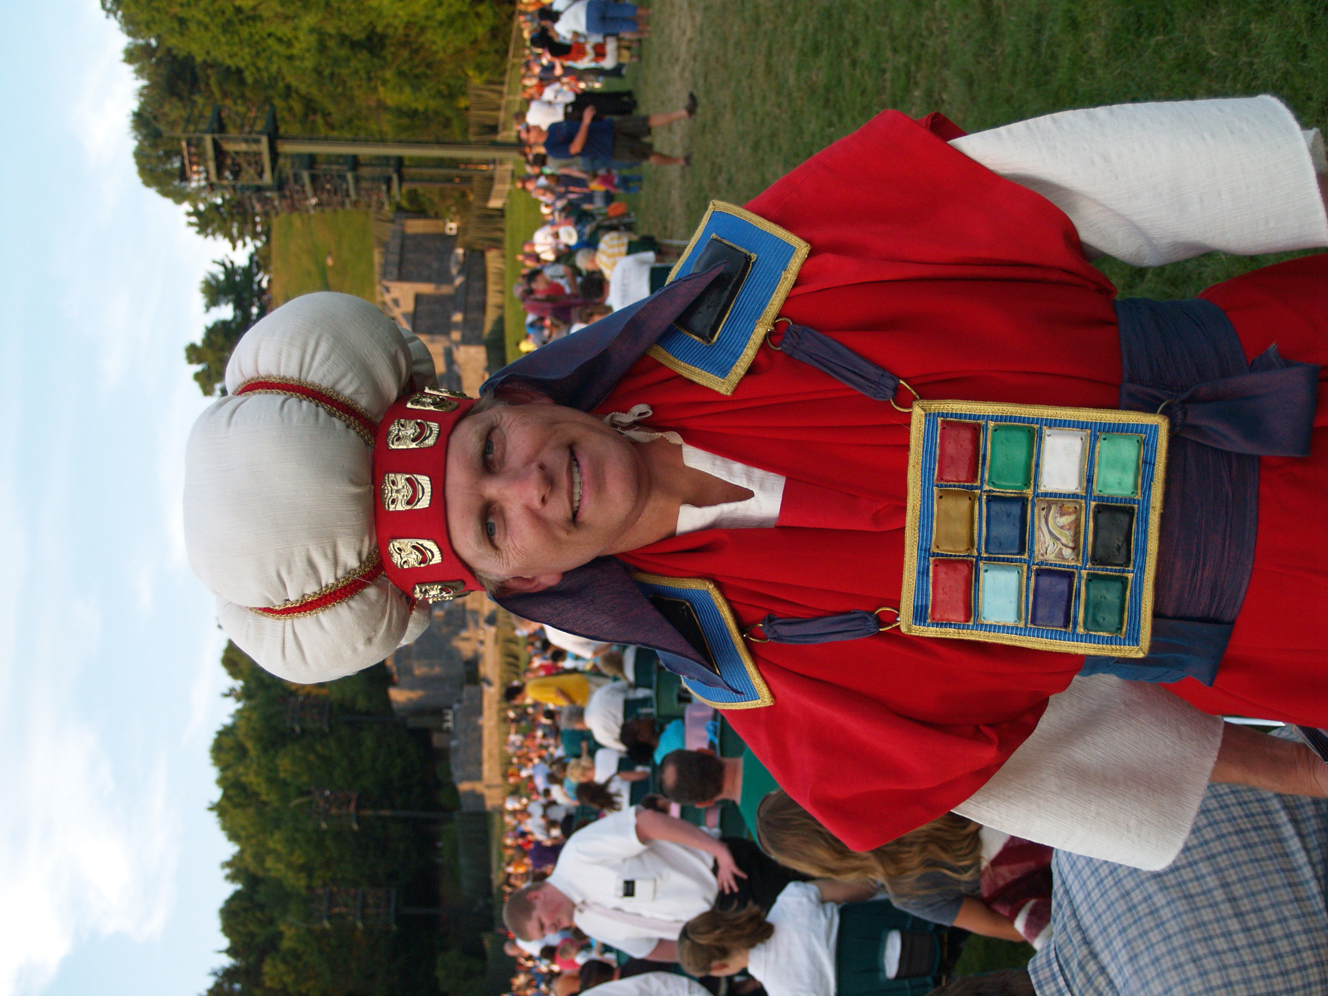
Joseph Smith allegedly found a breastplate and the Urim & Thummim at the Hill of Cumorah. Smith used the Urim & Thummim to translate part of the golden plates.

Slide 23
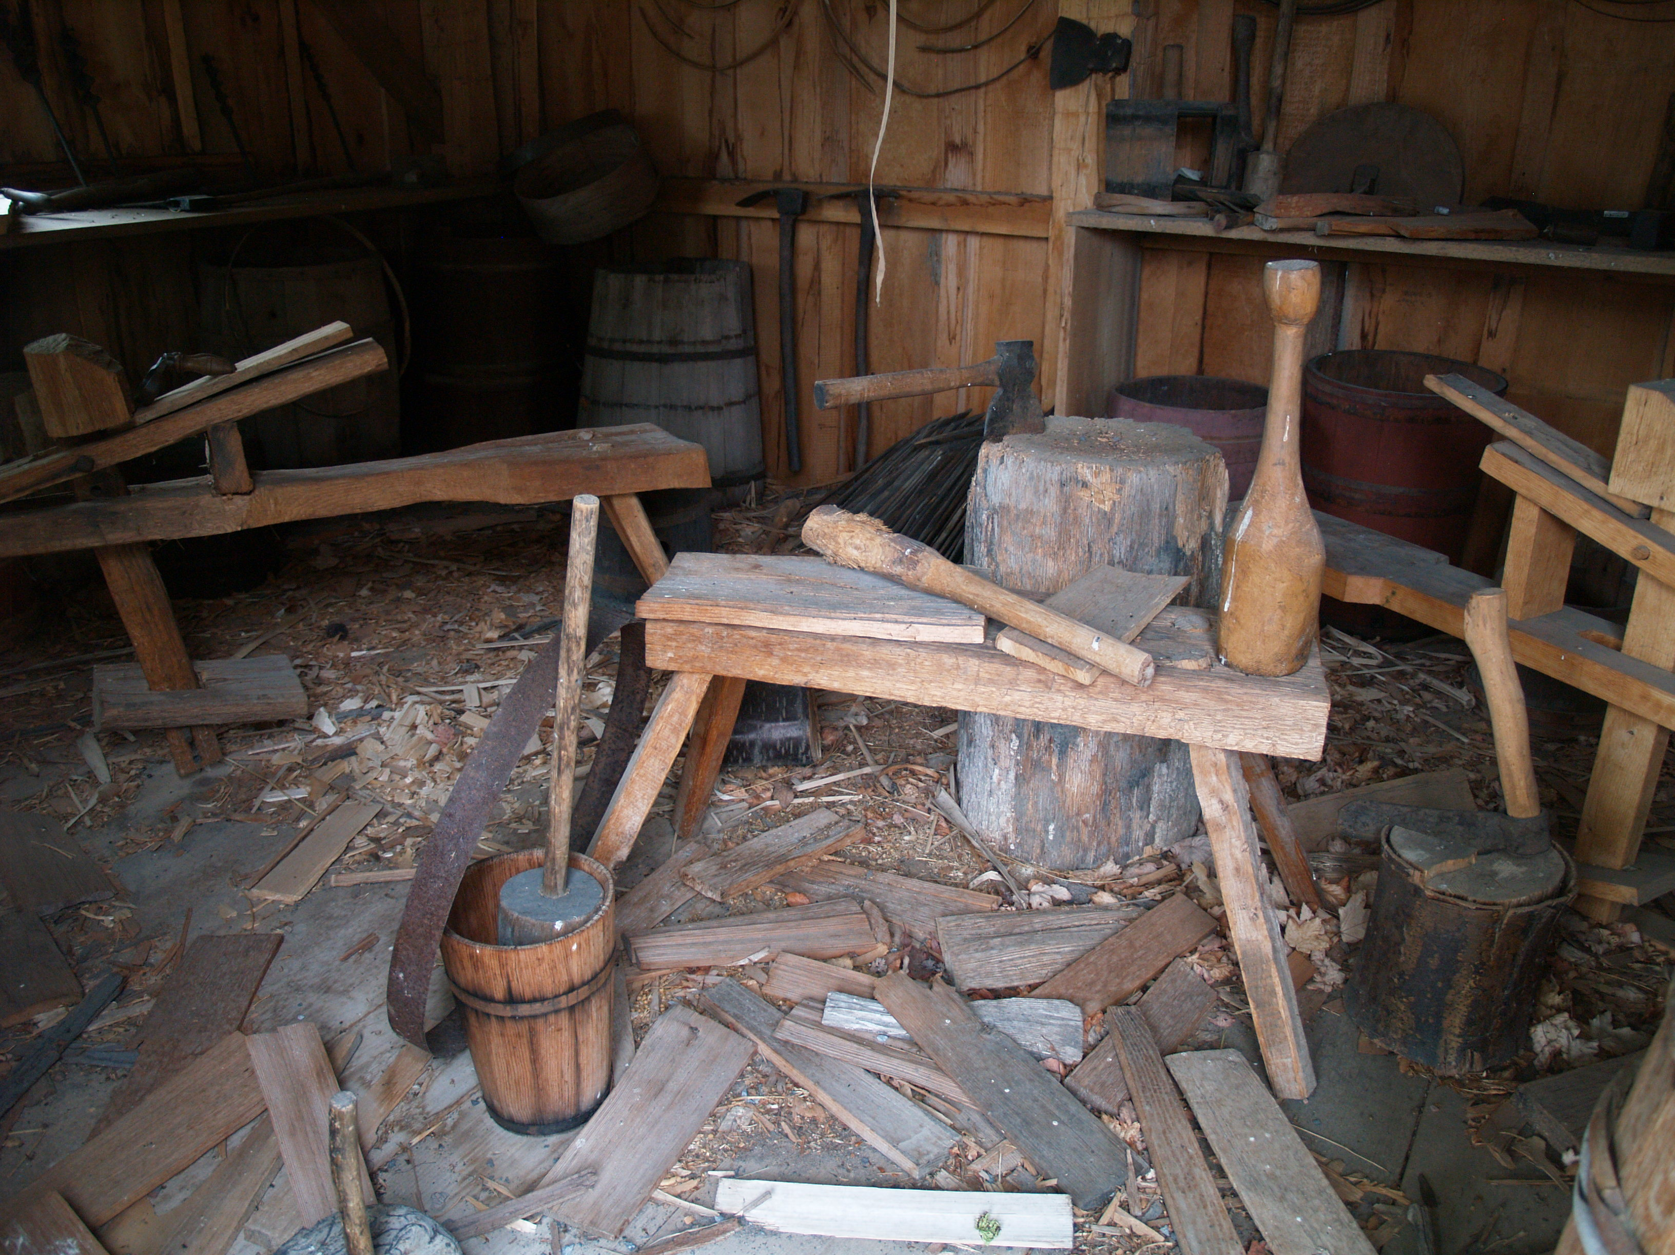
Joseph Smith says he hid the Golden plates in the cooper shop in a barrel.

Slide 24
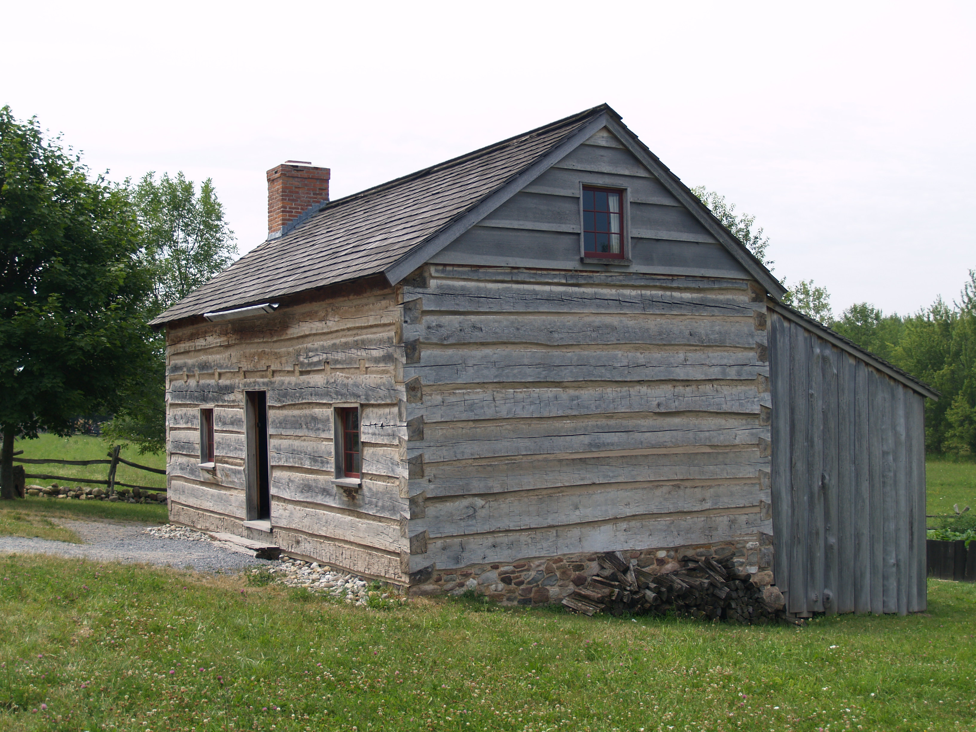
Later Joseph Smith hid the golden plates under the floor boards of the log house.

Slide 25
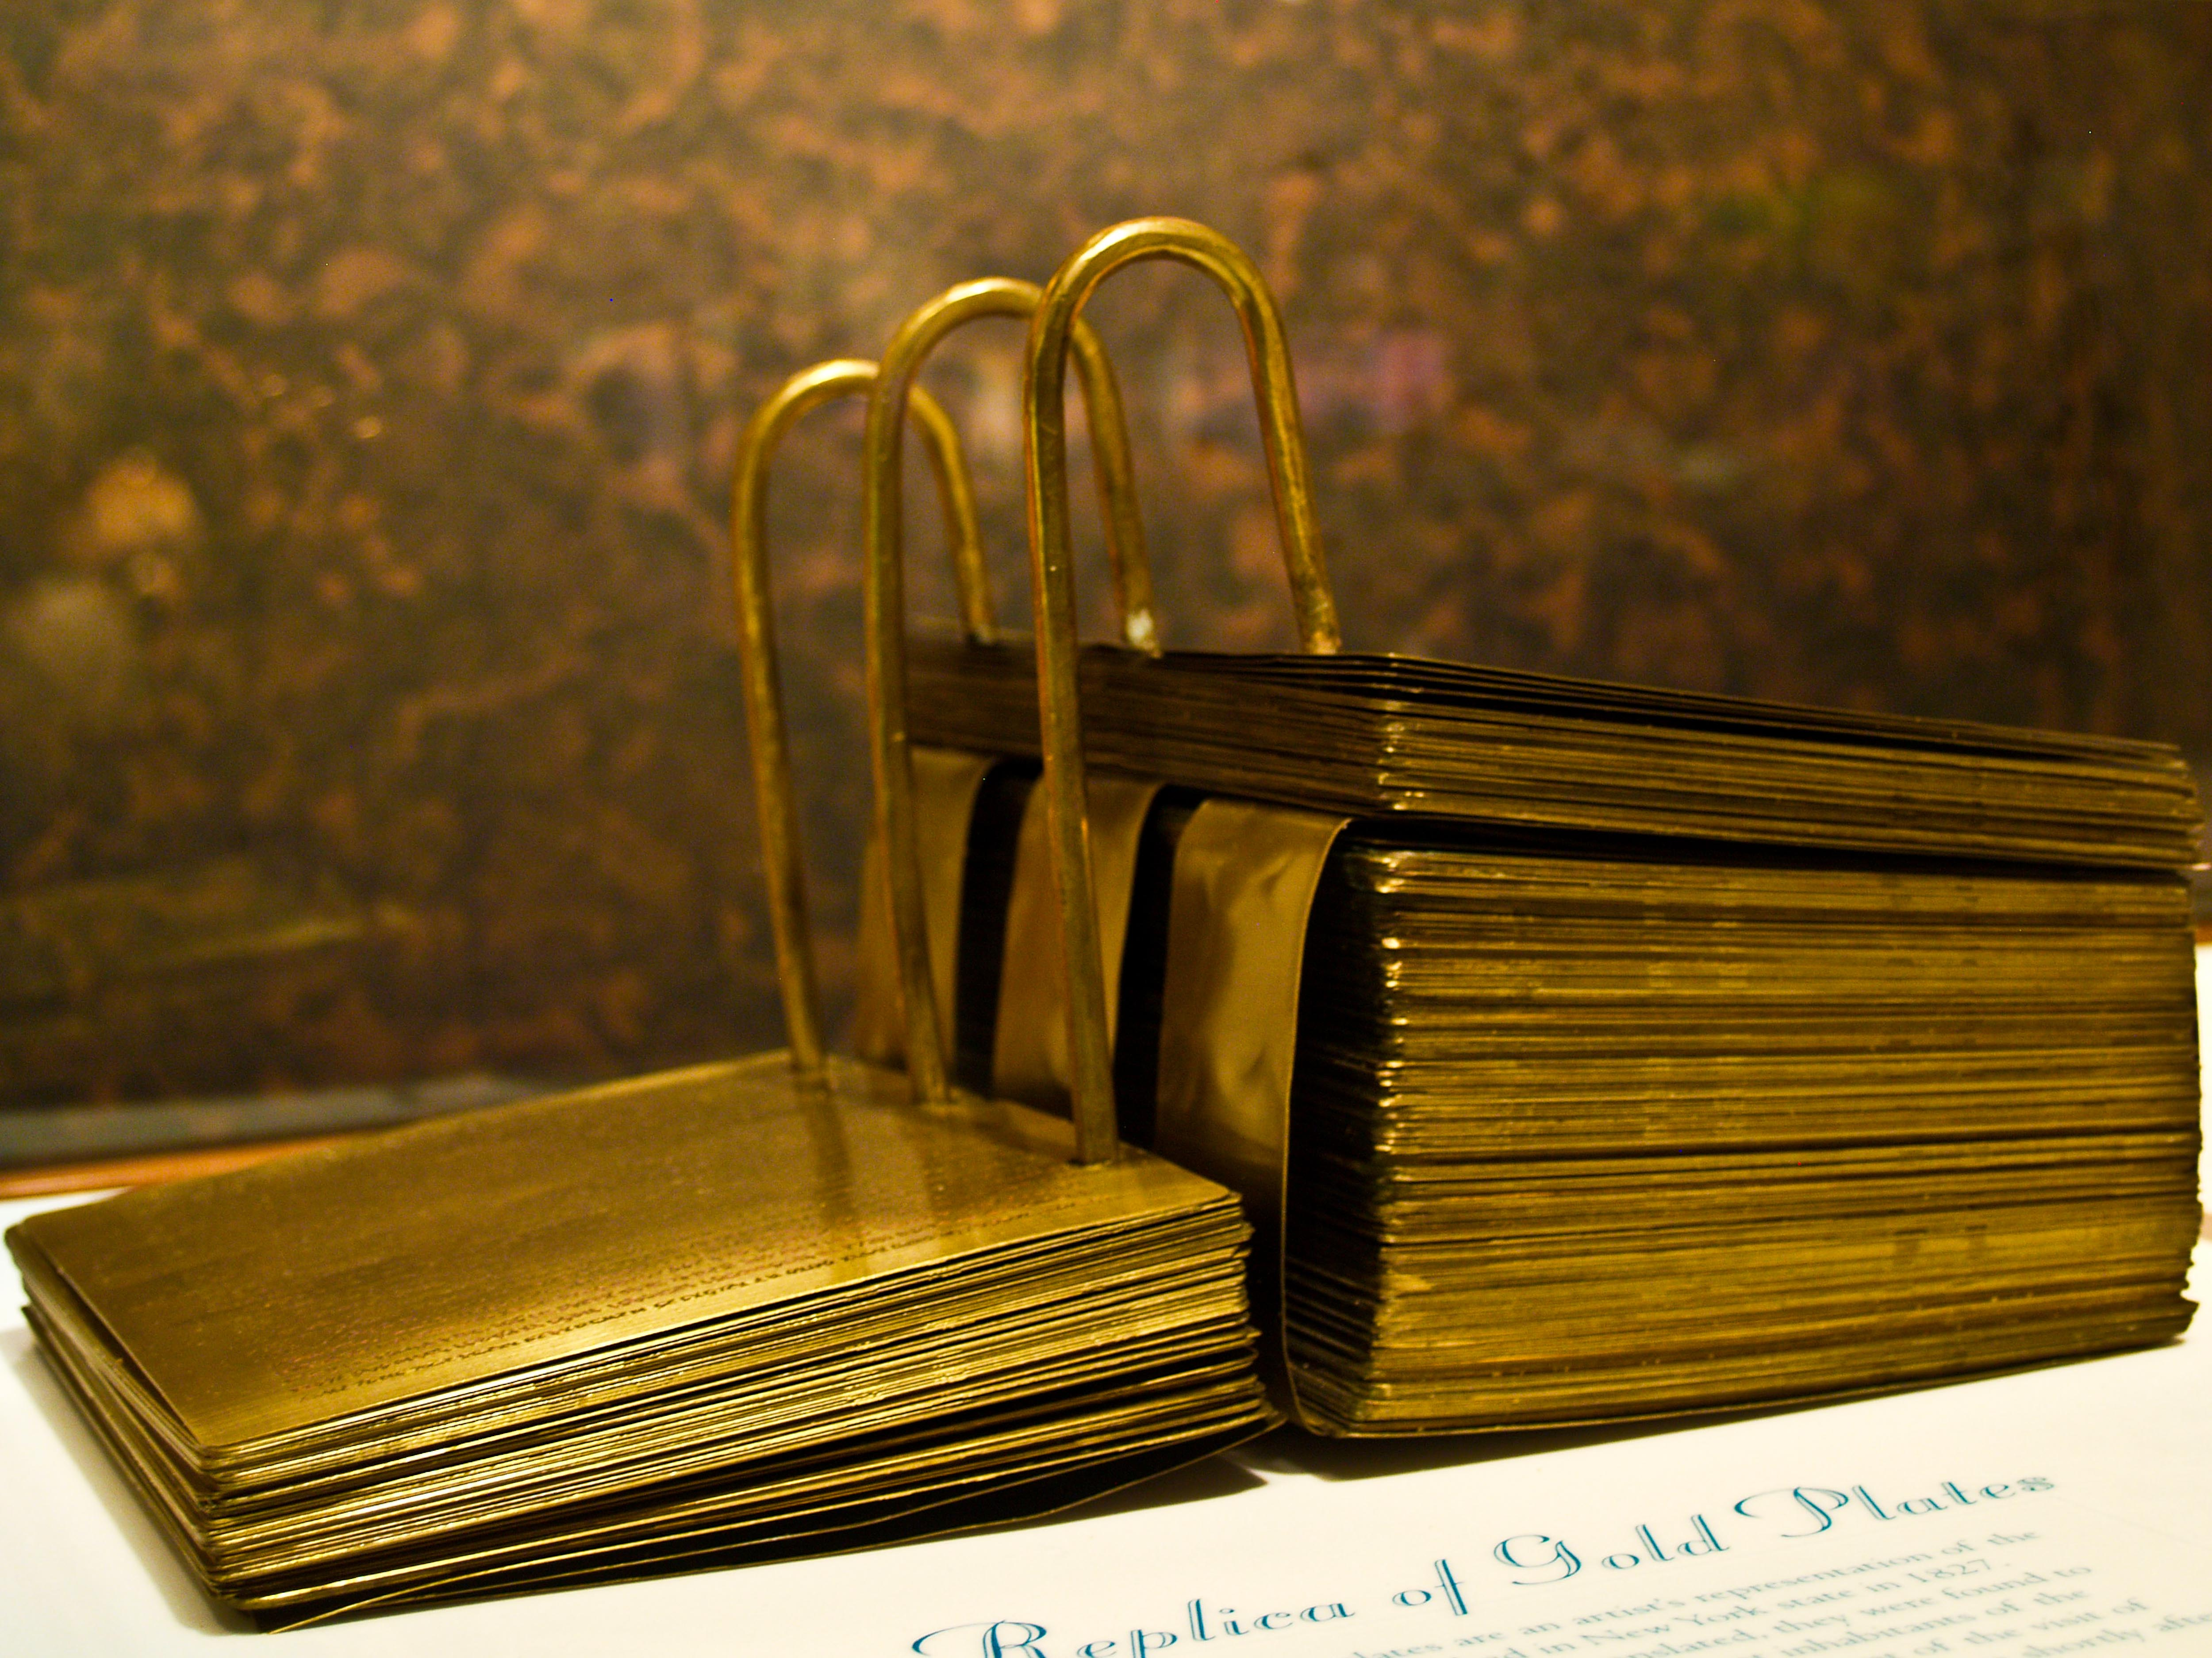
Mormonism
Golden Plates
-These golden plates contained the missing pieces of the Bible otherwise known as the book of Mormon.
-Had secular history of the ancient Jews coming to the Americans and being ancient ancestors of the Native Americans.
-Also, prophesies of the plates was in reformed hieroglyphics.
-The plates were translated by Smith; only he could read them.
-Where are the plates now? There are different theories such as they were taken up to heaven; they no longer exist on Earth; they never existed at all.

Slide 26
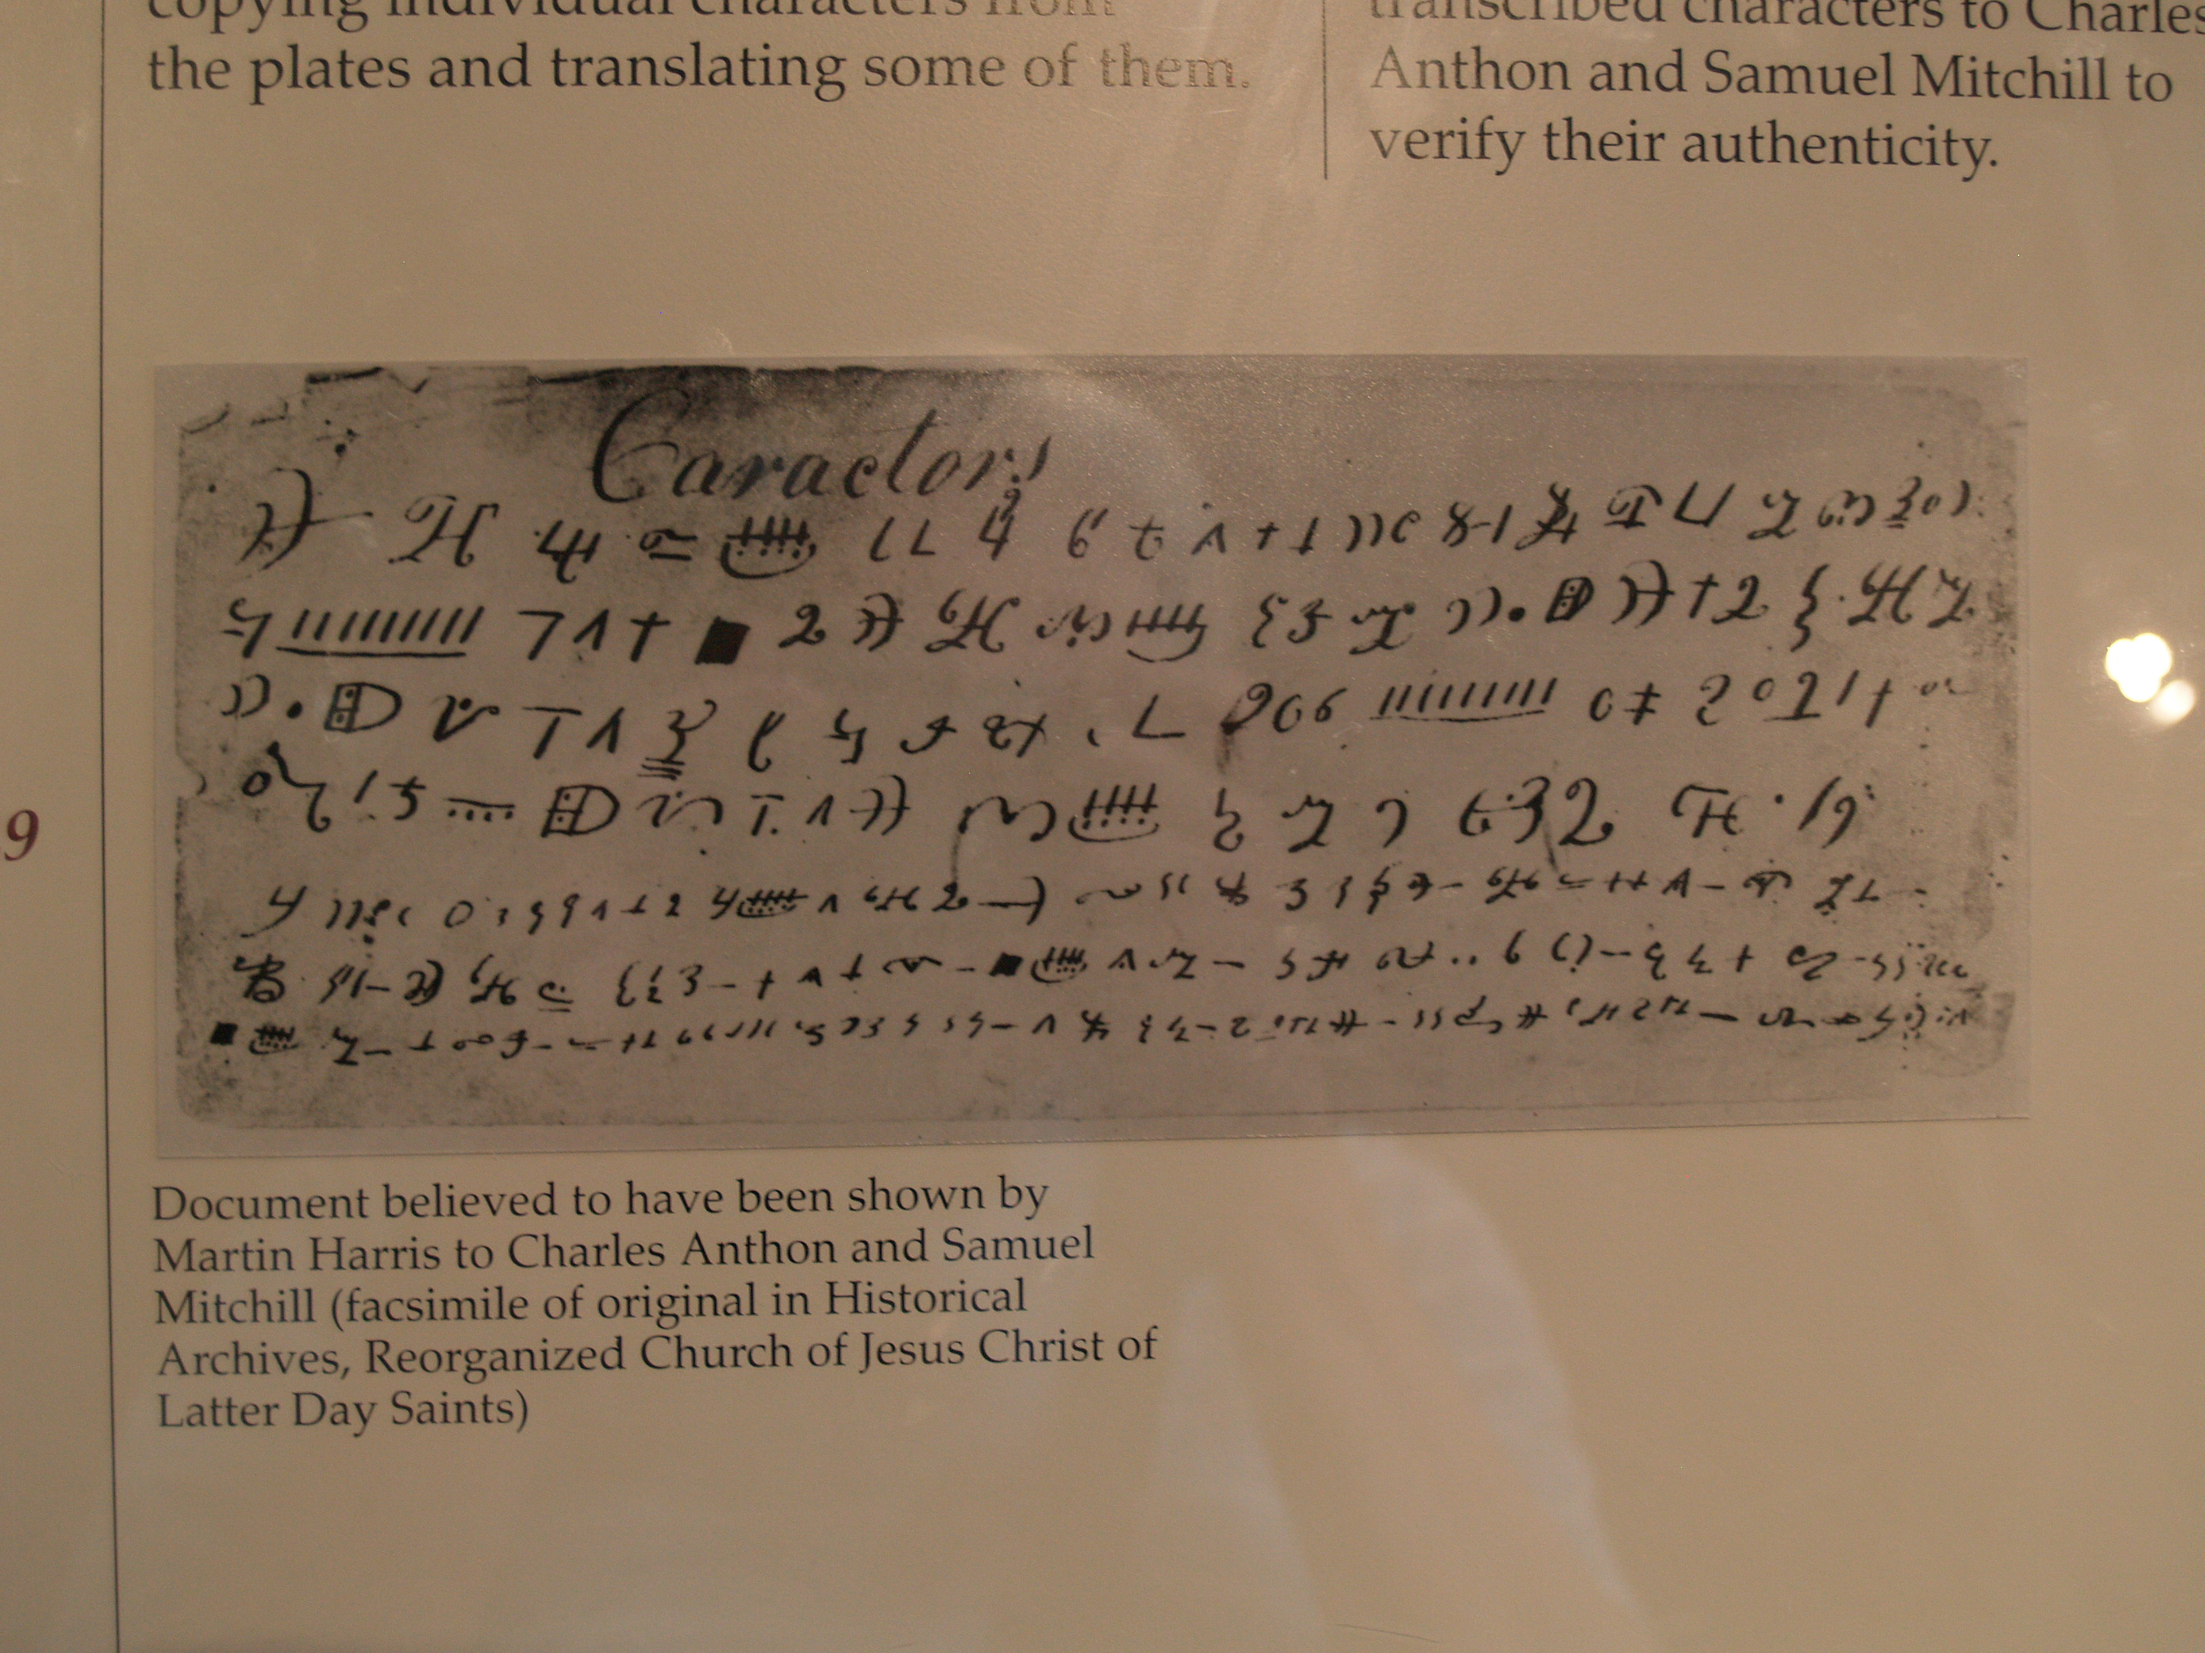
Supposed hieroglyphic characters on the Golden plates.
These symbols do not match any Egyptian hieroglyphics.

Slide 27
The Three Witnesses that saw the Golden Tablets?
In his article “Brodie Revisited: A Reappraisal,” published in Dialogue: A Journal of Mormon Thought, Hill states;
“What of the prophet's story about gold plates, and what about his witnesses? Given Brodie's assumptions, was there not deception here, if not collusion? Brodie maintains that the Prophet exercised some mysterious influence upon the witnesses which caused them to see the plates, thus making Joseph Smith once more the perpetrator of a religious fraud. The evidence is extremely contradictory in this area, but there is a possibility that the three witnesses saw the plates in vision only, for Stephen Burnett in a letter written in 1838, a few weeks after the event, described Martin Harris' testimony to this effect: ‘When I came to hear Martin Harris state in public that he never saw the plates with his natural eyes only in vision or imagination, neither Oliver nor David . . . the last pedestal gave way, in my view our foundations.’”

Slide 28
There are another eight witnesses that claim to have seen the Golden plates. The question is whether they saw them physically or spiritually?

Slide 29
“Meanwhile, Smith continued traveling western New York and Pennsylvania as a treasure seeker and also as a farmhand. In 1826, he was tried in Chenango County, New York, for "glass-looking," the crime of pretending to find lost treasure. While boarding at the Hale house in Harmony, he met Emma Hale and, on January 18, 1827, eloped with her because her parents disapproved of his treasure hunting. Claiming his stone told him that Emma was the key to obtaining the (golden) plates, Smith went with her to the hill (of Cumorah) on September 22, 1827. This time, he said, he retrieved the plates and placed them in a locked chest. He said the angel commanded him not to show the plates to anyone else but to publish their translation, reputed to be the religious record of indigenous Americans. Joseph later promised Emma's parents that his treasure-seeking days were behind him.
Although Smith had left his treasure hunting company, his former associates believed he had double-crossed them by taking for himself what they considered joint property. They ransacked places where a competing treasure-seer said the plates were hidden, and Smith soon realized that he could not accomplish the translation in Palmyra” (Wikipedia).

Slide 30
In October 1827 Smith and his pregnant wife fled to Harmony, PA (now Oakland, PA) where Joseph Smith translated most of the Book of Mormon.

Slide 31
Print Shop in Palmyra, NY where the first Book of Mormon was published in 1830 by E.B. Grandin.

Slide 32
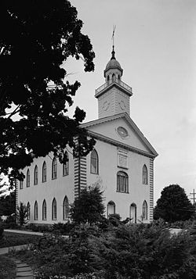
“After publishing what he said was an English translation of the plates as the Book of Mormon, he organized branches of the Church of Christ, a church whose adherents were later called Latter Day Saints, Saints, or Mormons.
In 1831, Smith moved west to Kirtland, Ohio intending to establish the city of Zion in western Missouri, but his plans were frustrated when Missouri settlers expelled the Saints in 1833. After leading Zion's Camp, an unsuccessful paramilitary expedition to recover the land, Smith began building a temple in Kirtland. In 1837, the Kirtland Safety Society, a bank established by Smith and other church leaders, suffered a major financial crisis, and the following year Smith joined his followers in northern Missouri. The 1838 Mormon War ensued with Missourians who believed Smith had incited insurrection. When the Saints lost the war, they were expelled, and Smith was imprisoned on capital charges.
(Wikipedia)
Kirtland Temple in Ohio

Slide 33
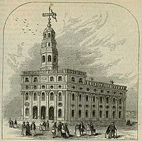
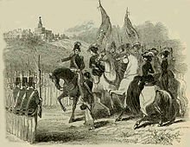
After being allowed to escape state custody in 1839, Smith led his followers to settle at Nauvoo, Illinois on Mississippi River swampland, and there he served as both mayor and commander of its large militia, the Nauvoo Legion. In early 1844, he announced his candidacy for President of the United States. That summer, after the Nauvoo Expositor criticized Smith's practice of polgyamy, the Nauvoo City Council ordered the paper's destruction. During the ensuing turmoil, Smith first declared martial law and then surrendered to the governor of Illinois. Although the governor promised his safety, Smith was murdered while awaiting trial in Carthage, Illinois.” (Wikipedia)
Nauvoo Temple
Smith head of the Nauvoo Legion

Slide 34
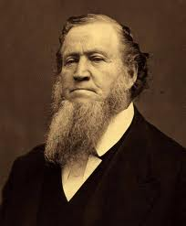
After Joseph Smith was killed, there was a crisis in leadership. Brigham Young’s bold recollections indicated an experience of some kind that persuaded followers that the Quorum of the Twevle Apostles was to lead the church with Young as the Quorum's President. Young was ordained President of the Church in December 1847, more than two and a half years after Smith's death. Rigdon became the president of a separate church organization based in Pittsburgh, Pennsylvania and other potential successors emerged to lead what became other denominations of the movement.
Governor of Utah Territory
As colonizer and founder of Salt Lake City, Young was appointed the territory's first governor and superintendent of American Indian affairs by President Millard Fillmore. During his time as governor, Young directed the establishment of settlements throughout Utah, Idaho, Arizona, Nevada, and parts of southern Colorado and northern Mexico. Under his direction the pioneers built roads and bridges, forts, irrigation projects, and established public welfare, organized a militia, and pacified the Native Americans. (Wikipedia)
Brigham Young is best known for his practice of polygamy. He is also known for revoking the priesthood, and temple blessings from black members of the LDS.
Brigham Young

Slide 35
Summary of the
Book of Mormon
1st Edition of the Book of Mormon

Slide 36
Lehi a rich Israelite from the tribe of Manasseh was warned of the destruction of Jerusalem by Jeremiah. Lehi is told by God in a vision to flee and build a ship and sail to the promised land, America.

Slide 37
After arriving in the Americas, Lehi dies and the family splits into two factions: the Lamanites who follow the eldest son Laman and the Nephites who follow the righteous, younger son Nephi).
The Lamanites quickly fall into idolatry. The Nephites, however, generally follow the religious traditions of Abraham and Moses, though they often fall into idolatry, and other sins. A series of prophets are sent to the Nephites to keep them faithful to the god of Abraham, and to the teachings of Moses. These prophets also teach that the Messiah will be sent to the Israelites in Jerusalem, and that after He is crucified at Jerusalem He will appear to the Nephites and bring peace.
These two groups remain in constant warfare, with the Lamanites being more numerous than the Nephites. The Nephites migrate north several times, and during the 3rd century B.C. they come into contact with a civilization descended from a group of Jews that had fled Jerusalem at the time of its destruction (the Mulekites). They join together.

Slide 38
Jesus appears to the Indians in the Americas.
The climax of the Book of Mormon is the destruction of much of the Nephite and Lamanite civilizations at the time of the crucifixion of Jesus in Jerusalem. Shortly after this destruction the resurrected Jesus Christ appears to the surviving righteous people. Christ establishes a church among the people and delivers to them the gospel.

Slide 39
After Jesus appears there is 200 years of peace and harmony, after which the people begin again to break apart into factions. By the mid 4th century A.D., the people are again divided into Lamanites and Nephites, but both having rejected Jesus and His teachings. There is a major battle near Hill of Cumorah around the year A.D. 385 which destroys nearly all of the Nephites.

Slide 40
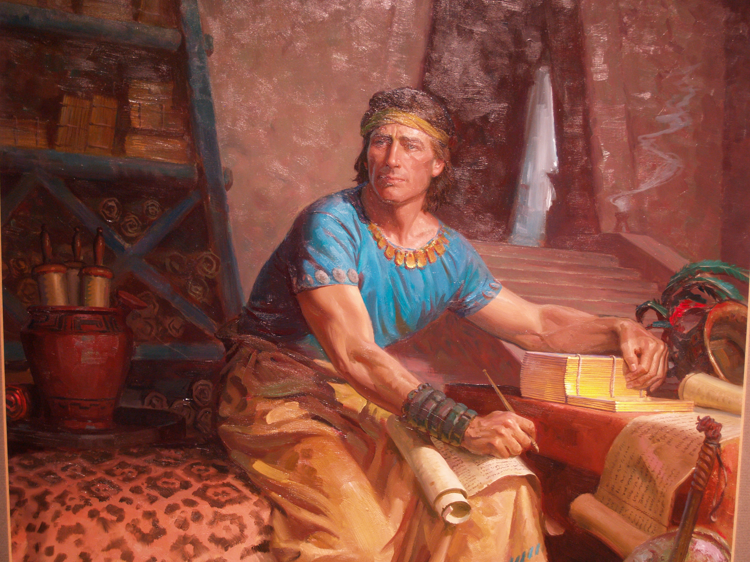
The Book of Mormon ends with the writings of Mormon and his son Moroni, the two last Nephite prophets. They create the Book of Mormon by abridging the records of their civilization and writing the text on gold plates.

Slide 41
The final entry in the Book of Mormon is written around A.D. 421 by Moroni and indicates that God instructed him to bury the plates and that they will be found and translated in the future.

Slide 42
Book of Ether
There is another civilization in the Book of Mormon called the Jaredites who were a group that left the Old World around the time of the Tower of Babel and were led by God to the Americas. This culture lasted from approximately 2200 B.C. until the 4th or 5th century B.C. The Mulekites had met a survivor of the Jaredites, and the Nephites found a written history of that people as recorded by a Jaredite prophet named Ether. Moroni’s abridgement of, and commentary on, this record appears within the Book of Mormon as the Book of Ether.

Slide 43
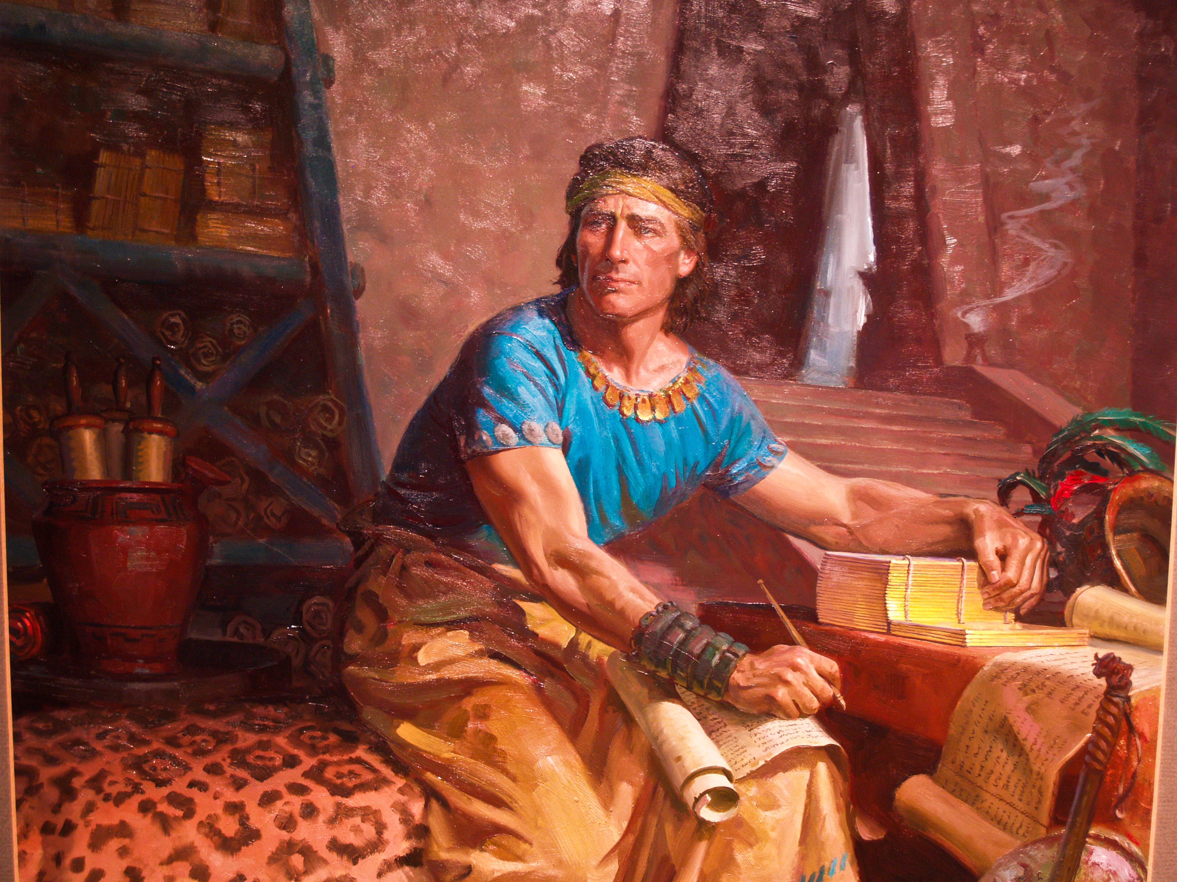
Mormonism
Beliefs
-The Bible is corrupted.
-Book of Mormon translated from golden plates.
-Native Americans are Jewish.
-Jesus Christ came to the Americas.
-Part of the book of Mormon was written approximately 600 B.C.
-Joseph Smith was a prophet.
-Polygamy was a common practice until 1890.
-Salvation is earned through faith and good works.
-Men can become gods over planets.
-Satan is Jesus’ brother.
-Water Baptism for the dead.

Slide 44
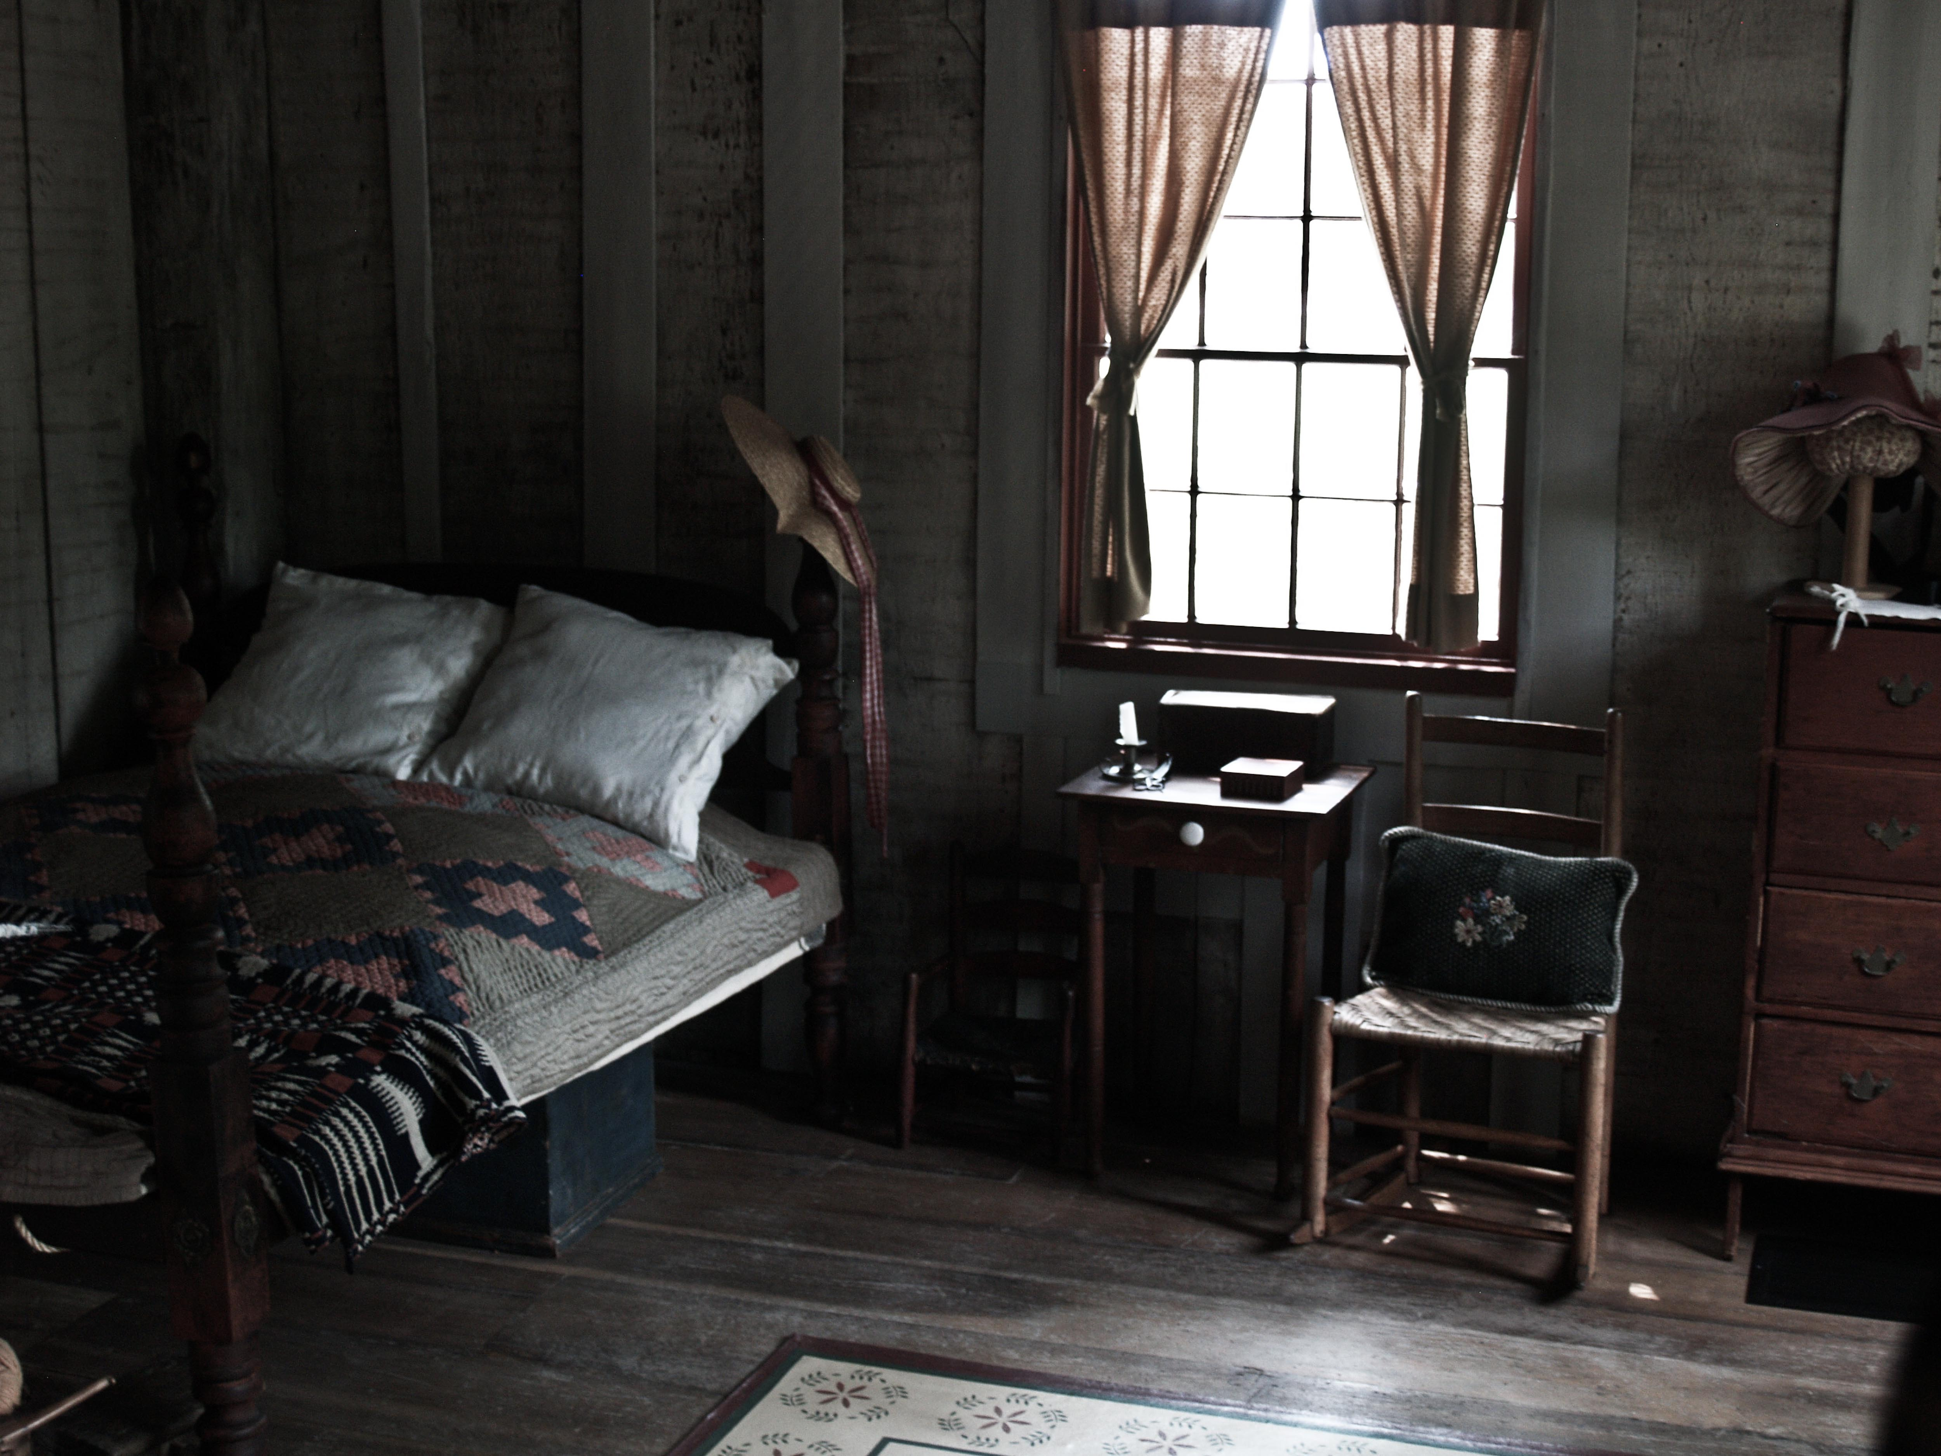
Joseph Smith Jr.
Polygamy
In 1843, Emma reluctantly allowed Smith to marry four women who had been living in the Smith household—two of whom Smith had already married without her knowledge. Emma also participated with Smith in the first "sealing" ceremony, intended to bind their marriage for eternity. However, Emma soon regretted her decision to accept plural marriage and forced the other wives from the household, nagging Smith to abandon the practice. Smith dictated a revelation pressuring Emma to accept, but the revelation only made her furious. (Wikipedia)
-had 35 wives.
-11 of his 35 wives were already wives of other men.
-believed in polygamy.

Slide 45
Joseph Smith Jr.’s Wives
Emma Hale Fanny Alger Lucinda Morgan Harris Louisa Beaman Zina Huntington Jacobs Presendia Huntington Buell Agnes Coolbrith Sylvia Sessions Lyon Mary Rollins Lightner Patty Bartlett Sessions Marinda Johnson Hyde Elizabeth Davis Durfee Sarah Kingsley Cleveland Delcena Johnson Eliza R. Snow Sarah Ann Whitney Martha McBride Knight Ruth Vose Sayers Flora Ann Woodworth Emily Dow Partridge Eliza Maria Partridge Almera Johnson Lucy Walker Sarah Lawrence Maria Lawrence Helen Mar Kimball Hanna Ells Elvira Cowles Holmes Rhoda Richards Desdemona Fullmer Olive Frost Melissa Lott Nancy Winchester Fanny Young
Here is most about his wives and their husbands.
Wives of Joseph Smith

Slide 46
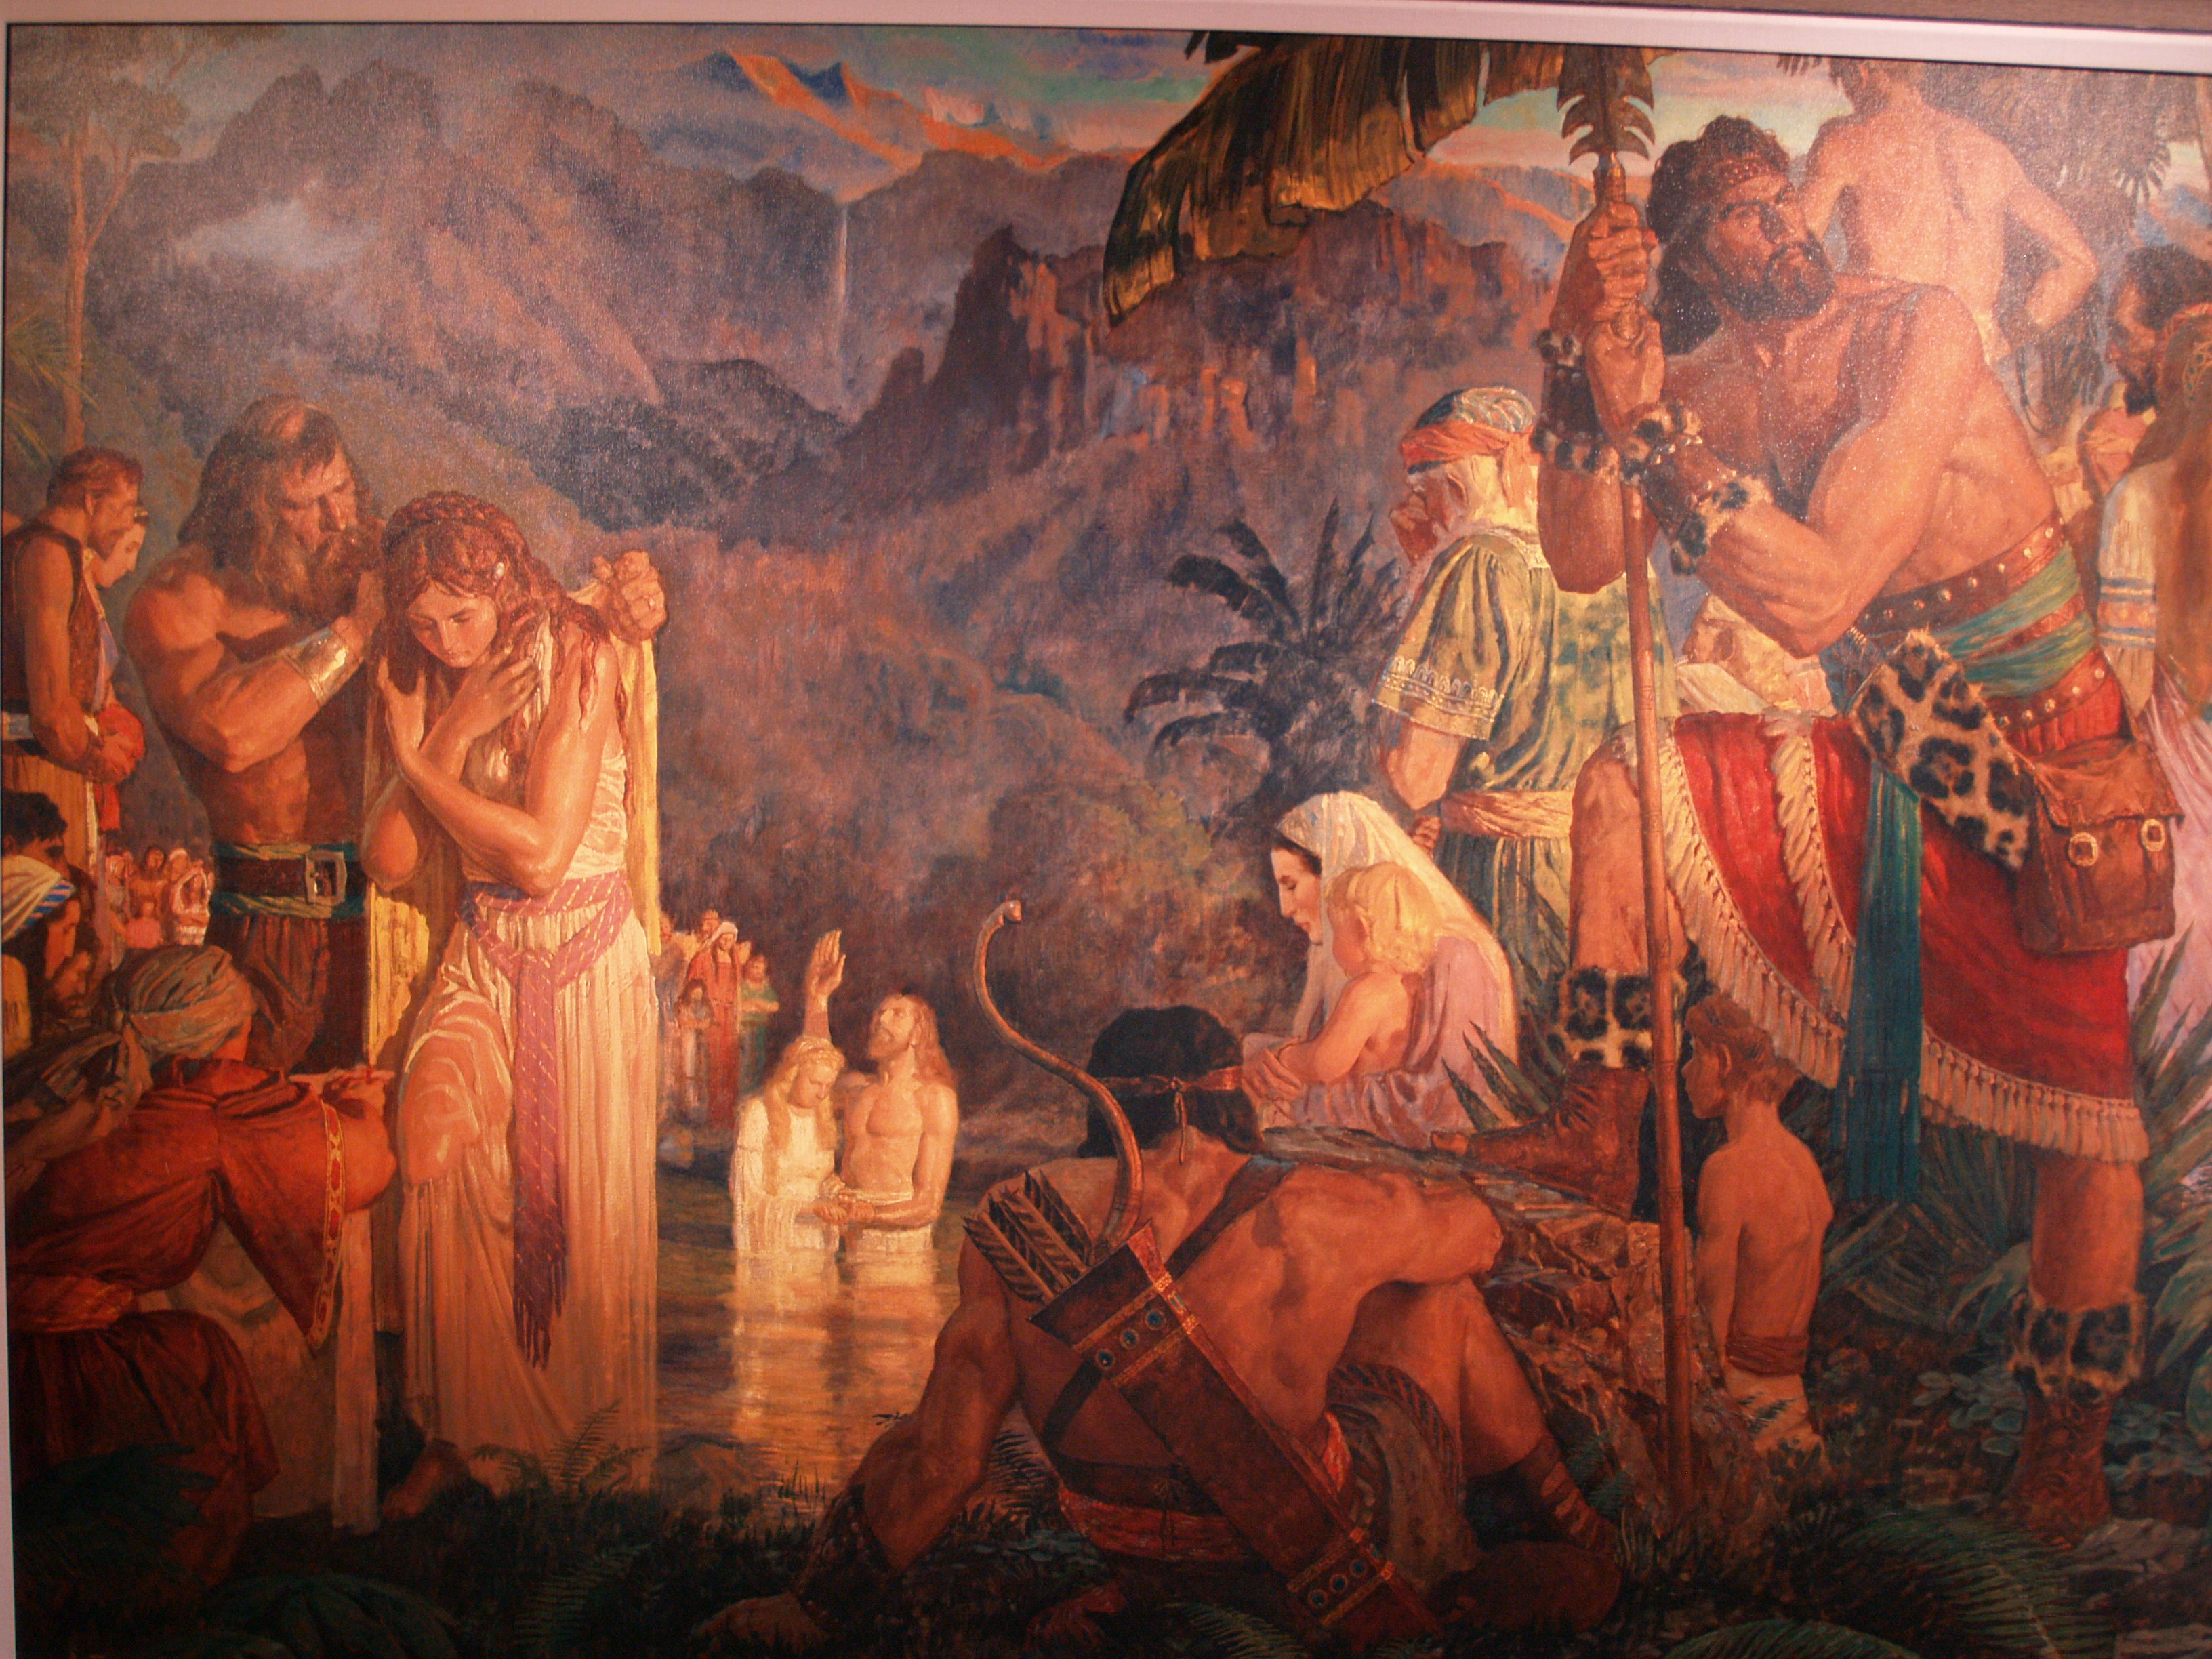
Baptism for the dead
Doctrine formed from I Corinthians 15:29

Slide 47
Smith eventually viewed God as an advanced and glorified man, embodied within space with a throne situated near a star or planet named Kolob, and measuring time at the rate of a thousand years per Kolob day. Both God the Father and Jesus were distinct beings with physical bodies, but the Holy Spirit was a "personage of Spirit.” Through the gradual acquisition of knowledge, those who were sealed to their exaltation could eventually become coequal with God. (Wikipedia)
Man can become a god and rule over his own planet with a harem of many wives.

Slide 48
Problems with Mormonism
Archaeology
-There is no archeological evidence of Mormonism. There are no manuscripts, golden plates, remains of native society, or other means of proof in anything the book of Mormon says.
-It is impossible for societies that have lived, fought war, and died for hundreds of years and have no archeological evidence.
-There is no evidence that Jews moved to America and lived there and are distant relatives to native American.
-There are no real cities like the book of Mormon states. All the cities can never be found.
-The Mayan representations have nothing to do with Mormonism and have no Jewish relation in the Americas.
-The book of Mormon states the use of copper and bronze while things in the Americas were made out of stone and had no idea of these materials.
-There was also indication of many animals and plants that did not exist in the Americas.

Slide 49
Problems with Mormonism
Genetics
-DNA evidence from Native Americans has proven that they do not have Jewish lineage. Their bloodline is Asiatic. Native Americans’ DNA can be traced back to the continent of Asia. There are no examples of ancient Jewish lineage in any of the Americas.

Slide 50
Problems with Mormonism
Additions to the Bible
-The additions to the Bible by Joseph Smith were not found in the Dead Sea scrolls. The additions also changed the meaning of the scriptures and indicated Joseph Smith as a prophet.

Slide 51
Problems with Mormonism
Plagiarism
-The book of Mormon was plagiarized from various sources in the 1800s. The book reads like it was written in the 1800s. It is claimed that he plagiarized from View of Hebrews, The Wonders of Nature, Apocrypha, King James Bible. Many sources consider the book of Mormon to be plagiarism of these four books. There are phrases that are very similar to those books and some almost identical.

Slide 52
Quiz
1. What year was Joseph Smith Jr. born?
1807
1805
1890
1885

Slide 53
Quiz
1. What year was Joseph Smith Jr. born?
1807
1805
1890
1885

Slide 54
Quiz
2. What was Smith’s highest education level?
First grade
High school
Third grade
Eighth grade

Slide 55
Quiz
2. What was Smith’s highest education level?
First grade
High school
Third grade
Eighth grade

Slide 56
Quiz
3. How many wives did Joseph smith have?
1
35
14
3

Slide 57
Quiz
3. How many wives did Joseph smith have?
1
35
14
3

Slide 58
Quiz
4. What was the name of the Angel who came to Joseph Smith?
Moroni
Gabriel
Isaiah
Amerni

Slide 59
Quiz
4. What was the name of the Angel who came to Joseph Smith?
Moroni
Gabriel
Isaiah
Amerni

Slide 60
Quiz
5. What did the angel show Joseph?
Silver plates
Nickel plates
Bronze plates
Golden plates

Slide 61
Quiz
5. What did the angel show Joseph?
Silver plates
Nickel plates
Bronze plates
Golden plates

Slide 62
Quiz
6. A Mormon belief is that salvation is earned through _______.
Faith
Faith & Good Works.
Good Works.
Love.

Slide 63
Quiz
6. A Mormon belief is that salvation is earned through _______.
Faith
Faith & Good Works.
Good Works.
Love.

Slide 64
Quiz
7. What is not one the 4 problems with Mormonism?
Genetics
Plagiarism
Printing
Additions to the Bible
Archeological Evidence

Slide 65
Quiz
7. What is not one the 4 problems with Mormonism?
Genetics
Plagiarism
Printing
Additions to the Bible
Archeological Evidence

Slide 66
Quiz
8. Which continent is ancient Indian ancestry traced back to?
Asia
Australia
Europe
South America
North America

Slide 67
Quiz
8. Which continent is ancient Indian ancestry traced back to?
Asia
Australia
Europe
South America
North America

Slide 68
Quiz
9. What archeological evidence that does not exist is in the book of Mormon?
Ancient Manuscripts
Ancient remains of the native jewish-american culture(bodies, graves, temples, homes, tools, pottery, ect.)
The Existence of animals and plants that were never in the Americas at that time period
Ancient Jewish language or culture anywhere found in ancient native america
No Mormon cities exist or are comparable
All of the Above

Slide 69
Quiz
9. What archeological evidence that does not exist is in the book of Mormon?
Ancient Manuscripts
Ancient remains of the native jewish-american culture(bodies, graves, temples, homes, tools, pottery, ect.)
The Existence of animals and plants that were never in the Americas at that time period
Ancient Jewish language or culture anywhere found in ancient native america
No Mormon cities exist or are comparable
All of the Above

Slide 70
Quiz
10. What books did Joseph Smith not plagiarize from?
Ancient Manuscripts
View of Hebrews
The Wonders of the World
Apocrypha
King James Bible

Slide 71
Quiz
10. What books did Joseph Smith not plagiarize from?
Ancient Manuscripts
View of Hebrews
The Wonders of Nature
Apocrypha
King James Bible

Slide 72
Resources
Video:
The Bible vs. Joseph Smith
Produced by Living Hope Ministries/Source Flix
DNA vs. The Book of Mormon
Produced by Living Hope Ministries
The Bible vs. The Book of Mormon
Produced by Living Hope Ministries
Books:
Joseph Smith and the Origins of the Book of Mormon
By: David Persuitte
Losing a Lost Tribe
By: Simon G. Southerton
Who Really Wrote the Book of Mormon?
By Wayne L. Cowdrey; Howard A. Davis; Arthur Vanick

